Slide 1
Housing allocations – avoiding the challenge
June 2024

Slide 2



Our Speakers

Slide 3
Court Judgments & Part 6, Housing Act 1996
2023
2024
4 cases
Irrationality/breach of policy
Error of fact/procedural impropriety
Article 8/Grenfell
Exclusion of reasonable preference sub-category
4 cases
Indirect discrimination (re prioritisation)
Backdating of qualifying date
Breach of s.11(2), Children Act 2004
Fettering of discretion/PSED

Slide 4
What are we covering?
Discrimination / PSED
Reasonable Preference
Extent of local discretion

Slide 5
Ensuring compliance with the Equality Act 2010
Tara O’Leary
June 2024

Slide 6
“Parliament has enacted that discriminatory acts proscribed by the [Equality Act 2010] are unlawful. The courts cannot be required to give legal effect to acts proscribed as unlawful.”
Lord Bingham of Cornhill
Lewisham LBC v Malcolm (EHRC intervening) [2008] AC 1399

Slide 7
Allocations – key equalities concepts
Direct – s.13
Indirect – s.19
Reasonable adjustments – s.20
PSED – s.149
LF v United Kingdom
(2022) 75 E.H.R.R. SE5
R (Z and another) v LB Hackney [2020] UKSC 40
R (Gullu) v Hillingdon LBC; R (Ward) v Hillingdon LBC [2018] EWCA Civ 692
R (TX) v Adur DC [2022] EWHC 2240 (Admin)
R (H) v Ealing LBC [2017] EWCA Civ 1127
R (C) v Islington LBC [2017] EWHC 1288 (Admin)
Gullu & Ward [69-74]
R (Nur) v Birmingham City Council [2020] EWHC 3526 (Admin) and [2021] EWHC 1138 (Admin)

Slide 8
Evidence and justification
Proportionality: is it the least intrusive action that can be taken without compromising a legitimate objective? Does it strike a fair balance between the obective and the effect of discrimination? Akerman-Livingstone v Aster Communities [2015] UKSC 15 [28].
Evidence: that LHA has specifically considered this group and sought to accommodate their needs (arising from their protected characteristic) in some way: Adur [65]
Flexibility across the scheme: have you met the group's needs in some way, even if not in the way contended for by the applicant? R (C) v Islington [104]
Justification crosses all equality duties: a good EIA offers justification for indirect discrimination, reasonableness of adjustments and PSED: Gullu [69]
Duty of inquiry: Statistics, lettings, housing stock, nomination partners, equalities data

Slide 9

Review and refresh
Policies are made to be reviewed, and equality duties are continuous
Gullu, Ward [72-74]: LHA does not have to hypothetically consider every imaginable group until an issue comes to its attention
PSED was initially lawful when completed in 2013, but became deficient when Mr Gullu's challenge highlighted a problem
Nur [2021] [27-28]: failure to monitor or assess implementation over time. Could not justify policy in absence of data. After 4 years had no idea if objectives achieved.

Slide 10
Refusing relief?
Section 31(2A) Senior Courts Act 1981: "highly likely" that outcome for applicant would not have been "substantially different" if the conduct complained of had not taken place
Gullu, Ward [111]: Limited declaratory relief – identified that it remained open to LHA to justify the proportionality of an indirectly discriminatory policy (though remember Nur... can it actually be justified?)
(H) v Ealing [117]: Ealing admitted its initial EIA was deficient & a review was underway. Court found evidence of compliance with PSED "inadequate" but declined to grant relief.

Slide 11
Has ‘Reasonable Preference’ been given?
Catherine Rowlands
June 2024

Slide 12
Reasonable preference – the basics
* No allocation save in accordance with the AS – s. 166A
* RP categories: s. 166A(3):
(a) people who are homeless within the meaning of Part 7 of the 1996 Act (including those who are intentionally homeless and those not in priority need)
(b) people who are owed a duty by any housing authority under section 190(2), 193(2) or 195(2) of the 1996 Act (or under section 65(2) or 68(2) of the Housing Act 1985) or who are occupying accommodation secured by any housing authority under section 192(3)
(c) people occupying insanitary or overcrowded housing or otherwise living in unsatisfactory housing conditions
(d) people who need to move on medical or welfare grounds, including grounds relating to a disability, and
(e) people who need to move to a particular locality in the district of the housing authority, where failure to meet that need would cause hardship (to themselves or others)

Slide 13
Reasonable preference – the basics
* Code of Guidance Chapter 4 and Annex 1
* No need for cumulative preference
* how to give preference is a matter for the local authority
* regulations give further categories:
- former members of armed forces
- serving members who need to move because of injury etc
- bereaved spouses of members of the armed forces
(Housing Act 1996 (Additional Preference for Armed Forces) (England) Regulations 2012
* Reasonable just means "reasonable head start" – not a guarantee of an allocation
R (A) v Lambeth LBC [2002] EWCA Civ 1084

Slide 14
Overlaps
Housing
Care/
health
Immig-ration
localism

Slide 15
The King (on the application of Carly Jayne Willott) v Eastbourne Borough Council
Overlap between Allocations and localism
C had history of ASB, and mental health problems – was excluded from the AS
Was entitled to RP as homeless – after a trial at which her disability had been considered – but the flexibility in an AS to downgrade someone even if they have RP meant the decision was lawful
She argued that any AS must include a residual discretion – this was rejected
Argument that the AS did not set out its criteria clearly enough was also rejected
[2024] EWHC 113 (Admin)

Slide 16
R. (on the application of Jaberi) v Westminster City Council
Overlap between Homelessness and Allocations
C, a refugee, has serious epilepsy and mobility issues (disabled).
Homeless application in 2018. Main housing duty accepted; provided with TA which has stairs he can't manage – Westminster accepted he needed to move
Was then offered 18th floor flat with lift access. C was worried about what would happen if he needed to be evacuated having had a fit. Adaptations were also needed to this flat which had not been done by the time of hearing. He sought a review of its suitability for him – County Court appeal was lodged.
[2023] EWHC 1045 (Admin)
Appeal compromised

Slide 17
R. (on the application of Jaberi) v Westminster City Council
In the meantime he jr'd Westminster for breach of statutory duty ie failure to provide accom under s. 193
Court accepted there was no current breach in light of offer of new flat. However, there had been historic breach.
On reasonable preference, complained that the AS was unlawful. Whilst he had priority for TA, he was not entitled to priority for permanent accom.
He argued he should be able to pick which category he was in. As a homeless person he only got 150 pts, whereas his medical priority would mean he got 200 pts
Westminster pointed out that the people who have both characteristics have a route out of their accom as the LA owes them a duty to secure suitable accom
[2023] EWHC 1045 (Admin)

Slide 18
R. (on the application of Jaberi) v Westminster City Council
Court rejected C's case on this. An AS must be framed to give RP – not absolute priority, and there is no need to give someone with 2 RPs priority over those with only 1.
C had RP by being given 150 points as homeless – and giving people a choice would be an administrative nightmare!
[2023] EWHC 1045 (Admin)

Slide 19
R. (on the application of Jaberi) v Westminster City Council
"At first glance, it may appear incongruous that a person who has a medical need to move will be given fewer priority points if they have the additional misfortune of being homeless and in temporary accommodation. However, on analysis, the approach taken by the defendant is clearly a rational one. It is proper for the defendant to proceed on the basis that if it owes an applicant a duty to secure suitable temporary accommodation, it will comply with that duty."
[2023] EWHC 1045 (Admin)

Slide 20
R. (on the application of Jaberi) v Westminster City Council
C also argued that D was in breach of its duty
to publish as part of their allocation policy the information required by section 166A(9)(a)(ii) ":
(ii) whether housing accommodation appropriate to his needs is likely to be made available to him and, if so, how long it is likely to be before such accommodation becomes available for allocation to him;
But in fact, it's not a duty to publish that info; it means that the AS must include the right to request it. Westminster had given him info.
[2023] EWHC 1045 (Admin)

Slide 21
R. (on the application of Campbell) v Ealing LBC
Overlap between Care Act 2014 and Housing Act 1996
C partially sighted and has OCD and depression - disabled
Housed in TA by Hillingdon under Part 7
Lambeth ASC took over after Hillingdon discharged duty, exercising power under s19(3).
After CA assessment, which found he had eligible needs, C declined care package. He was then moved to a guest house, then to B&B accom. He applied to go on the AS.
He rejected all offers of TA but did not bid for properties on the waiting list.
ASC decided to cease funding the TA .
Challenged by way of JR.
Claimant argued he needed care and support under the CA which required accom for its delivery but Defendant argued that he did not have a care need for accom.
[2024] EWCA Civ 540

Slide 22
R. (on the application of Campbell) v Ealing LBC
Claimant argued his medical needs meant he could circumvent allocations
He was never going to get a property under the AS but his care needs meant the LA could give him one under the CA14
Court disagreed. C's RP did not mean that he was entitled to something the LA was supposed to do under the HA 96 Ie provide accommodation
[2024] EWCA Civ 540

Slide 23
True extent of Local discretion available
Andy Lane
June 2024

Slide 24
All sounds very simple
Localism Act 2011
Sections 145, 146 and 147 make reforms to the legislation on the allocation of social housing under Part 6 of the Housing Act 1996 (the 1996 Act). They give local housing authorities in England the power to determine what classes of persons are or are not qualifying persons to be allocated housing and take existing social tenants out of the scope of Part 6 of that Act, with the exception of those who must be given reasonable preference for an allocation.
Explanatory Notes, para. 371

Slide 25
“Wide discretion”
Section 159(7)
“in such manner as they consider appropriate”
Section 166A(11)
“may decide on what principles the scheme is to be framed”
Statutory Guidance
“power to determine which applicants do or do not qualify”

Slide 26
Providing social housing for local people
Statutory Guidance – 31/12/13
7. The Localism Act has also given back to local authorities the freedom to better manage their social housing waiting list, as well as providing authorities with greater flexibility to enable them to tackle homelessness by providing homeless households with suitable private sector accommodation. Local authorities can now decide who qualifies for social housing in their area, and can develop solutions which make best use of the social housing stock.

Slide 27
3 common qualifications
Housing need
Residency
Behaviour

Slide 28
But beware…
Reasonable preference
Statutory guidance
Discrimination
Additional preference
Public law duties
Clarity

Slide 29
And also
Section 166A(12), Housing Act 1996
The need for flexibility/discretion
The need to consider:
The current homelessness strategy;
The current tenancy strategy; and
The London Housing Strategy (if a London Borough).
E.g. exceptional cases panels
Supreme Court – R(Z) v LB Hackney [2020] UKSC 40; [2020] 1 W.L.R. 4327
See RBKC Grenfell policies - R(Gomes) v RBKC [2023] EWHC 778 (Admin)
'Providing social housing for local people’ at [19]

Slide 30
Domestic Abuse
Following on from the Domestic Abuse Act 2021
Statutory Guidance
The purpose of this guidance is to assist local authorities to apply the allocation legislation to ensure that victims of domestic abuse are able to move into social housing from a refuge or other form of temporary accommodation by ensuring that:
they have appropriate priority under the local authority’s allocation scheme, and
those who have fled to a refuge in another local authority area are not disadvantaged by any residency or local connection requirements.
Improving access to social housing for victims of domestic abuse
Last updated 25/1/22

Slide 31
Lord Neuberger in R (Ahmad) v Newham LBC [2009] 3 All E.R. 755 at 55
“However, what is important is to emphasise that once a housing allocation scheme complies with the requirements of section 167 and any other statutory requirements, the courts should be very slow to interfere on the ground of alleged irrationality.”

Slide 32
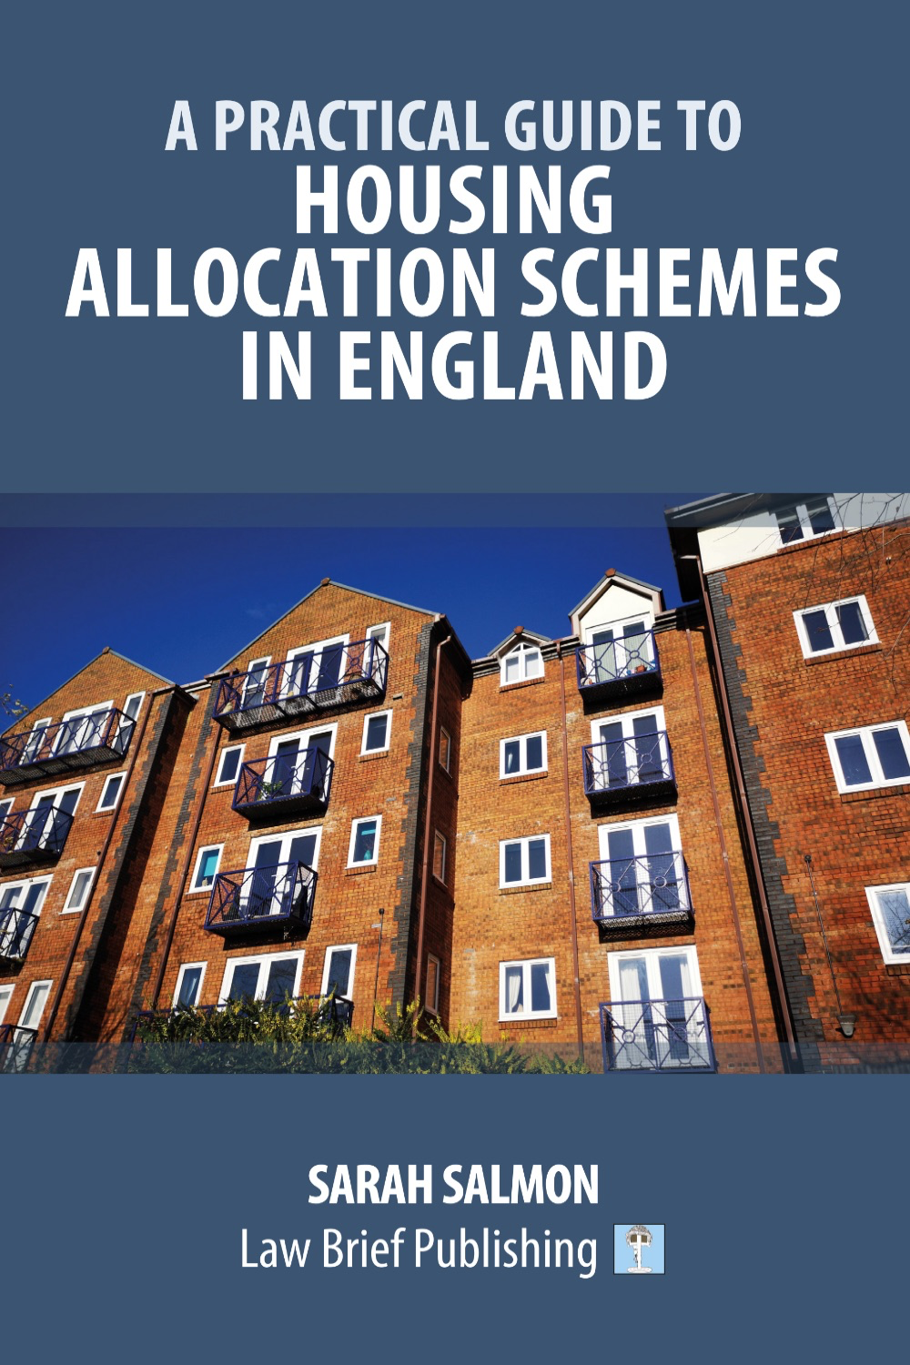

Sarah Salmon

