Slide 1
Evidence
Sarah Salmon, Alistair Cantor and Dr Alex Williams
Housing Day October 2023

Slide 2
Evidence:
Tips and tactics for presenting your case at its best
Sarah Salmon, Alistair Cantor and Dr Alex Williams
9 October 2023, Cornerstone Barristers Housing Day

Slide 3
What are we covering?
Case preparation and pleadings
Witness statements
In court: live evidence

Slide 4
Let’s start at the very beginning…
01
Sarah Salmon

Slide 5
Brem v Clark [2023] EWHC 1358 (KB), Martin Spencer J at [38].
“…it seems to me clear that the learned judge was entitled to take the view that this litigation was going nowhere. Given the incompetent way that the litigation had been conducted to date, he saw little prospect of the matter being put into a state whereby it was fit to be tried without further wasted costs… He was entitled to take the view that enough of the court’s resources had been expended on this litigation and enough leeway had been afforded to the claimant’s advisers to enable them to get their “ducks in a row”, to no avail…..”

Slide 6
Rosebery Housing Association Ltd v Williams & Anor (2021) EW Misc 22 (CC), HHJ Luba KC at [77]-[79].
A bit closer to home…
“Any reader of this judgment down to this point would find it extraordinary that this claim has been pressed to trial in this way by a responsible social landlord. The claim has been a forensic disaster for Rosebery and for the residents in whose interests it thought it was proceeding.
When constrained…to advancing its case on only six sample allegations one might have expected it to select ‘typical’ instances from the mass of material on which it thought it was able to draw. The six samples would have each been the subject of clear, direct, corroborated evidence from witnesses who could be called…
…five out of the six allegations selected as examples had…no sustainable evidential ‘legs’.…..”

Slide 7
What I will cover
Case preparation
Evidence
Pleadings

Slide 8

Case preparation is key
Keep an open mind i.e. do not have legal proceedings as the “goal”.
Try not to be influenced by personal feelings or opinions or the “majority” in considering the facts that ultimately may go before a court.
Consider what needs to be proved. Think about alternative cases where relevant.
Consider what, if anything, might be said against the case by way of defence.
Keep in mind both sides of the case even when first reviewing.
Build the right narrative and ensure the information is there.
Seek early advice in trickier cases.
This Photo by Unknown Author is licensed under CC BY-SA-NC

Slide 9
Considering the case
What needs to be proved and helpful evidence
Potential defences and counterclaims
Possession claims
Lesser measures and compliance with PAP
The notice (inc. any relevant review procedure)
The ground(s)/the facts
Reasonableness
(Proportionality – mandatory grounds)
Is the Equality Act 2010 engaged? Any health issues?
Housing benefit/UC issues
Any relevant decisions/policies e.g. failed succession
Injunction applications (some overlap with the above)
Warnings and other tools used
The relevant behaviour
Is an injunction necessary and/or proportionate?
POA and terms
Exclusion from the home
Without notice
Possession claims
Compliance with PAP and other technical defences
The notice not served/not correct
Errors in review process (if relevant)
Denying the ground(s)/facts are made out
(Proportionality under article 8 – mandatory grounds)
Equality Act 2010
Public law defences
Problems with benefits
Housing conditions
Injunction applications (some overlap with the above)
Denying behaviour
Not a necessary or proportionate order
Capacity to comply

Slide 10
Strong evidence
Direct
Witness will attend court
Records
Independent
“a clear ‘audit trail’”
Clear information

Slide 11
Weaker evidence
No Contemporaneous records
No corroborative evidence
Who is telling you what has happened?
Conflicting accounts
Tit for tat

Slide 12
The importance of pleadings
The case will be decided on the basis it is pleaded.
The contents of a statement of case are not evidence in a trial, even though verified by a statement of truth BUT
      (1) Subject to paragraph (2), the general rule is that evidence at hearings other than the trial is to be by witness statement unless the court, a practice direction or any other enactment requires otherwise.
      (2) At hearings other than the trial, a party may, rely on the matters set out in –
        (a) his statement of case; or
        (b) his application notice, if the statement of case or application notice is verified by a statement of truth.
        Civil Procedure Rules, r. 32.6

Slide 13

Getting pleadings right
Dos
Don’ts
Assess what needs to go into your pleading
Plead your best case
Set out a concise statement of the nature of the claim
For possession, ensure you have the text for any grounds for possession
Set out a concise statement of the facts
Make sure you have contained everything required by the relevant Practice Direction
Specify all the remedies you seek
Use paragraph numbers
Ensure the correct person has signed the statement of truth
CHECK IT (especially dates)
Do not use templates from previous cases without checking (and double checking) the information.
Try and avoid generic statements (tailor the case to build the right narrative).
Do not copy and paste from file notes.

Slide 14
Witness statements
02
Alistair Cantor

Slide 15
What I will cover
Purpose of witness statements
Taking the statement
Drafting the statement

Slide 16
The importance of knowing your stuff on witness statements
Proving your case
Capitalising on mistakes
Exclusion of evidence
Contempt
Without good evidence to support your case your risk of losing increases.
Recognising the other side’s errors gives you an opportunity to pounce on them!
Court can refuse to admit witness evidence that doesn’t comply with court rules, or disallow costs of preparing (CPR 32 PD para. 25.1).
Makers of false statements liable to contempt of court proceedings – with the lawyer’s role under the microscope.

Slide 17
The importance of case analysis
Without thorough case analysis you won’t know:
    who the best witnesses are; or
    what their evidence needs to say.

Slide 18
Understanding the rules of evidence
What is a witness statement of fact for?
What is it not for?
Proving facts in issue
Argument
Opinions
Lengthy recitations regarding documents/suggested interpretations of them
Irrelevancies

Slide 19
Appendix to CPR 57ACPD, ‘Statement of Best Practice in relation to Trial Witness Statements’
Factual witnesses give evidence at trials to provide the court with testimony as to matters of which they have personal knowledge, including their recollection of matters they witnessed personally, where such testimony is relevant to issues of fact to be determined at trial, and:
(1) a matter will have been witnessed personally by a witness only if it was experienced by one of their primary senses (sight, hearing, smell, touch or taste), or if it was a matter internal to their mind (for example, what they thought about something at some time in the past or why they took some past decision or action),
(2) for the avoidance of doubt, factual witness testimony may include evidence of things said to a witness, since the witness can testify to the statement made to them, if (a) the fact that the statement was made to the witness is itself relevant to an issue to be determined at trial or (b) the truth of what was said to the witness is relevant to such an issue and the statement made to the witness is to be relied on as hearsay evidence.

Slide 20
What is the witness statement for?
Trial
Interim application
Witness will usually be required to give oral evidence
Strictly confined to evidence of fact
Written evidence only, unless cross-examination of the witness ordered
More scope for ‘procedural’ type witness statement:
  Sets out the full basis of why order is sought
  Might include second-hand evidence e.g. from a party’s lawyer

Slide 21
Taking the statement
Risks of obtaining evidence in a suggestive manner:
      Pollution of witness’ evidence
      Obscure evidence that undermines your case or supports the other side’s case
N.B. the statement will have to confirm how it has been prepared!

Slide 22
Taking the statement: dos and don’ts
Do
Don’t
Be aware of ‘confirmation bias’
Ask open questions
Guard against risk of contaminating evidence (e.g. by showing the witness documents they have not seen before)
Ask leading questions
Stick rigidly to a present agenda/checklist
Show the witness documents they had not seen while contemporaneous events were still fresh in their mind.

Slide 23
Drafting the statement
Formalities
Structure
Accuracy
CPR 32 and its Practice Direction
Any other applicable rules?
Is the statement’s structure likely to assist the court?
Put yourself in the judge’s shoes
Substantive accuracy
Spelling and grammar

Slide 24
Sources of information or belief
Why is it important?
What needs to be done?
Fairness: opposing party may wish to challenge the accuracy of the information concerned at the hearing of the application or trial.
Reliability: undermines credibility if witness is giving evidence on matters clearly has no first-hand knowledge of if fails to identify the source.
Identify the source in all instances where required to do so.
If the source is a person, or persons, they must be identified and named (Punjab National Bank (International) Ltd v Techtrek India Ltd & Ors [2020] EWHC 539 (Ch)).
A corporate entity cannot experience events and can only operate through the medium of real persons. It follows that the source of evidence must be a named person or persons (Punjab National Bank (International) Ltd). Not enough to say “officers of the company”.

Slide 25
Whose evidence: the lawyer or the witness?
Witness statements must be in the witness’ own words
Risks of obtaining evidence in a suggestive manner:
      Pollution of witness’ evidence
      Obscure evidence that undermines your case or supports the other side’s case
N.B. the statement will have to confirm how it has been prepared!

Slide 26
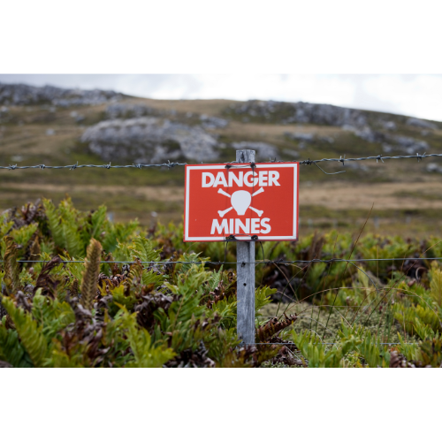
Whose evidence: the lawyer or the witness?
Witness statements must be in the witness’ own words
Preparation of statements by lawyers is both:
      routine; and
      a minefield!

Slide 27
Whose evidence: the lawyer or the witness? (cont.)
Typical result of an ‘over-lawyered’ witness statement is that the reliability of the evidence is undermined
But can be even worse! See Alex Lawrie Factors Ltd v Morgan The Times 18 August 1999

Slide 28
A useful guide to best practice
Appendix to CPR 57ACPD, ‘Statement of Best Practice in relation to Trial Witness Statements’
Available at: https://www.justice.gov.uk/courts/procedure-rules/civil/rules/part-57a-business-and-property-courts/practice-direction-57ac-trial-witness-statements-in-the-business-and-property-courts#6

Slide 29
In court: live evidence
03
Dr Alex Williams

Slide 30
What I will cover
Overview
Preparing for court
On the stand

Slide 31
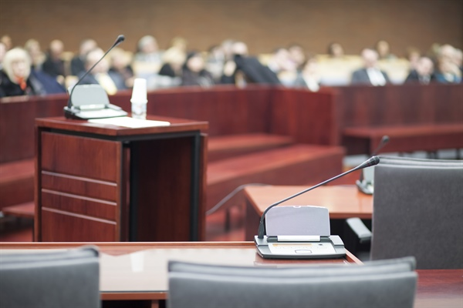
Live Evidence – Overview
Don’t squander the groundwork!
Time passes, memories fade
Officers – may lack trial experience
Changes in personnel – staff may move
Judges – some are feared!
Personal allegations – sadly quite common
Procedural twists and turns

Slide 32
Preparing for Court - General
Witnesses (except experts) are witnesses of fact, not opinion (CPR 32.2)
Live evidence usually only at trial (CPR 32.6)
Normally no evidence without a witness statement (CPR 32.10)
Statement usually stands as evidence in chief (CPR 32.5) – so brief introduction and then straight into XX
Court’s permission needed to amplify/add to the statement (CPR 32.5)
Statement is fundamental!

Slide 33
Preparing for Court – Tips
Know your statement!
Re-read the statement before court
Get reacquainted with the general facts of the case
Anticipate XX questions
Stick to the material issues in the case – no hobby horses
No to coaching from counsel

Slide 34

On the Stand
Don’t rely on notes/the statement in court
Concise answers – stay calm!
Ask if you need a break
Avoid advocating
It’s fine not to know the answer
XX – don’t feel afraid to say “yes, but…”
Don’t rely on your own advocates
XX – rules on speaking to others

Slide 35
Preparing for Court – Criminal Courts
Bench vs district judge
Expect longer evidence in chief
Beware hearsay
Beware bad character
Anticipate more attacks on investigation (or even on credibility)
Contemporaneous judgment more likely

Slide 36
Questions?

Slide 37

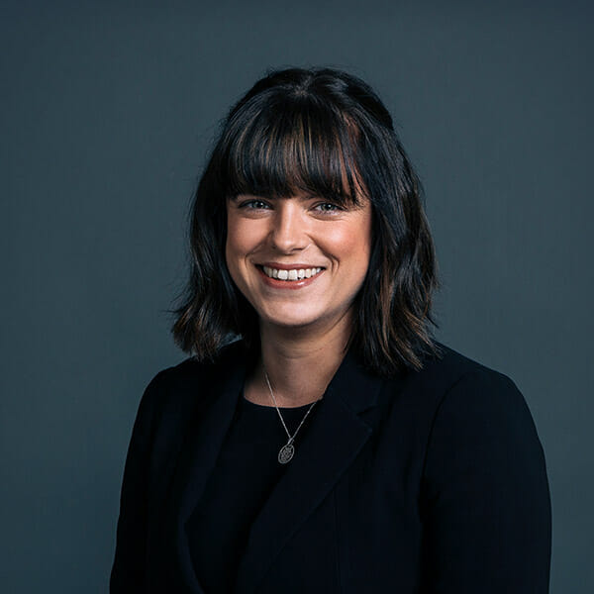
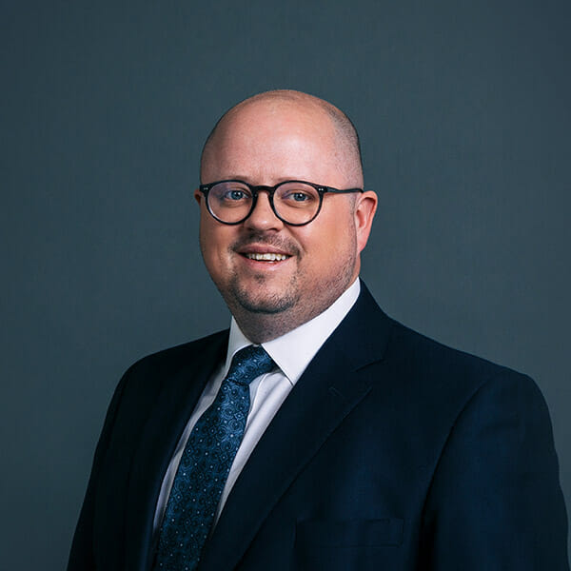
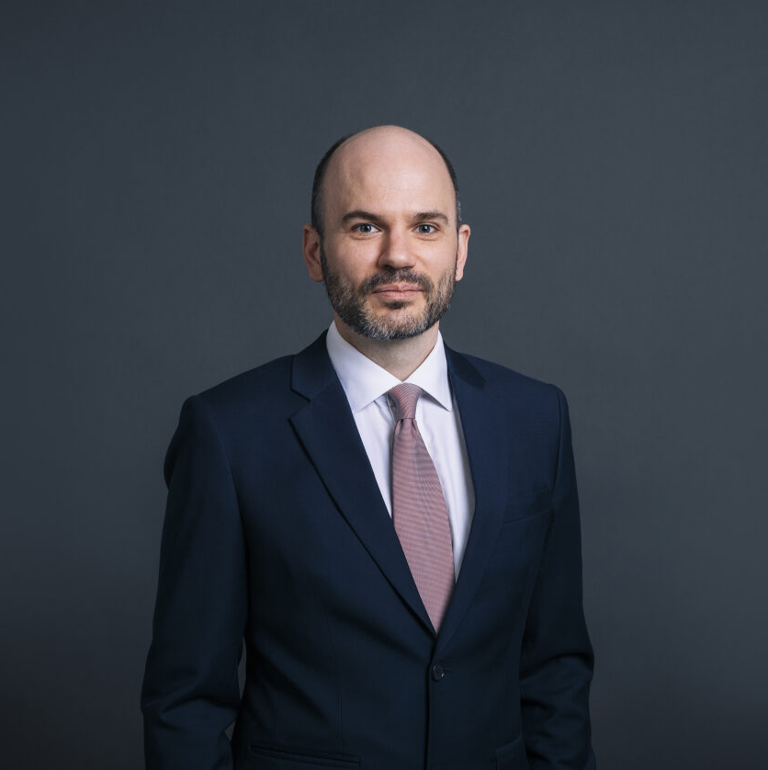
Sarah Salmon
SSalmon@cornerstonebarristers.com
Alistair Cantor
acantor@cornerstonebarristers.com
Dr Alex Williams
awilliams@cornerstonebarristers.com

