Slide 1
Domestic abuse and housing
Alexander Campbell and India Flanagan
Housing Day, October 2023

Slide 2
What is ‘domestic abuse’?
Powers to deal with DA
Homelessness
Housing allocations
Equality law

Slide 3
What is domestic abuse?
The Domestic Abuse Act 2021

Slide 4

What is domestic abuse?
Section 1 Domestic Abuse Act 2021
(1) This section defines "domestic abuse" for the purposes of this Act.
(2) Behaviour of a person ("A") towards another person ("B") is "domestic abuse" if—
(a) A and B are each aged 16 or over and are personally connected to each other, and
(b) the behaviour is abusive.

Slide 5
What is domestic abuse?
(3) Behaviour is "abusive" if it consists of any of the following—
(a) physical or sexual abuse;
(b) violent or threatening behaviour;
(c) controlling or coercive behaviour;
(d) economic abuse (see subsection (4));
(e) psychological, emotional or other abuse;
and it does not matter whether the behaviour consists of a single incident or a course of conduct.

Slide 6

Economic abuse
(4) "Economic abuse" means any behaviour that has a substantial adverse effect on B's ability to —
(a) acquire, use or maintain money or other property, or
(b) obtain goods or services.
(5) For the purposes of this Act A's behaviour may be behaviour "towards" B despite the fact that it consists of conduct directed at another person (for example, B's child).

Slide 7
Economic abuse
SS v RS [2023] EWFC 32

Slide 8
What is domestic abuse?
Coercive behaviour
EXPLANATORY NOTES
Controlling behaviour

Slide 9
‘Personally connected’ (s.2 DAA 2021)
Married
Civil partners
Agreed to marry
Civil partnership agreement
Intimate personal relationship
Parental relationship
Relatives
PAST OR PRESENT
Notes:
Past or present

Slide 10

Child victims of DA
Section 3 DAA 2021
(1) This section applies where behaviour of a person ("A") towards another person ("B") is domestic abuse.
(2) Any reference in this Act to a victim of domestic abuse includes a reference to a child who—
(a) sees or hears, or experiences the effects of, the abuse, and
(b) is related to A or B.

Slide 11

Getting it wrong…
Re A (Domestic abuse: incorrect principles applied) [2021] 6 WLUK 601
“a constellation of failures in the judge’s consideration of the domestic abuse issue”

Slide 12
Powers to deal with DA
The Domestic Abuse Act 2021

Slide 13

Powers for dealing with DA
DA
Commissioner
DA
protection notices
DA protection orders
Local
authority
support
Special measures in legal proceedings
Offences
Notes:
Past or present

Slide 14
Domestic Abuse and homelessness

Slide 15
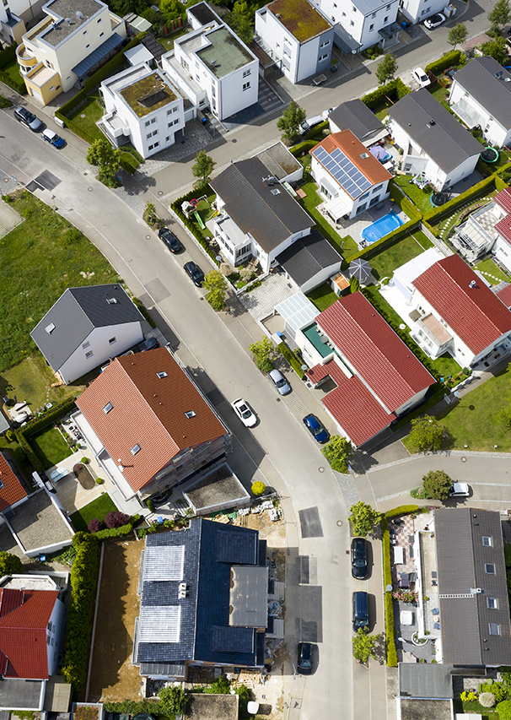
‘Homelessness’
Section 175 Housing Act 1996
(1) A person is homeless if he has no accommodation available for his occupation, in the United Kingdom or elsewhere, which he—
(a) is entitled to occupy by virtue of an interest in it or by virtue of an order of a court,
(b) has an express or implied licence to occupy, or
(c) occupies as a residence by virtue of any enactment or rule of law giving him the right to remain in occupation or restricting the right of another person to recover possession.

Slide 16
‘Homelessness’
Section 175 Housing Act 1996:
(3) A person shall not be treated as having accommodation unless it is accommodation which it would be reasonable for him to continue to occupy.
(4) A person is threatened with homelessness if it is likely that he will become homeless within 56 days.

Slide 17
‘Homelessness’
Section 177 Housing Act 1996:
(1) It is not reasonable for a person to continue to occupy accommodation if it is probable that this will lead to domestic violence or other violence against him, or against—
(a) a person who normally resides with him as a member of his family, or
(b) any other person who might reasonably be expected to reside with him.

Slide 18
‘Homelessness’
Section 177 Housing Act 1996:
(1A) For this purpose “violence” means—
(a) violence from another person; or
(b) threats of violence from another person which are likely to be carried out;
and violence is “domestic violence” if it is from a person who is associated with the victim.

Slide 19

‘Violence’
Danesh v Kensington and Chelsea Royal LBC [2006] EWCA Civ 1404
Yemshaw v Hounslow LBC [2011] UKSC 3
Supplementary Guidance on Domestic Abuse and Homelessness: CLG, November 2014

Slide 20
‘Violence’
Waltham Forest LBC v Hussein [2015] EWCA Civ 14

Slide 21

‘Reasonable to continue to occupy’
Section 177 Housing Act 1996:
(1) It is not reasonable for a person to continue to occupy accommodation if it is probable that this will lead to violence or domestic abuse against him, or against—
(a) a person who normally resides with him as a member of his family, or
any other person who might reasonably be expected to reside with him.
(1A) For this purpose—
(a) "domestic abuse" has the meaning given by section 1 of the Domestic Abuse Act 2021;
(b) "violence" means—
(i) violence from another person; or
(ii) threats of violence from another person which are likely to be carried out.

Slide 22
‘Reasonable to continue to occupy’
Section 177 Housing Act 1996:
(2) In determining whether it would be, or would have been, reasonable for a person to continue to occupy accommodation, regard may be had to the general circumstances prevailing in relation to housing in the district of the local housing authority to whom he has applied for accommodation or for assistance in obtaining accommodation.

Slide 23

‘Reasonable to continue to occupy’
Section 57, Housing (Wales) Act 2014:
(1) It is not reasonable for a person to continue to occupy accommodation if it is probable that it will lead to the person, or a member of the person's household, being subjected to abuse.
(2) In this section “member of a person's household” means—
(a) a person who normally resides with him or her as member of his or her family, or
(b) any other person who might reasonably be expected to reside with that person.
(3) In determining whether it would be, or would have been, reasonable for a person to continue to occupy accommodation, a local housing authority—
(a) may have regard to the general circumstances prevailing in relation to housing in the area of the local housing authority to whom the person has applied for help in securing accommodation;
(b) must have regard to whether or not the accommodation is affordable for that person.

Slide 24
‘Reasonable to continue to occupy’
Section 57, Housing (Wales) Act 2014:
(3) In determining whether it would be, or would have been, reasonable for a person to continue to occupy accommodation, a local housing authority—
(a) may have regard to the general circumstances prevailing in relation to housing in the area of the local housing authority to whom the person has applied for help in securing accommodation;
(b) must have regard to whether or not the accommodation is affordable for that person.

Slide 25

Common mistakes
Whether there is a history of actual violence
What steps the applicant could use to prevent abuse:
Bond v Leicester City Council [2001] EWCA Civ 1544
English Code of Guidance and Welsh Code

Slide 26

Priority need
Section 189 Housing Act 1996:
(1) The following have a priority need for accommodation—
(a) a pregnant woman or a person with whom she resides or might reasonably be expected to reside;
(b) a person with whom dependent children reside or might reasonably be expected to reside;
(c) a person who is vulnerable as a result of old age, mental illness or handicap or physical disability or other special reason, or with whom such a person resides or might reasonably be expected to reside;

Slide 27
Priority need
Section 189 Housing Act 1996:
(d) a person who is homeless or threatened with homelessness as a result of an emergency such as flood, fire or other disaster;
(e) a person who is homeless as a result of that person being a victim of domestic abuse.

Slide 28
Priority need
Section 189 Housing Act 1996:
(5) In this section "domestic abuse" has the meaning given by section 1 of the Domestic Abuse Act 2021.

Slide 29
Priority need
Housing (Wales) Act 2014, section 70:
The following persons have a priority need for accommodation for the purposes of this Chapter—
[…]
(e) a person—
(i) who is homeless as a result of being subject to domestic abuse, or
(ii) with whom a person who falls within sub-paragraph (i) resides (other than the abuser) or might reasonably be expected to reside;

Slide 30
Priority need
Housing Act 1996, section 189:
(2) The Secretary of State may by order—
(a) specify further descriptions of persons as having a priority need for accommodation, and
(b) amend or repeal any part of subsection (1).

Slide 31
Priority need
Homelessness (Priority Need for Accommodation) (England) Order 2002/2051
2. Priority need for accommodation
The descriptions of person specified in the following articles have a priority need for accommodation for the purposes of Part 7 of the Housing Act 1996.

Slide 32
Priority need
Homelessness (Priority Need for Accommodation) (England) Order 2002/2051
6. Vulnerability: fleeing violence or threats of violence
(1) A person who is vulnerable as a result of ceasing to occupy accommodation by reason of violence from another person or threats of violence from another person which are likely to be carried out.
(2) For the purposes of this article—
(a) "violence" does not include violence that is domestic abuse;
(b) "domestic abuse" has the meaning given by section 1 of the Domestic Abuse Act 2021.

Slide 33

Local connection
Section 199, Housing Act 1996:
A person has a local connection with the district of a local housing authority if he has a connection with it—
(a) because he is, or in the past was, normally resident there, and that residence is or was of his own choice,
(b) because he is employed there,
(c) because of family associations, or
(d) because of special circumstances.

Slide 34
Local connection
Section 198, Housing Act 1996:
(2) The conditions for referral of the case to another authority are met if—
(a) neither the applicant nor any person who might reasonably be expected to reside with him has a local connection with the district of the authority to whom his application was made,
(b) the applicant or a person who might reasonably be expected to reside with him has a local connection with the district of that other authority, and
(c) neither the applicant nor any person who might reasonably be expected to reside with him will run the risk of domestic abuse in that other district.

Slide 35
Local connection
Section 198, Housing Act 1996:
(2A) But the conditions for referral mentioned in subsection (2) or (2ZA) are not met if—
(a) the applicant or any person who might reasonably be expected to reside with him has suffered violence (other than violence that is domestic abuse) in the district of the other authority; and
(b) it is probable that the return to that district of the victim will lead to further violence of a similar kind against him.

Slide 36
Allocations

Slide 37

Grant of secure tenancies
Section 79, Domestic Abuse Act 2021
Section 81ZA, Housing Act 1985

Slide 38

Challenge to allocation decision
R (TRX) v Network Homes [2022] EWHC 456 (Admin)

Slide 39
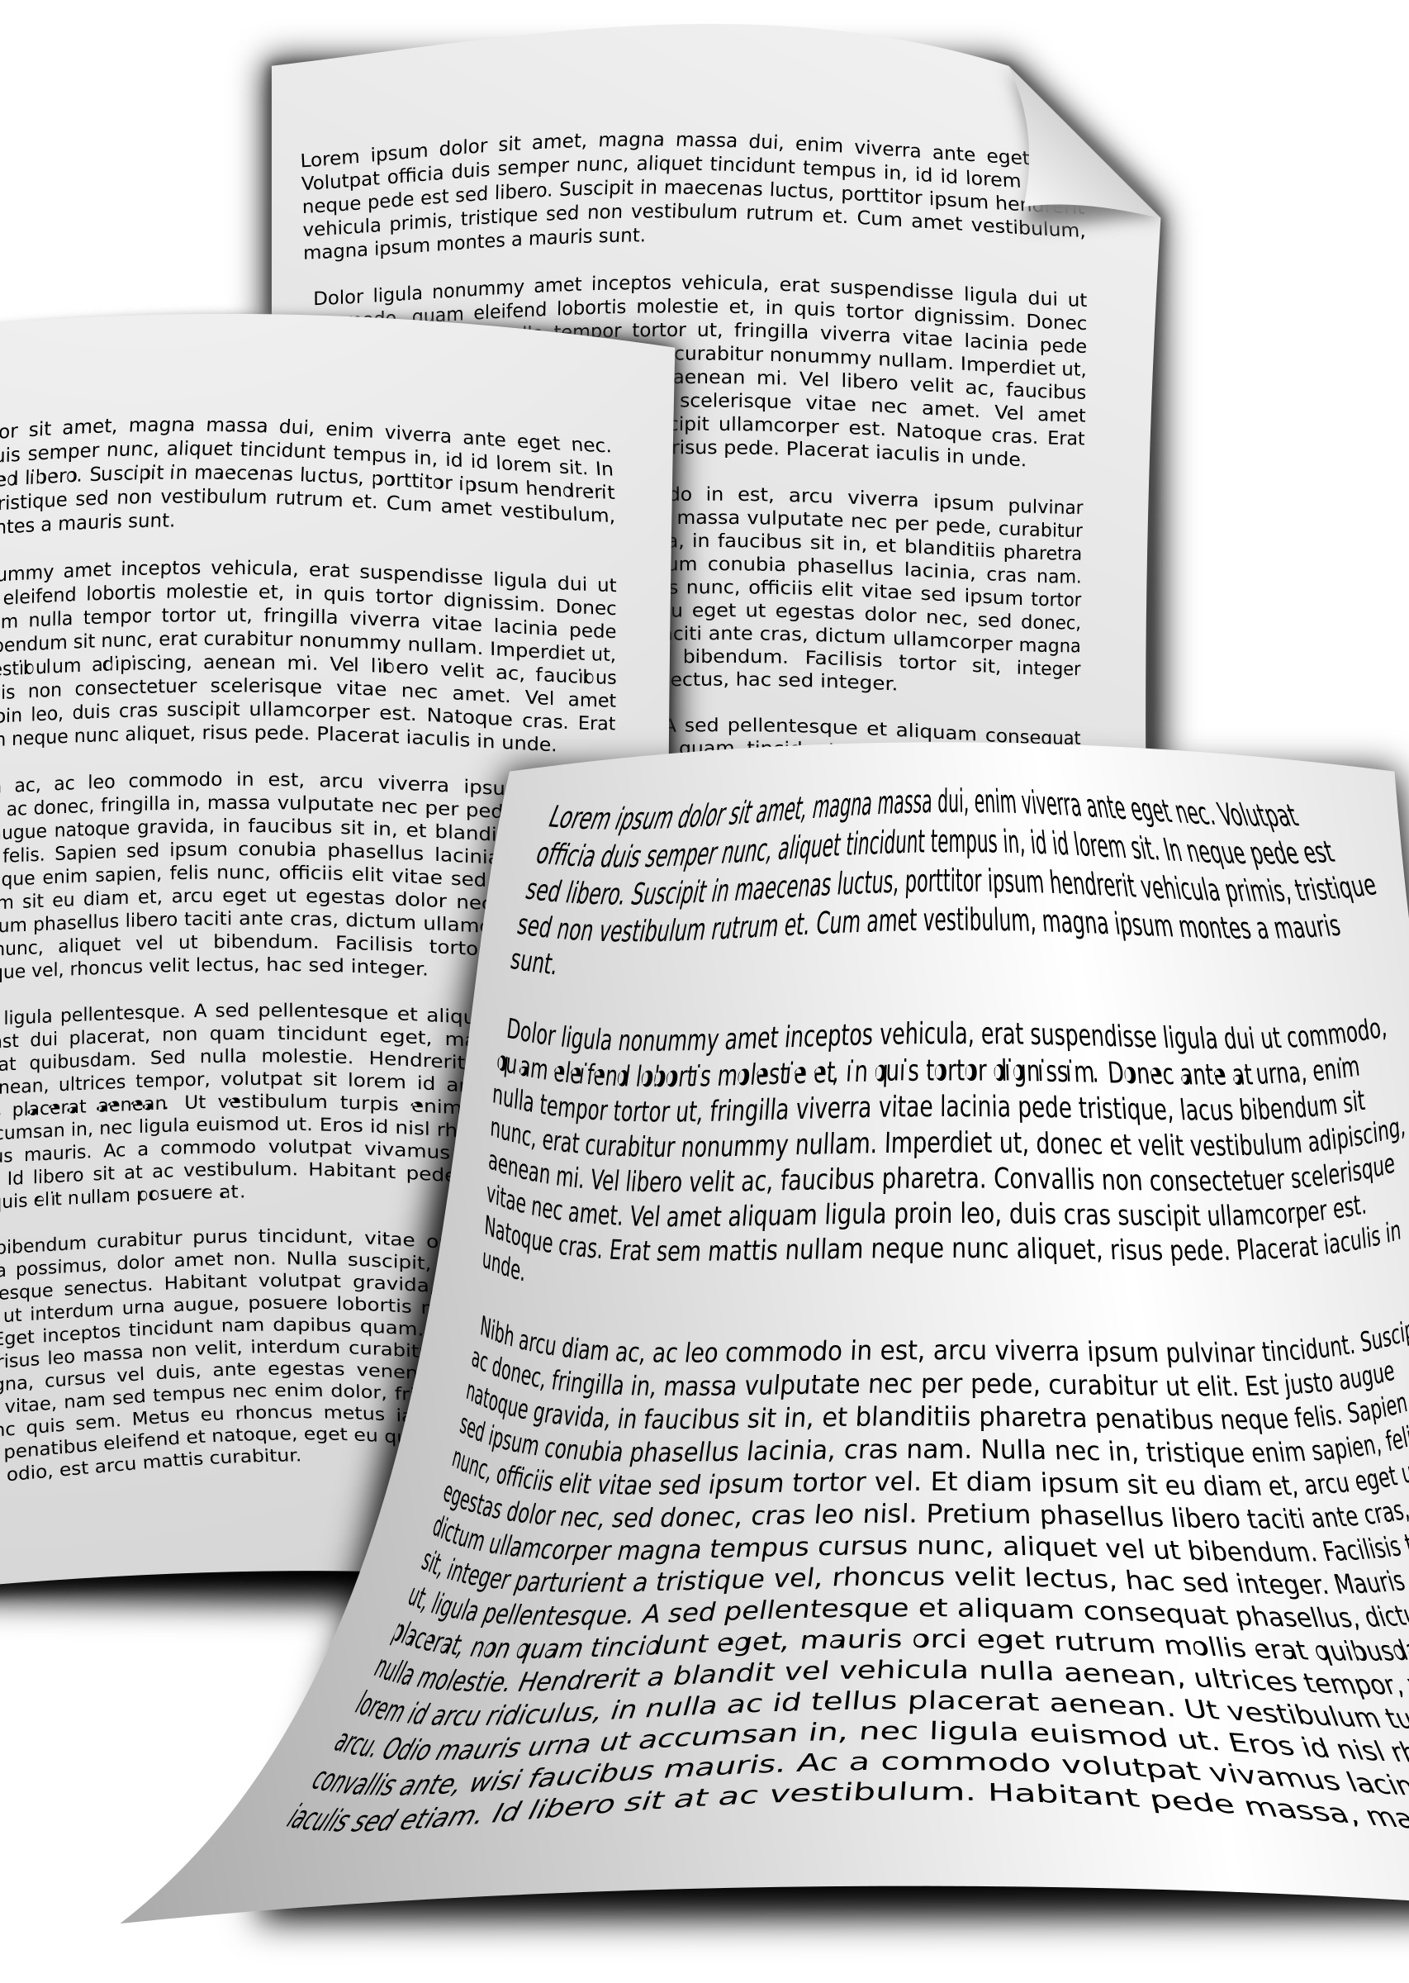
Allocations schemes
Drafting
Reasonable preference
Residence rules

Slide 40

Possession claims
New ground for possession for secure and assured tenancies
s145, Housing Act 1996: secure tenancies (ground 2A)
S149, Housing Act 1996: assured tenancies (ground 14A)

Slide 41
Possession claims
The dwelling-house was occupied (whether alone or with others) by a married couple or a couple living together as husband and wife and—
(a) one or both of the partners is a tenant of the dwelling-house,
(b) the landlord who is seeking possession is a registered social landlord or a charitable housing trust,
(c) one partner has left the dwelling-house because of violence or threats of violence by the other towards—
(i) that partner, or
(ii) a member of the family of that partner who was residing with that partner immediately before the partner left, and
(d) the court is satisfied that the partner who has left is unlikely to return.

Slide 42

Consultations
Local connection requirements for social housing for victims of DA
The impacts of joint tenancies on victims of DA

Slide 43
Equalities issues

Slide 44
Public Sector
Equality Duty
Counterclaims
Policies

Slide 45


Slide 46
Thank you
acampbell@cornerstonebarristers.com
iflanagan@cornerstonebarristers.com

