Slide 1
A Look Ahead to 2024
Catherine Rowlands – Lindsay Johnson – Andy Lane
9 October 2023

Slide 2



The Speakers

Slide 3
More action on dampness
In response to the death of Awaab Ishak in Rochdale, the government is promising more action
New Code already published - Damp and mould: understanding and addressing the health risks for rented housing providers - GOV.UK (www.gov.uk)
How will this guidance be used in the courts?
Guidance promises “Awaab’s Law” to force landlords to address hazards such as damp and mould in the home
Decent Homes Standard to be reviewed and to apply to private rented houses
When?
…“as soon as Parliamentary time permits”

Slide 4
Speaking of which…
The Renters Reform Bill?
Due for second reading about now
Gove said it would get second reading “before Christmas” at a Conservative Party conference forum

Slide 5
Proposals for reform of HHSRS
Report https://www.gov.uk/government/publications/housing-health-and-safety-rating-system-hhsrs-review-outcomes-and-next-steps/summary-report-outcomes-and-next-steps-for-the-review-of-the-housing-health-and-safety-rating-system-hhsrs
New regs proposed to reduce the number of hazards

Slide 6


Slide 7
Fixed Recoverable Costs Regime
Fixed Recoverable Costs
Allocation
Do not apply to a claim or counterclaim which relates to residential premises and includes a claim or counterclaim for possession, disrepair or unlawful eviction CPR 45.1(4), even where that element of the claim has been discontinued CPR 54.1(5) – query whether will continue to apply in the future
Otherwise, applies to all proceedings valued over £100,000, issued on or after 1 October 2023, subject to exceptions (including where a party is a protected party
The only costs recoverable are those set out in CPR 45
A new intermediate track for claims valued between £25,000 and £100,000 – CPR26.9(7)-(11).
If in fast or intermediate track, must also assign the claim to a complexity band – the level of band determines the costs that are to be allowed (see table 12, 14 CPR 45 PD).
    e.g. A case allocated to the intermediate track that only has one issue in dispute and is not likely to last longer than a day, is in complexity band 1.

Slide 8
Contract holders
Secure & Standard contracts
Renting Homes (Wales) Act 2016
Occupation contracts
Joint contract holders
Model contracts
Termination

Slide 9


Election 2024/25

Slide 10

Cornerstone Barristers 2024
Housing Team

Slide 11
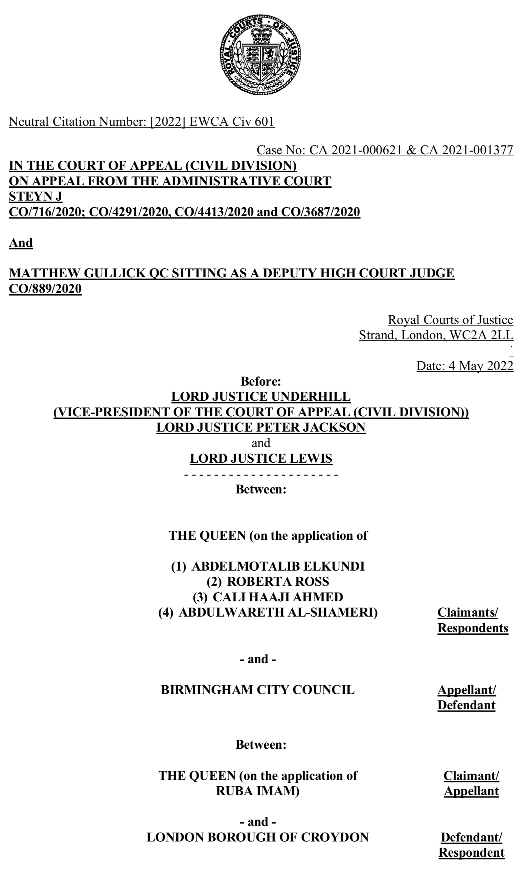


R (Imam) v LB Croydon – Supreme Court
Kelvin Rutledge KC & Riccardo Calzavara
Court of Appeal – [2022] 3 W.L.R. 71
Heard on 3 & 4 May 2023

Slide 12
Kyle v Coventry City Council – Court of Appeal
Catherine Rowlands for Coventry
Issue: intentionally homeless from temporary accommodation
To be heard on 25 October 2023
A applied as homeless and main duty accepted
He has a history of heroin addiction and anti-social behaviour
Was placed in HMO accommodation with support
Found to have stolen from other rooms and evicted by the provider
Is he intentionally homeless? Nature of the accommodation is central issue (following Hodge v Folkestone & Hythe DC [2023] EWCA Civ 896 and R (Ahamed) v LB of Haringey [2023] EWCA Civ 975)

Slide 13



A New Book!
The latest in the “Cornerstone on…” series arising from its authors practical casework experience of Gang Injunctions.
Also published soon is “Cornerstone on Councillors' Conduct and Standards in Public Life” (Matt Lewin)

Slide 14
Some more news…
Jack Barber
Lindsay Johnson
Andy Lane
Short practitioner's text
'A Practical Approach to Accommodating Asylum Seekers - Planning, Housing and Licensing Issues.'
R. (on the application of Jaberi) v Westminster City Council [2023] EWHC 1045 (Admin); [2023] P.T.S.R. 1402
Appeal to Court of Appeal
LB Newham v Hussain LON/00BB/HBA/2022/0001
Appeal to Upper Tribunal (Lands Chamber)

Slide 15


Homelessness Webinar – 1/11/03

