Slide 1
Freedom of Speech and Equality in Higher Education Sam Fowles
s
Sfow

Slide 2
Overview
The Higher Education (Freedom of Speech) Act 2023
Other (equally important!) legal duties
Challenges for HEP
Proposals to respond to those challenges
Questions

Slide 3
1. The Freedom of Speech Act

Slide 4
1. The Freedom of Speech Act
HEP Duties
SU Duties
OFS Powers
Statutory Tort
Limitation on NDA

Slide 5
1. The Freedom of Speech Act
HEP Duties
“Reasonably practicable steps” to secure freedom of speech “within the law”.
Use of premises
Applies to: Staff, members, students, and external speakers.
Cannot impose cost of security.
Code of Practice.

Slide 6
1. Freedom of Speech Act
Defines “academic freedom”:
6) In this Part, “academic freedom”, in relation to academic staff at a registered higher education provider, means their freedom within the law—
(a) to question and test received wisdom, and
(b) to put forward new ideas and controversial or unpopular opinions,
without placing themselves at risk of being adversely affected in any of the ways described in subsection (7).
(7)Those ways are—
(a) loss of their jobs or privileges at the provider;
(b) the likelihood of their securing promotion or different jobs at the provider being reduced.

Slide 7
1. Freedom of Speech Act
SU Duties
Replicates HEP duties
Also applies to affiliating student societies
Code of Practice

Slide 8
1. Freedom of Speech Act
OFS Powers
Require HEP to include FOS provisions in governing documents
Monitor compliance
Fine SU
“Free Speech Champion”
Complaints scheme

Slide 9
1. Freedom of Speech Act
Tort
Claim against HEP or SU
Any breach of duty
Financial or injunctive relief
Must go through complaints scheme first (unless just injunction)
Must prove “loss”

Slide 10
Other relevant (and equally important) duties

Slide 11
2. Other Duties
Right to Protest
Common law
Art. 11 ECHR
Negative duty – permit
Positive duty – facilitate
Public Order Act/Police Crime Sentencing and Courts Act powers – conditional and not mandatory.

Slide 12
2. Other Duties
Right to Freedom of Expression
Common law
Art. 10 ECHR
Qualified right – interference permitted if:
Lawful
Necessary in a democratic society
Proportionate
Art. 17 – ECHR rights don’t protect expression that is contrary to the ECHR itself.

Slide 13
2. Other Duties
Criminal Law
Threats/incitement
Violence
Malicious communications
Separately – Data protection rights

Slide 14
2. Other Duties
Equality Act
Public Sector Equality Duty (PSED)
Discrimination (direct or indirect)
Harassment
Derogations – Proportionate means of achieving a legitimate aim.

Slide 15
2. Other Duties
Equality Act (Application)
Myth buster: Trans people are protected
Religion and belief
“Grainger test”: (1) Genuine, (2) not transitory, (3) substantial issue, (4) cogent, (5) worthy of respect in a democratic society.
Forstater – “belief that biological sex is immutable” (Myth buster: Not all GC beliefs)
Belief not necessarily expression
Myth buster : Bailley didn’t “beat” Stonewall

Slide 16
3. Challenges

Slide 17
3. Challenges
Reducing Academic Standards
Right to platform justified by “having an opinion”
Many (not all) of the recent “cancel culture” controversies involve speakers who are questionably qualified.
Academic freedom framed as freedom from criticism.
Anathema to the academy – the essence of academia is discernment.

Slide 18
3. Challenges
Free Speech Becomes Privileged Speech
FSA doesn’t impact equally
Free speech/freedom from criticism/dissent
“Miltonian fallacy”
Balance fallacy
Little real “debate” in controversial events
Controversy sells

Slide 19
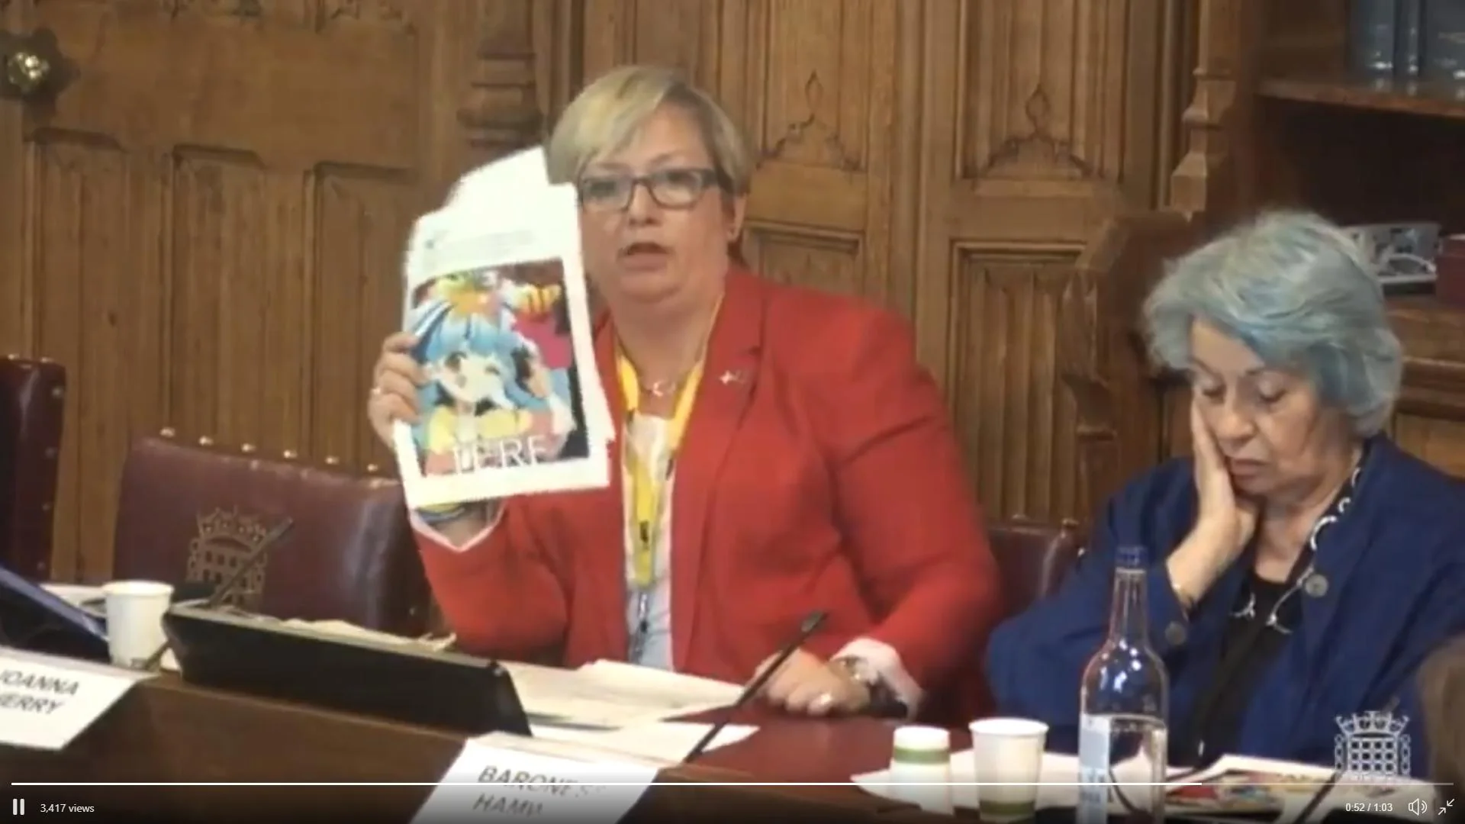
3. Challenges

Slide 20

3. Challenges

Slide 21
3. Challenges
Polarisation/Extremism
Free Speech Act – most useful for extreme perspectives that generate controversy
Controversy sells
Right to determine platform – itself a form of FOE – mitigated (now rolled back)
Benefits the better funded
Incentive to “own the libs” rather than have a genuine discourse.

Slide 22
3. Challenges
Govt/Privileged Control
Govt has more control over content of academic discourse than ever before
Priorities likely to be influenced by “culture war” politics
May pick on “easy targets” (SU)
Rich backers may facilitate tort cases

Slide 23
Proposals

Slide 24
4. Proposals
Focus on Quality not Content
Freedom of Speech Act preserves “institutional independence”
Duties qualified – must allow academic discernment
Policies/codes could recognise
Qualification (publications/expertise/professional experience)
History of misinformation
Contribution to academic discourse

Slide 25
4. Proposals
Platform Criticism/Dissent
Other people have rights too
Protest (inc direct action) is “speech”
Perception of privilege enhances tension
May be required to give platform but not required to give exclusive/unchallenged platform
Lots of forms of speech (direct action/debate/social media/art etc)
Won’t always solve the problem

Slide 26
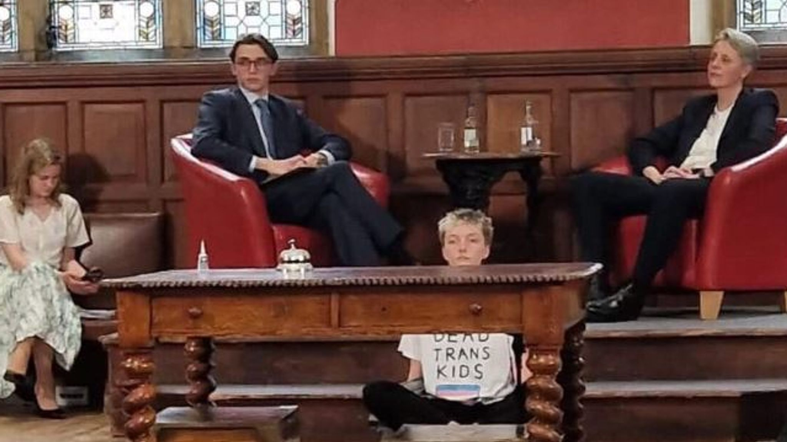
This is Speech

Slide 27
4. Proposals
Recognise Competing Rights
“Reasonably practicable” and “within the law” – leaves space to balance rights
Analyse facts/repercussions
Impact of both event and perceived endorsement by the institution
Context – what other events occurring?
Mitigation?
Get legal advice early!

Slide 28
4. Proposals
Tackle This Head On
There is a real chance you will get sued
Assume you will end up in court (and hope you won’t!)
Clear policy/code – consult widely
Do your research (generally and into specific speakers)
Take legal advice before you need it.

Slide 29
Questions?
sfowles@cornerstonebarrristers.com
@SamFowles

