Slide 1
The webinar will begin shortly
The slides and recording will be available on our website shortly after the webinar

Slide 2
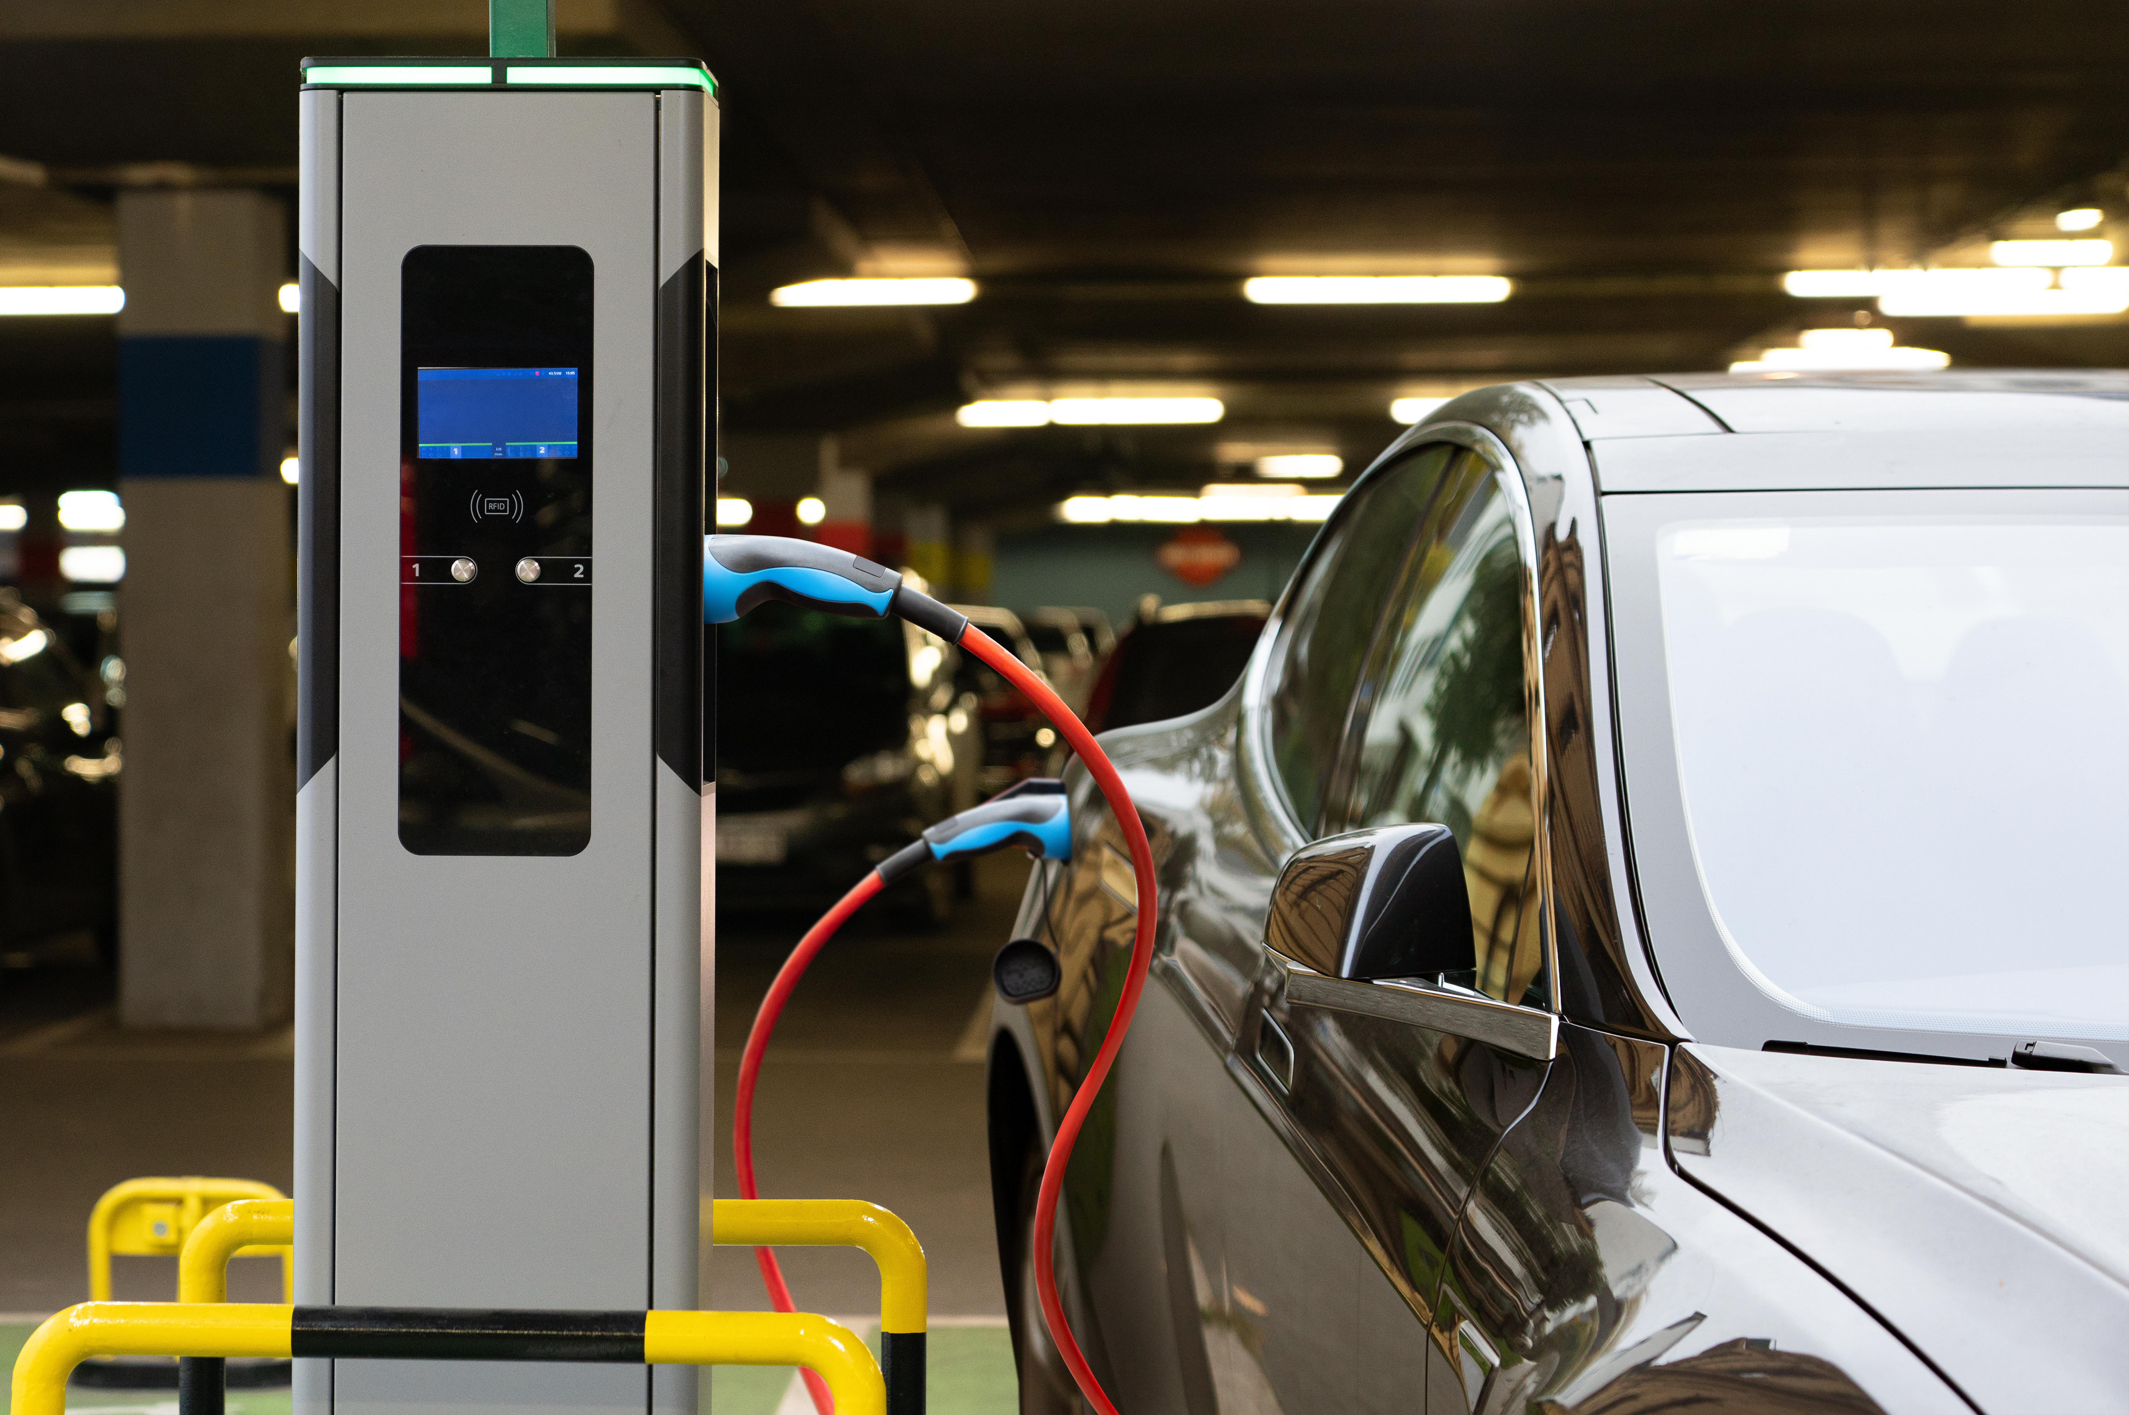
EV Charging by 2030 (or 2035?) – How do we hit the government’s target?
Cornerstone Climate, with Arcadis

Slide 3




Roisin Naughton, Arcadis
(assisted by Simran Matharu)
Ruchi Parekh,
Cornerstone
Dr Ashley Bowes,
Cornerstone
Robert Williams,
Cornerstone

Slide 4
Meeting the Need – Roisin Naughton

Slide 5
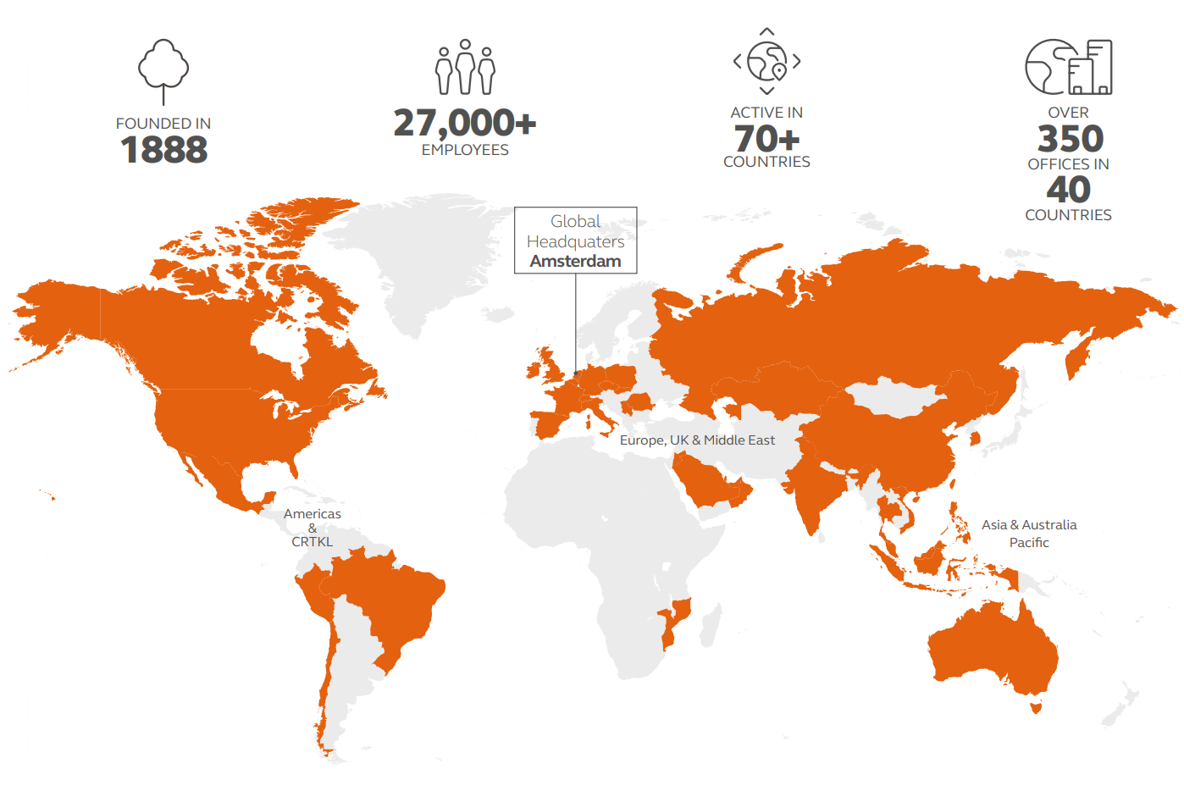

Improving Quality of Life
Arcadis employees over 27,000 people across 40 countries dedicated to improving the quality of life. This year we have delivered over 35,000 projects for clients, and in recent years this has included the installation of over 10,000 electric vehicle chargers.
Arcadis is recognised as one of the leading brands within the EV industry. The combined experience and skills of our multi-disciplinary team provides excellent capability to deliver our client’s requirements and surpass their expectations.

Slide 6

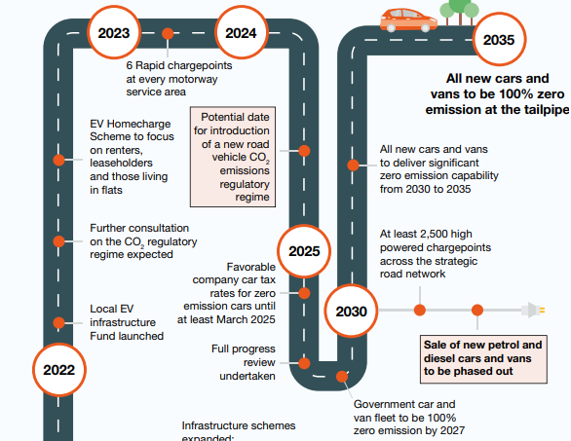
Transitioning to Zero Emission Vehicles
Back in 2020, recognising the scale of this challenge the UK government pushed forward its commitment to ban new diesel and petrol vehicles from 2040 to 2030 and to fully convert its public fleet to ULEVs by 2027.

Slide 7
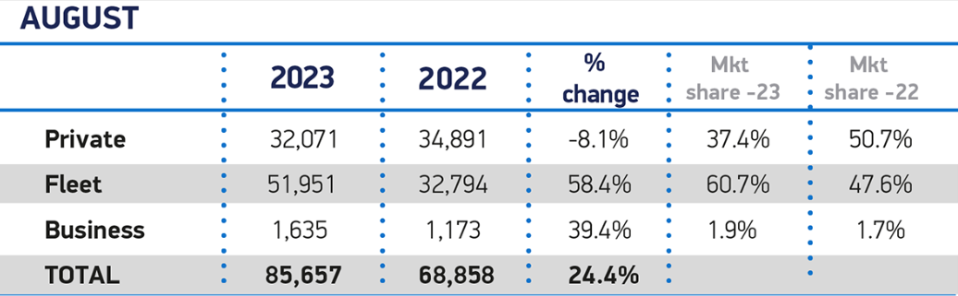
New Car Registration Trends
On average, 55% of annual new car registrations are fleet or business registrations. With previous policy targets, there would still be a significant number of ICE vehicles on the road by 2030.
New Vehicle Registrations for August 2023. Source: UK new car registration data, UK car market - SMMT
On average car owners change their car every
7-10 years
Of cars on the road could have been EV’s by 2030
50%

Slide 8

Incentives & Market Reaction to 2030 ICE Phase Out
Incentives (introduced in 2020)
Plug-in Car grant | Grant of up to £2,500 off eligible EV’s
EV Home charge scheme | Grant up to 75% (capped at £350) of the cost of purchasing and installing a domestic charging unit
Workplace charging scheme | £350 per socket for up to 40 charge points
Road tax exemption | Exempt from road tax
ULEZ, Congestion charge & Parking permit exemption | Widely offered by Local Authorities
OEMs backed the Government ambition to phase out ICE sales from 2030, supported by an array of financial incentives provided by Government at the time.

Slide 9
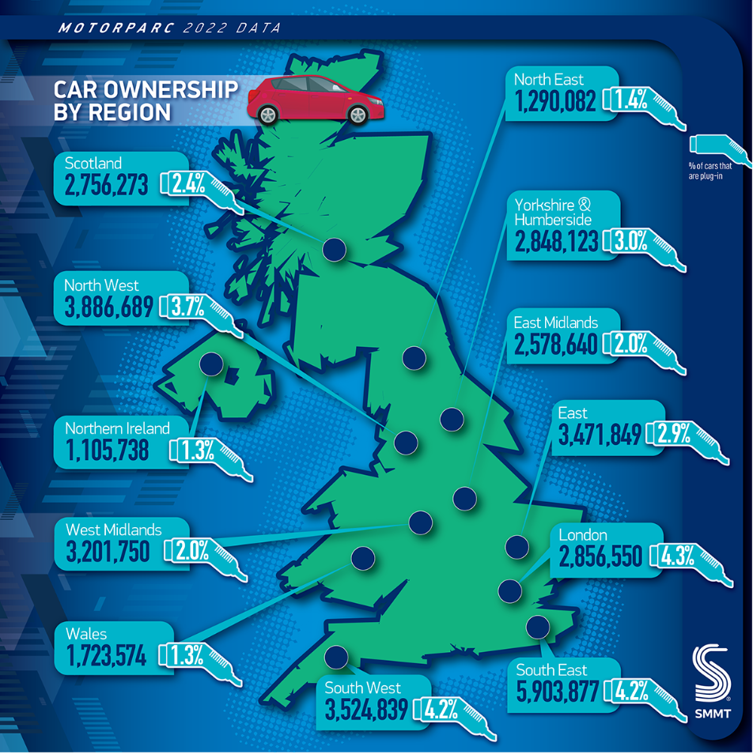
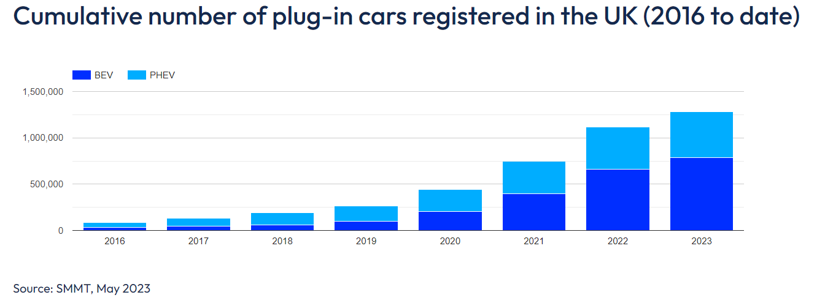
EV Registrations in the UK
Tesla Model Y
is the best selling EV in the UK.
Cumulative number of plug-in cars registered in the UK 2016 to date
Source: https://www.moveelectric.com/e-cars/ten-best-selling-electric-cars-uk using SMMT data.
Source: https://media.smmt.co.uk/uk-motorparc-data-2022/

Slide 10
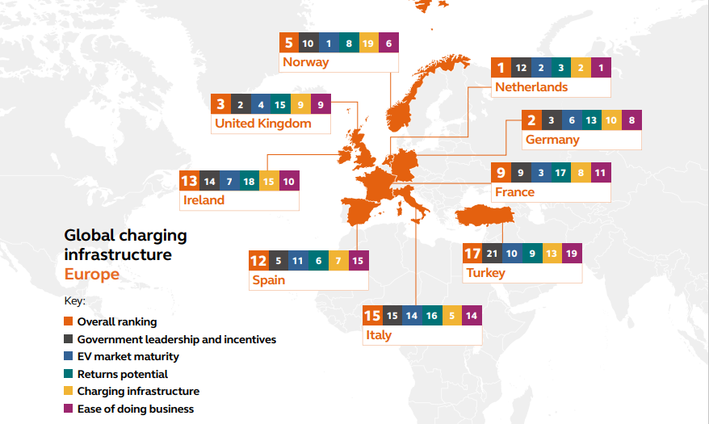

Notes:
Global rollout of electric vehicles will depend on countries creating right framework for investment, says Arcadis | Arcadis

Slide 11
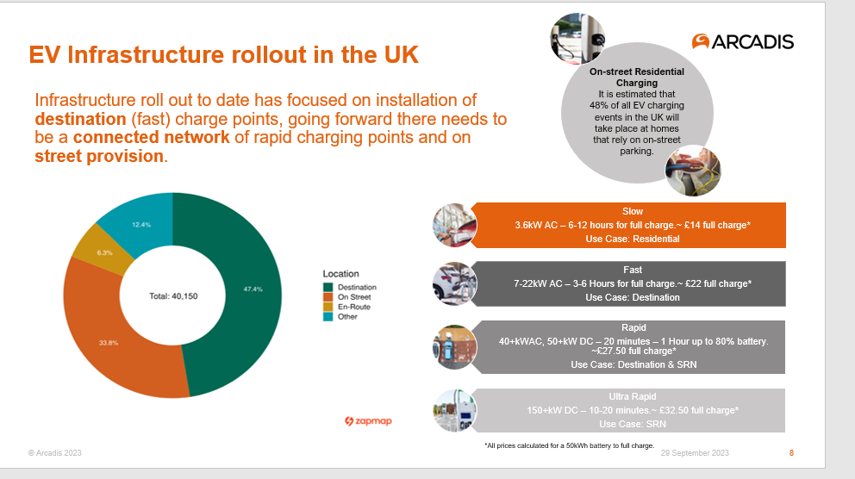

Slide 12
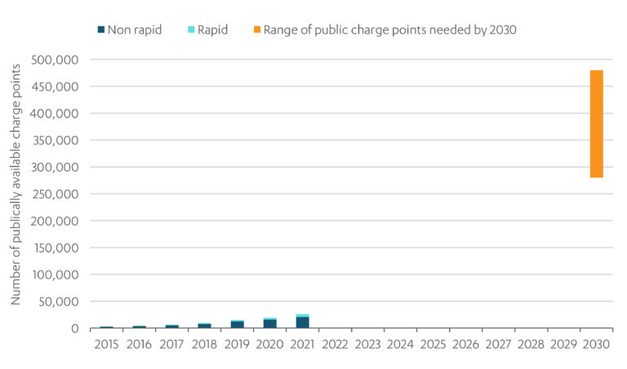
National EV Strategy Infrastructure Forecasts

Slide 13
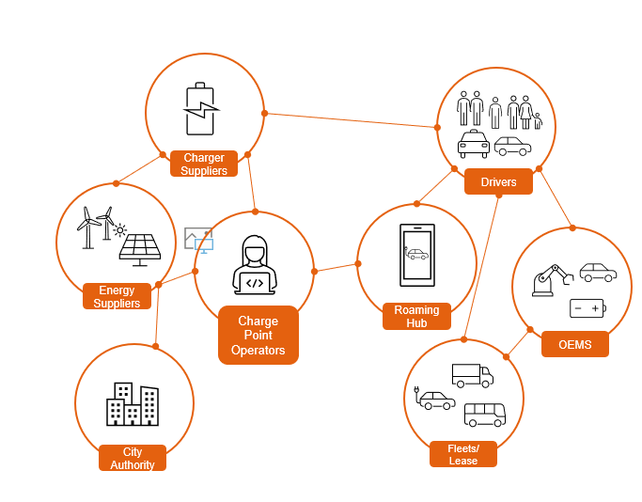
Ecosystem
The EV ecosystem is constantly evolving and involves lots of moving parts and players, stakeholder engagement is key to ensure appropriate and futureproofed delivery of EV infrastructure to meet users’ needs.

Slide 14


ZEV Mandate
22%
28%
33%
38%
52%
66%
80%
10%
16%
24%
34%
46%
58%
70%
2024
2025
2026
2027
2028
2029
2030
Industry has been provided with clarity on the Government’s commitment to the net zero transition with the ZEV mandate levy enforcing increasingly stringent EV sales targets on car and van makers from 2024 to 2030.
EV Sales Quota
EV Sales Quota

Slide 15


Conclusions
Break down policy & regulatory barriers to deployment of EV charging infrastructure
Government U-turns
Engaging directly with the private sector (supermarkets, service stations)
Explore shared charging strategies
Build close relationship with DNOs and engage early with EVCI developments
Take action now to plan for public charging demand

Slide 16
Policy Framework – Ruchi Parekh

Slide 17


Slide 18
Policy Framework
National Strategy
NPPF
Local Policies

Slide 19
Taking charge: the EV infrastructure strategy
Vision for 2030: 300,000 public charge points as a minimum
Delivery:
(1) Roll-out of high-powered chargers on the strategic road network
(2) Transform local on-street charging by placing obligation* on local authorities to develop and implement strategies
*subject to consultation

Slide 20
National Planning Policy Framework
“If setting local parking standards for residential and non-residential development, policies should take into account: … (e) the need to ensure an adequate provision of spaces for charging plug-in and other ultra-low emission vehicles” (107)
“applications for development should: … (e) be designed to enable charging of plug-in and other ultra-low emission vehicles in safe, accessible and convenient locations” (112)

Slide 21

Planning Policy Guidance

Slide 22
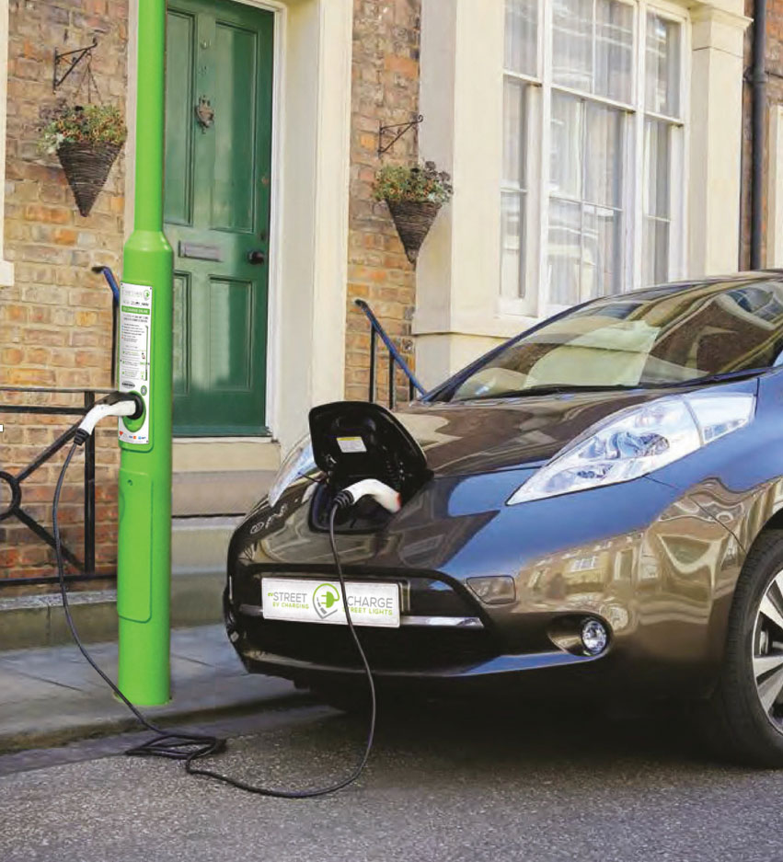
Other Guidance
Electric Vehicle charging infrastructure:
help for local authorities
Long-term strategy
Decarbonise vehicle fleets
Engage with businesses and public
Funding schemes

Slide 23
Local Level: Strategies
Transport for Southeast
Greater Manchester
Oxford City Council
Transport for London

Slide 24
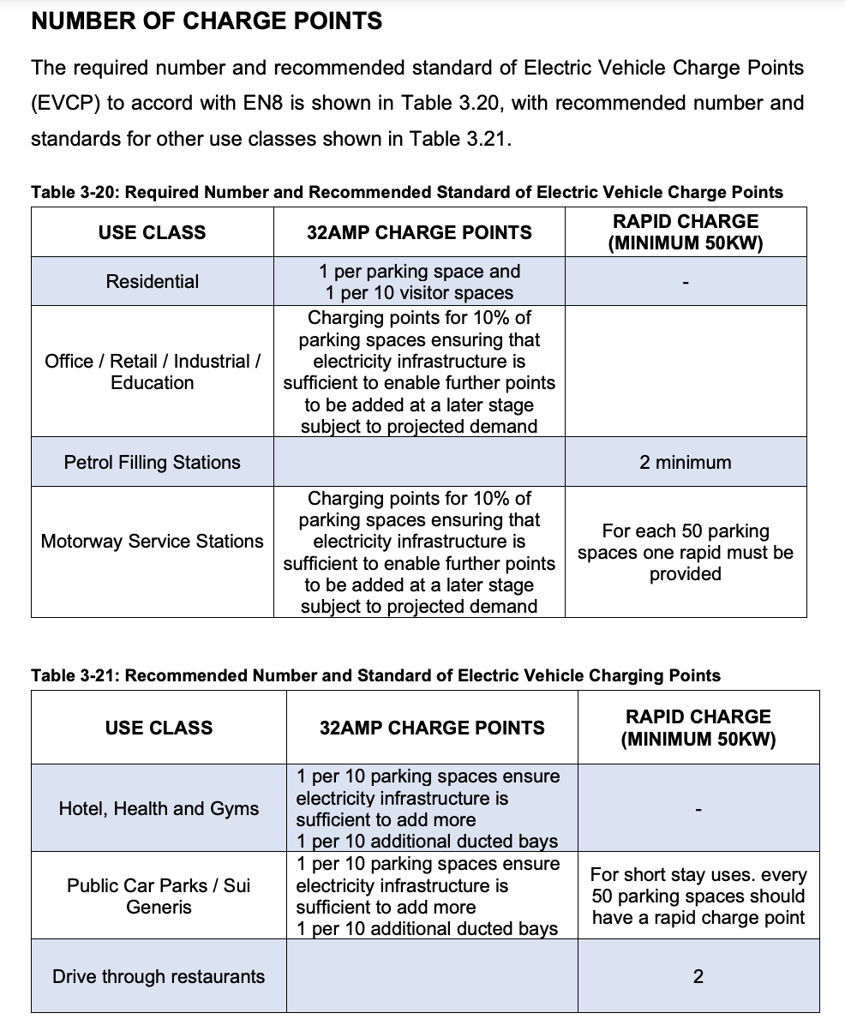
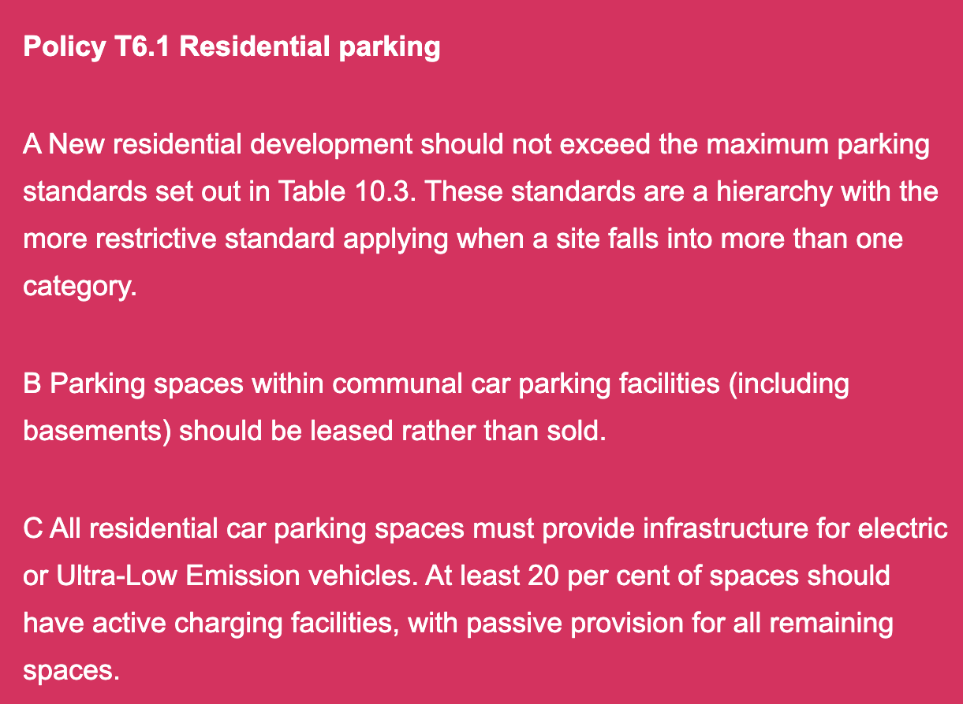
Local Level: Planning Policies

Slide 25
When Permission is necessary – Dr Ashley Bowes

Slide 26
Development?
Likely would be “development”:
Charging point on a building likely will change the external appearance.
Freestanding charging point likely by virtue of its permanence and annexation to the land.
Unless could be said to be an improvement of the highway.

Slide 27
Is permission required or is it PD?
Electrical outlet for recharging vehicles (Class D, Part 2)
It is in an area lawfully used for off-street parking.
It does not exceed 0.2m³.
It does not face onto or be within 2m or a highway.
It is not within a Scheduled Monument.
It is not within the curtilage of a listed building.
It is removed and the wall made good as soon as reasonably practicable if no longer needed for charging vehicles.

Slide 28
Is permission required or is it PD?
Electrical upstand for recharging vehicles (Class E, Part 2)
It is in an area lawfully used for off-street parking.
It does not exceed 1.6m in height from the surface to park vehicles.
It is further than 2m from a highway.
It is not within a Scheduled Monument.
It is not within the curtilage of a listed building.
It would not result in more than 1 upstand per parking space.
It is removed and the land made good as soon as reasonably practicable if no longer needed for charging vehicles.

Slide 29
EV Case Study – Robert Williams

Slide 30

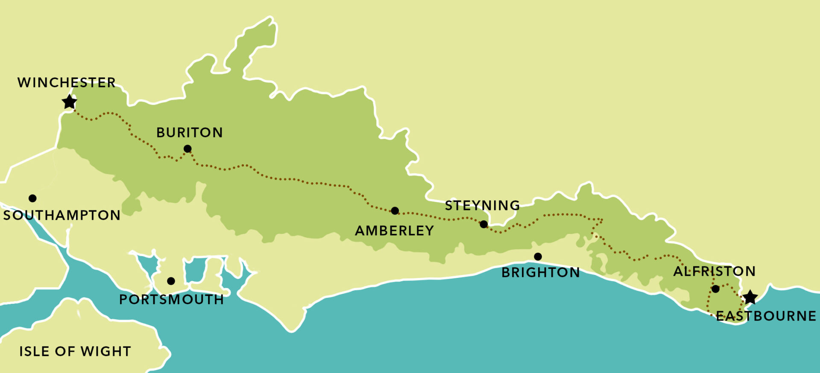
Re-charge One – EV Re-Charging Station, South Downs National Park

Slide 31
Re-charge One – Location

Slide 32
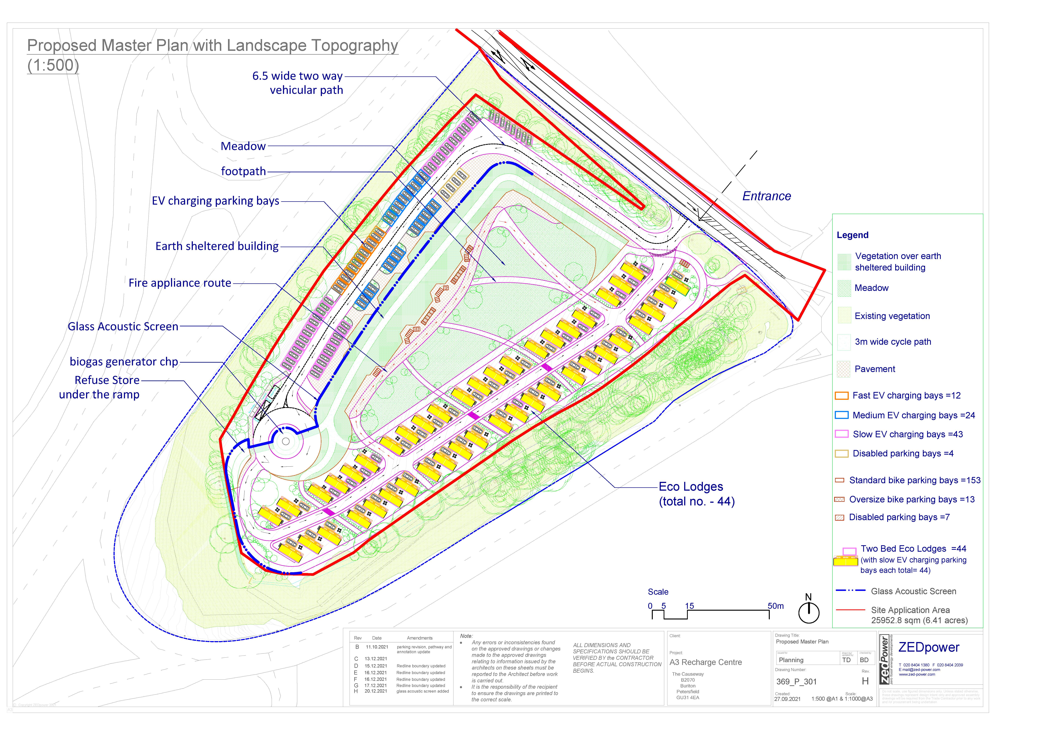
Re-charge One – Proposal
79 EV Chargers - variety of speeds
Earth Sheltered Commercial Building – farm shop and café, information centre, e-bike hire
Eco-lodges, each with dedicated EV
Off-grid – powered by biogas and solar
20 min walk/10 min cycle to South Downs Way

Slide 33

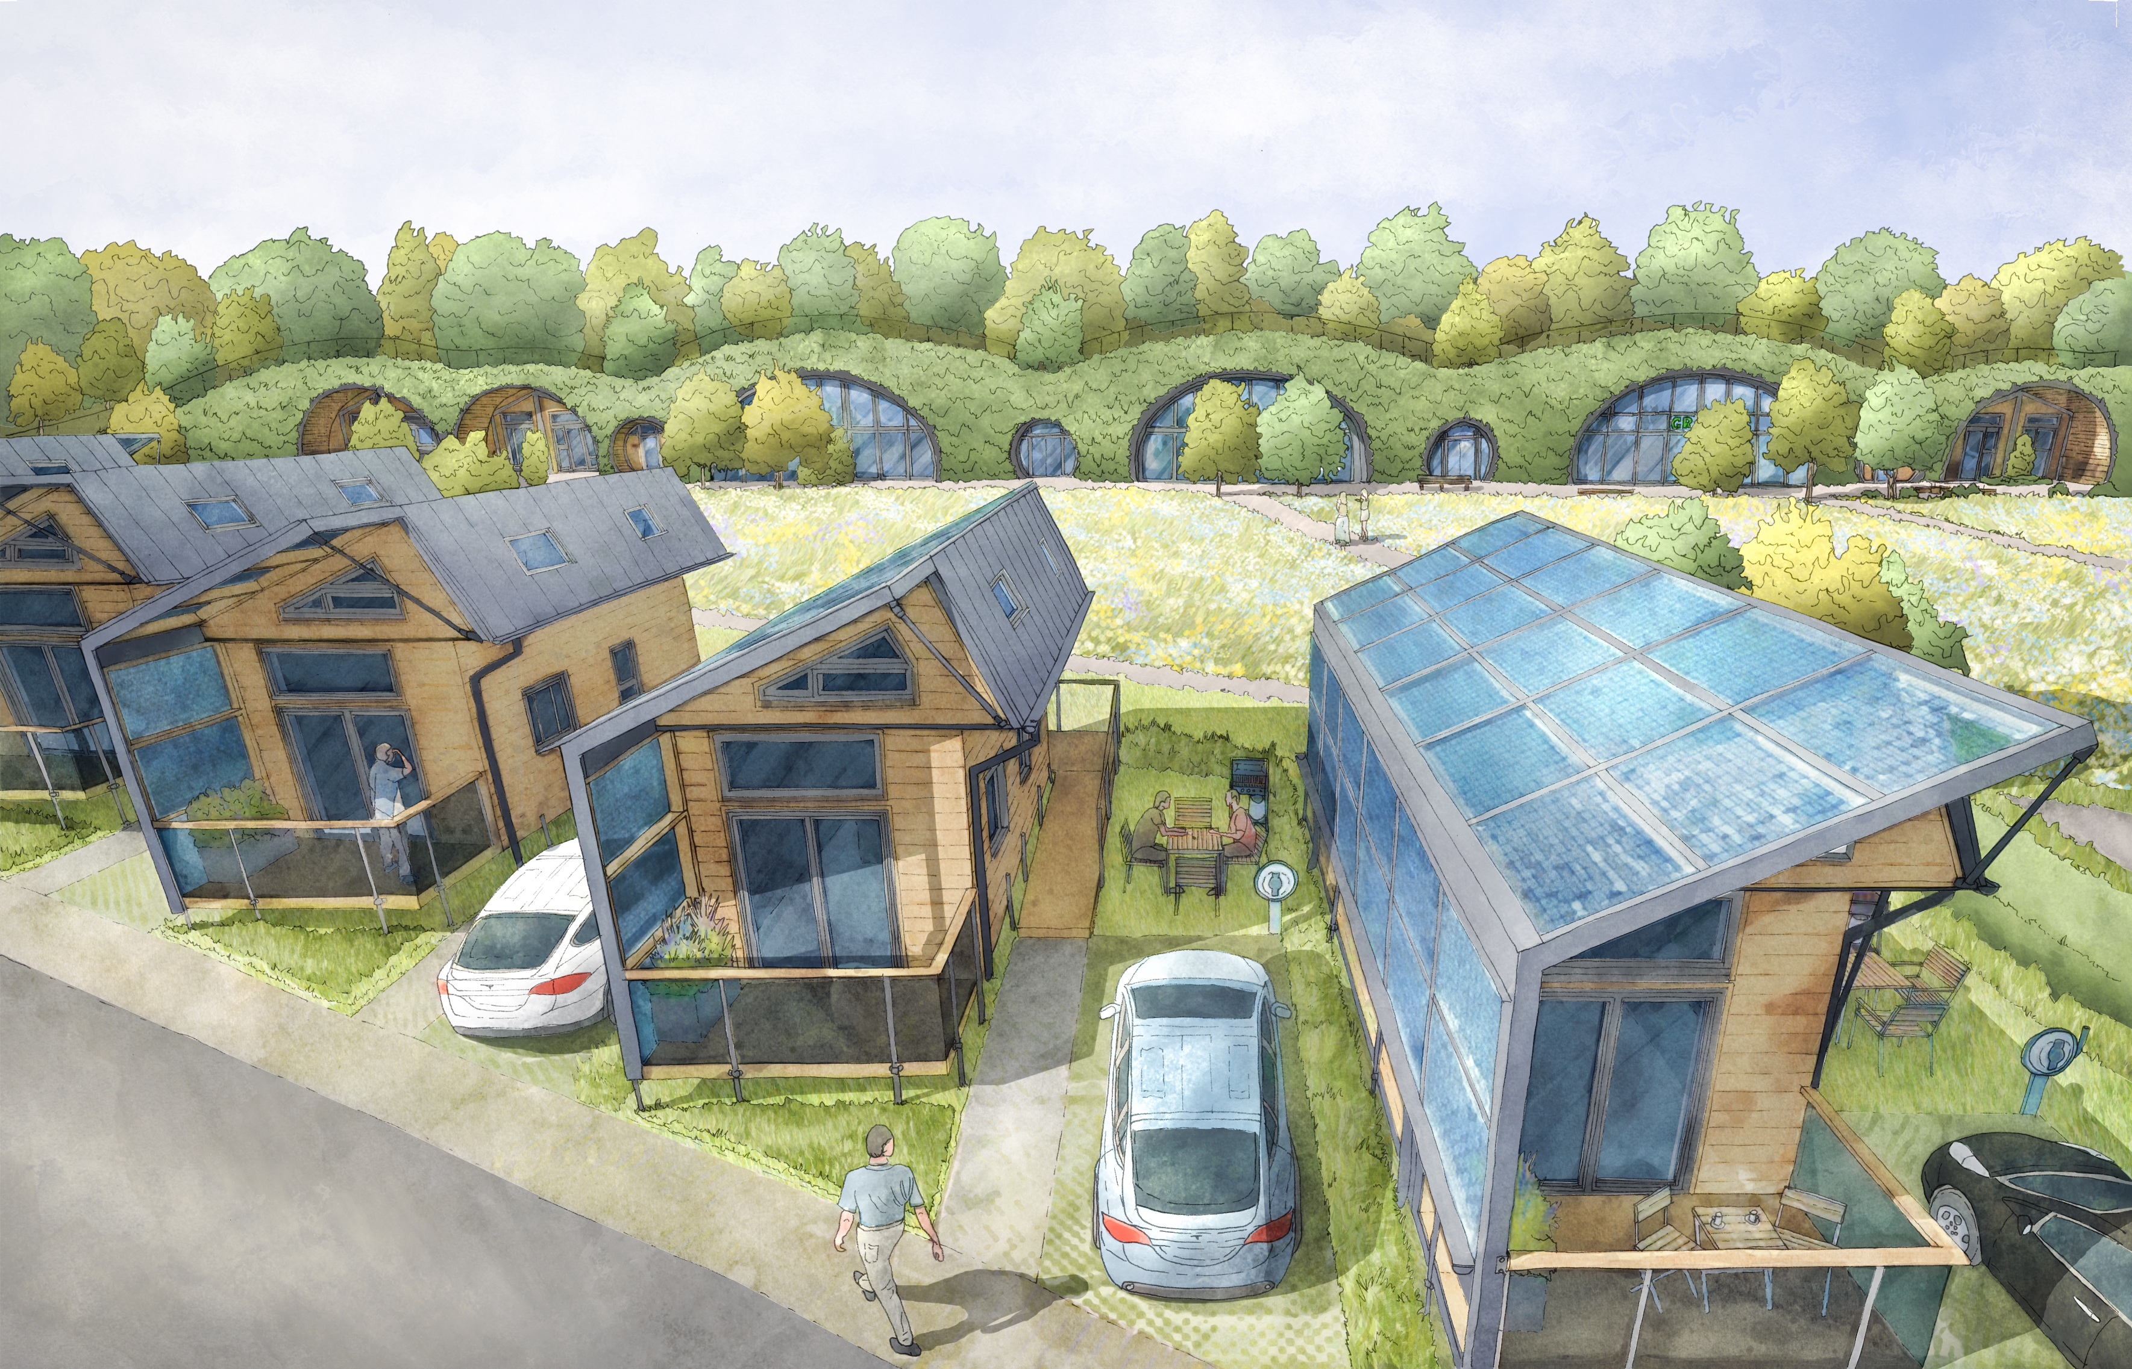
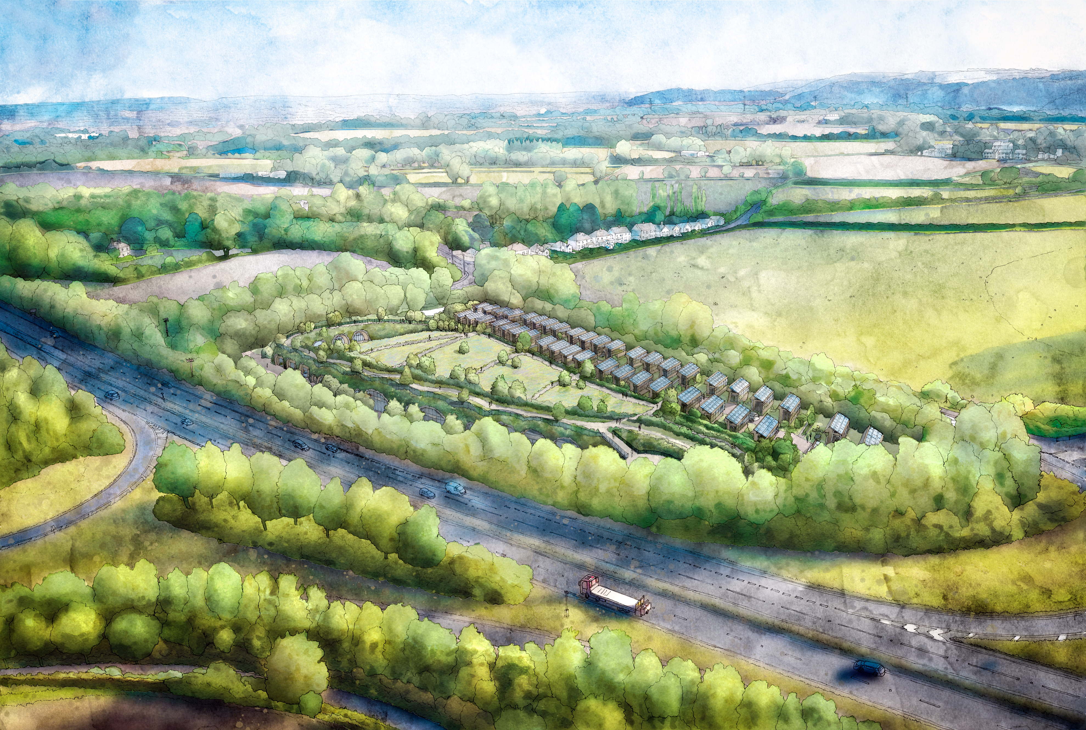


Re-charge One – Proposal

Slide 34

Re-charge One – Meeting the
Policy Test
Need for EV charging infrastructure at national, regional and local level – key plank of the case
National - 300,000 chargers by 2030, requiring 735 chargers installed per week
Regional - four-fold increase (+305%) in slow and fast chargers; seven-fold increase in rapid and ultra-rapid
Local - handful of public charging points

Slide 35
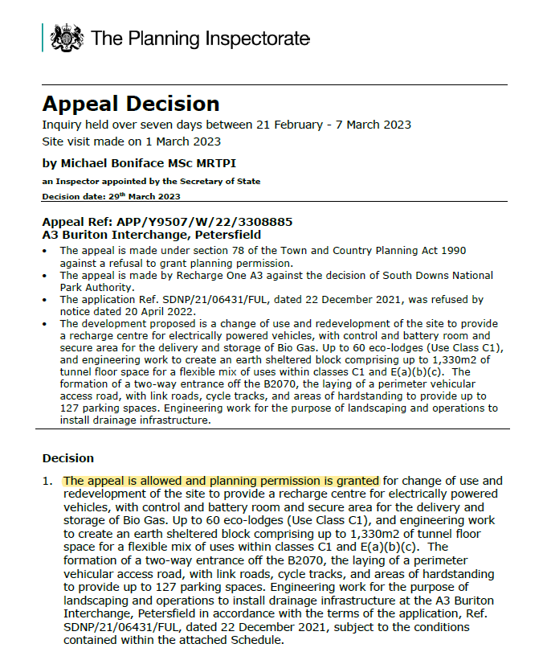
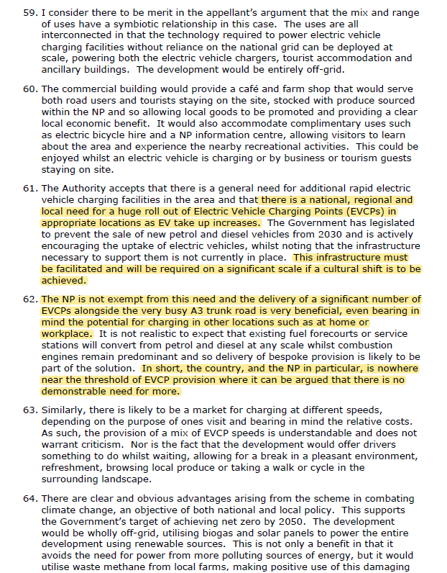
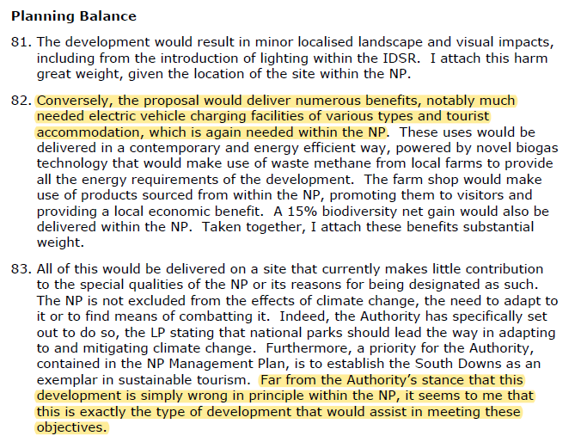
Re-charge One – Inspector’s Conclusions

Slide 36
Q & A
clerks@cornerstonebarristers.com

