Slide 1
Achieving Biodiversity Net Gain in Practice
Estelle Dehon KC, Emmaline Lambert and Josef Cannon

Slide 2

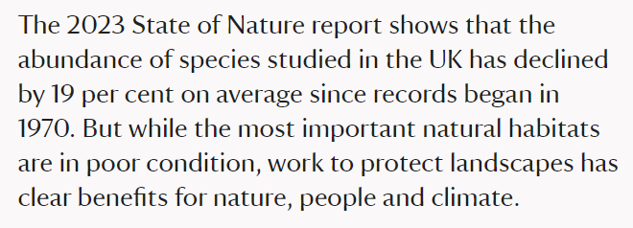
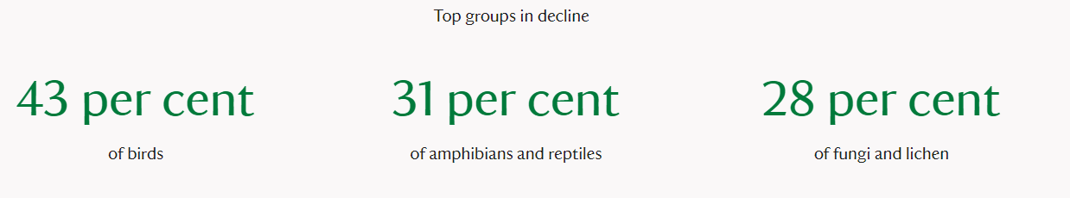
Timely webinar
https://stateofnature.org.uk/

Slide 3
Introduction to Biodiversity Net Gain
Emmaline Lambert

Slide 4
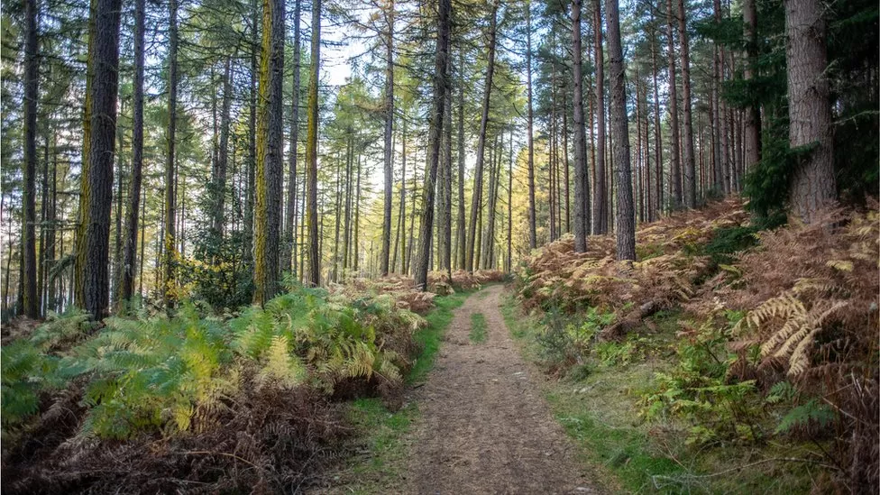

Slide 5
Current situation
Currently no minimum legal requirement for biodiversity net gain in planning;
Duty on local authorities amended so that it includes conservation and enhancement (s.40 NERC Act 2006);
Paragraph 174 of the NPPF provides that “planning policies and decisions should contribute to and enhance the natural and local environment by…(d) minimising impacts on and providing net gains for biodiversity…” and para 179 provides for “pursu[ing] opportunities for securing measurable net gains for biodiversity”
Can be interpreted to a low threshold by some inspectors in planning appeals especially where there is no local development plan policy requiring a minimum percentage (e.g.: “Paragraph 174 of the Framework simply seeks a net gain in biodiversity. It does not specify a specific percentage….A ‘net gain’, of any percentage, is all that is therefore required” APP/M2270/W/21/3273022)

Slide 6
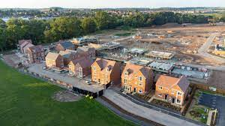
Huge biodiversity losses over recent years globally.
Urbanisation including development such as housing is a key cause of decline in biodiversity
Raft of changes proposed will require developers to consider how 10% biodiversity net gain can be provided early on in the process and the Environment Act 2021 is described by Natural England as “a significant step in setting out clear targets and direction in environmental legislation for nature recovery” and labels the mandatory BNG as “key”.

Slide 7
So what is BNG?
Natural England definition
The Environment Act 2021
“an approach to terrestrial development and/or land management that aims to leave the natural environment in a measurably better state”
Natural England – Biodiversity Net Gain – more than just a number
Schedule A, Part 1, para 2 defines the biodiversity gain objective as being met
“in relation to development for which planning permission is granted if the biodiversity value attributable to the development exceeds the pre-development biodiversity value of the onsite habitat by at least the relevant percentage”.
The relevant percentage is defined as 10% and the Act provides for the relevant percentage to be amended by regulations by the Secretary of State.

Slide 8
A requirement greater than 10% in Local Plans?
14 authorities
considering
Natural England advice
What would be needed?

Slide 9
The Environment Act 2021 BNG Framework
Amends Town & Country Planning Act (TCPA)
Minimum 10% gain required calculated using the Biodiversity Metric & approval of a biodiversity gain plan
Habitat secured for at least 30 years via planning obligations or conservation covenants
Delivered on-site, off-site or via a new statutory biodiversity credits scheme

Slide 10
“General condition of planning permission”
A new standard pre-commencement condition relating to biodiversity gain will secure BNG on developments – the “General condition of planning permission”.
It will require a “biodiversity gain plan” to be submitted for approval and Part 2 of Schedule 14 sets out the matters to which the plan is to refer.
The local planning authority must approve the plan only if it is satisfied that certain matters required are met, such as, that the post-development biodiversity value of the onsite habitat is at least the value specified in the plan and that the biodiversity gain objective is met.
The plan will set out the mechanisms for delivery, monitoring and maintenance for 30 years after the development is completed.

Slide 11
What the biodiversity gain plan should cover
How adverse impacts have been minimised
Biodiversity value of any offsite habitat provided in relation to development
Biodiversity gain plan
Pre-dev biodiversity value of onsite habitat
Any statutory biodiversity credits purchased
Post-dev biodiversity value of onsite habitat
Any further requirements (secondary legislation)

Slide 12
In line with the mitigation hierarchy, off-site mitigation should only be used where impacts cannot be avoided, minimised or where on-site gains cannot be achieved.
Off-site provision will be encouraged to be local - expected to be achieved via policies and guidance.
Further guidance expected on decision making for on-site and local off-site mitigation and in what circumstances developers would be able to look outside the local area.
In order to avoid unreasonable delays between the ecological impact and the off-site compensation being delivered, proposed that no more than 12 months should be allowed after discharge of the mandatory pre commencement condition.

Slide 13
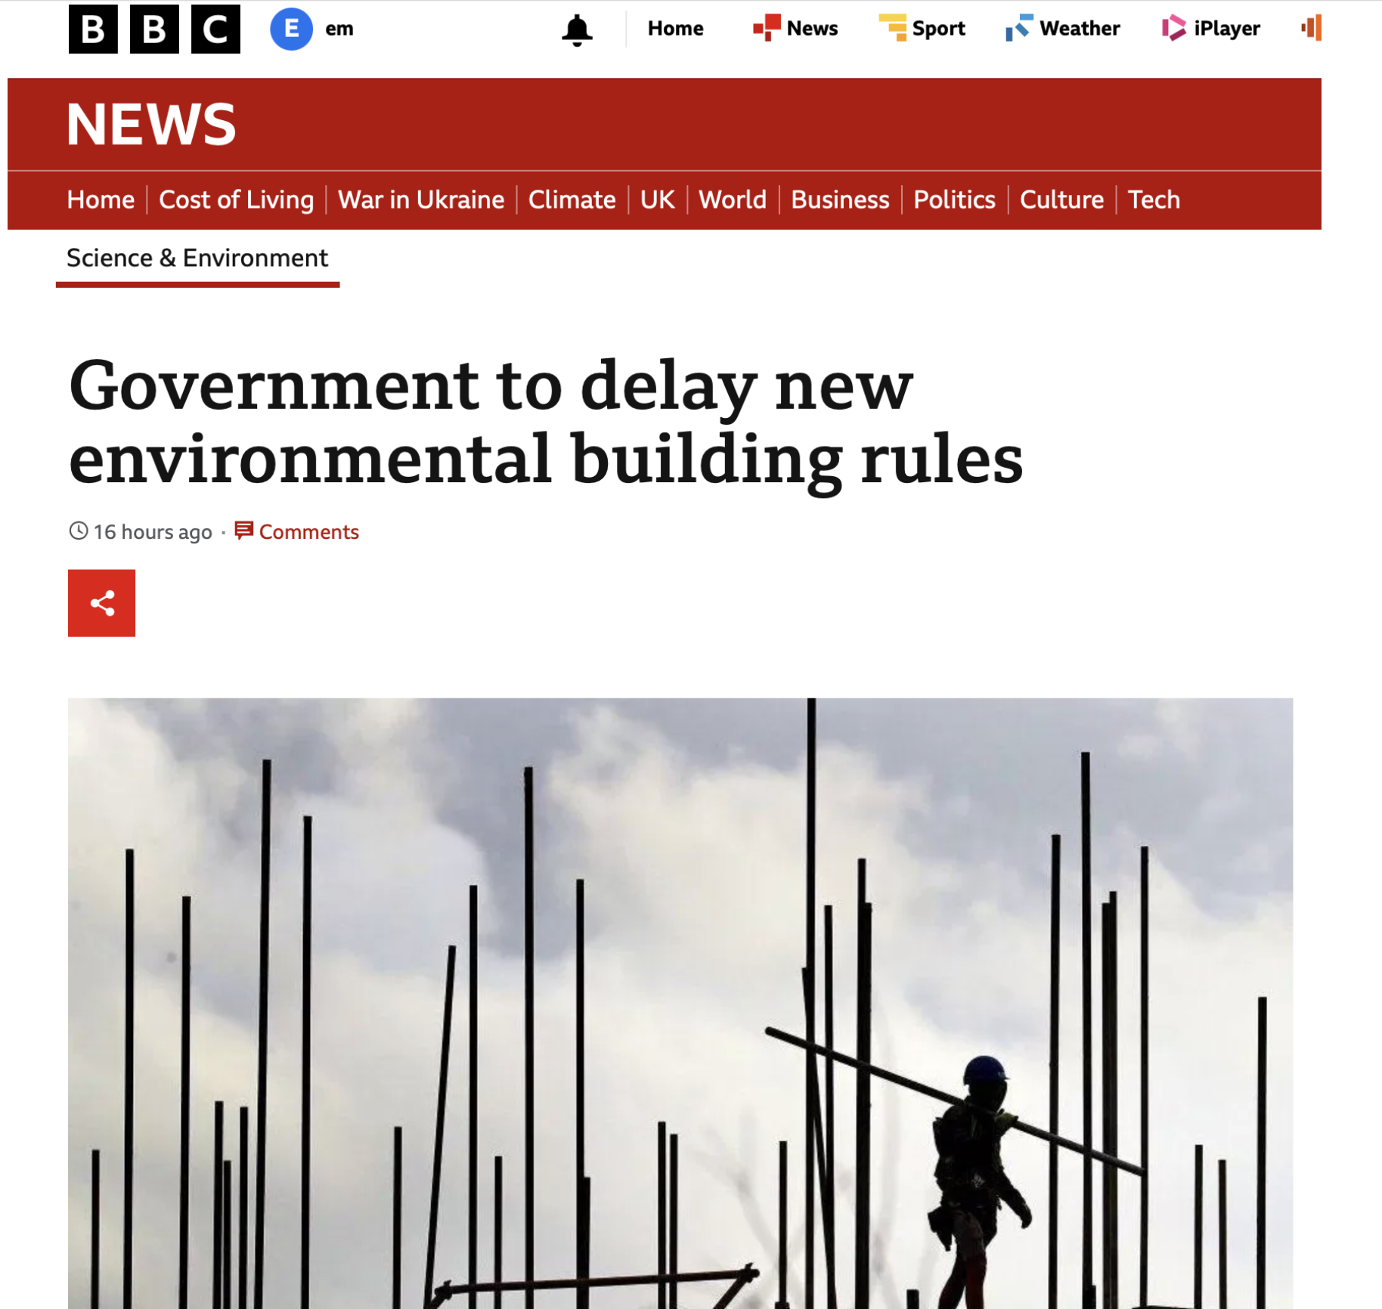
Latest news

Slide 14
Progress towards secondary legislation
DEFRA launched the Consultation on the Biodiversity Net Gain Regulations on 11th January 2022 and it closed on 5th April 2022
Its overview provided “We want to know what you think about how biodiversity net gain will work in practice”.
The government response was long awaited and was finally published in February 2023.

Slide 15
The Consultation
Part 1 focussed on defining the scope of the biodiversity net gain requirement: exemptions, development within statutory designated sites for nature conservation and the definition of irreplaceable habitats (controversially, irreplaceable habitats are excluded from the BNG calculation and views were specifically sought);
Part 2 focussed on BNG for other types of development like phased development, small sites, Nationally Significant Infrastructure Projects (NSIPs);
Part 3 covered how the BNG will be implemented and covers Biodiversity Gain Plan, off-site biodiversity gains, the market for biodiversity units, habitat banking, the BNG site register, additionality, statutory biodiversity credits, reporting, evaluation and monitoring.

Slide 16

The Response
February 2023
Updated guidance but….
Much more coming….

Slide 17

When is BNG mandatory - Updated Timetable
Announcement yesterday that the upcoming legislation to bring these rules will be laid in November
The mandatory requirement will be effective from January 2024
For small sites April 2024
For Nationally Significant Infrastructure Projects it is planned for 2025

Slide 18
Application
Exemptions
Environment Act 2021 exemptions: permitted development and urgent crown development;
Biodiversity metric (subject to its own consultation) allows for temporary impacts that can be restored within 2 years to be excluded from calculations and gives existing sealed surfaces a zero score meaning exempted.
Government intends to use regulations to make exemptions for:
development impacting habitat of an area below a ‘de minimis’ threshold of 25 metres squared (Defra confirmed in August that this is 5m x 5m), or 5m for linear habitats such as hedgerows and watercourses ;
householder applications;
biodiversity gain sites (where habitats are being enhanced for wildlife);
small scale self-build and custom housebuilding.

Slide 19
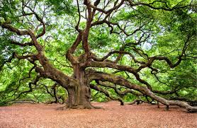
Application
Irreplaceable Habitat
Definition?
Secondary legislation will disapply the 10% net gain requirement for irreplaceable habitat and apply separate requirements to be used by the LPA when determining planning applications.

Slide 20
Application
Small Sites
Within scope
Definition:
(i) For residential: where the number of dwellings to be provided is between one and nine inclusive on a site having an area of less than one hectare, or where the number of dwellings to be provided is not known, a site area of less than 0.5 hectares.
(ii) For non-residential: where the floor space to be created is less than 1,000 square metres OR where the site area is less than one hectare.
Options being explored to reduce burden

Slide 21
Application
Outline and phased permissions
Additional information will be needed setting out how BNG to be achieved across all phases;
Prior to commencement of each phase, new biodiversity gain plan will be required
Condition requiring the same
Inflexible ‘front-loading’ to be avoided
Discretion to LPAs
Details to follow……

Slide 22
Application
Variations of planning permissions
Variations only subject to mandatory BNG requirement where original permission granted after BNG became mandatory requirement;
Guidance to be provided……

Slide 23
Application
Nationally Strategic Infrastructure Projects (NSIPs) will be expected to provide BNG
Permitted development will not
Change of use schemes will be subject to BNG

Slide 24
Calculating BNG
02
Josef Cannon

Slide 25

The Metric

Slide 26
The Metric – where it fits in
Pre-Development Biodiversity Value
Post-Development Biodiversity Value
Biodiversity Units:
- area units
- hedgerow units
- watercourse units
02 must be at least 10% better than 01

Slide 27
The Metric: a hierarchy of value
On-site improvements – highest value
Off-site and local – next best
Off-site and further away – lower value
“Credits” – last resort

Slide 28
The calculation – points to note (1)
Pre-Development Biodiversity Value

Slide 29
Pre-development biodiversity value:
Schedule 14
“Relevant date”
Application date
Earlier, by agreement
PP, if no application
30 January 2020*

Slide 30
Why 30 January 2020?
Date Bill introduced to parliament
Safeguard against intentional degradation
Where certain conditions met

Slide 31
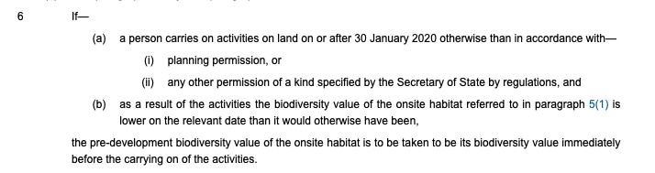
Why 30 January 2020?

Slide 32
The calculation – points to note (2)
Biodiversity Units:
- area units
- hedgerow units
- watercourse units

Slide 33
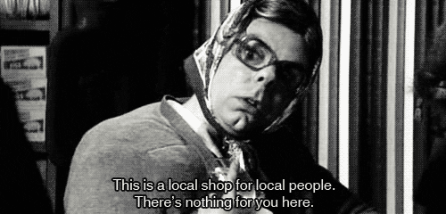
The calculation – points to note (2)

Slide 34

The hierarchy of value
The Metric assigns greater value to closer/more local measures
“Spatial Risk Multiplier”
Incentive-based approach
Is that sufficient? Local policy?

Slide 35

The hierarchy of value: unit trading
Habitat ‘Banks’ – run by LPAs?
(but cannot ‘prefer’ own land)
Sale of units above 10% BNG: ‘excess gains’ – missed opportunity?
NB Biodiversity Gain Site Register

Slide 36

The hierarchy of value: credits
Not to be confused with ‘units’
Bottom of hierarchy
Government-sold credits at higher price than any other units
Government will then deliver gains somewhere else (!)

Slide 37
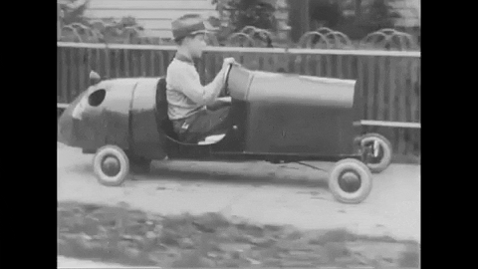
Delivery of BNG
Section 106 securing measures
Off-site areas – how secured?
Financing and monitoring
30 year period
NB register
Conservation covenants

Slide 38
Final observations
03
Estelle Dehon KC

Slide 39

Significant opportunities
Stacking
DEFRA guidance confirms the same sites can be used to provide multiple environmental benefits re land management:
BNG
Nutrient neutrality
ELMS
BUT not carbon credits

Slide 40

Significant opportunities
Strong statutory pricing
DEFRA published provisional price tiers
£42K low level habitat (market currently offering £30K)
High distinctiveness £125K
Lakes £650K
Two credits for each BNG unit
High cost of “last resort”
Not stifle a commercial market

Slide 41
What next?
Natural England update
LPA upskill
Funding
Guidance
BNG regs to go through Parliament in Nov
No further consultation
Corporate Natural Capital

Slide 42
Questions?
Estelle Dehon KC
Emmaline Lambert
Josef Cannon
clerks@cornerstonebarristers.com

