Slide 1
Public Law in the Supreme Court: Where Are We Now?
Kuljit Bhogal KC (kbhogal@cornerstonebarristers.com)
Sam Fowles (sfowles@cornerstonebarristers.com)
Alex Williams (awilliams@cornerstonebarristers.com)

Slide 2
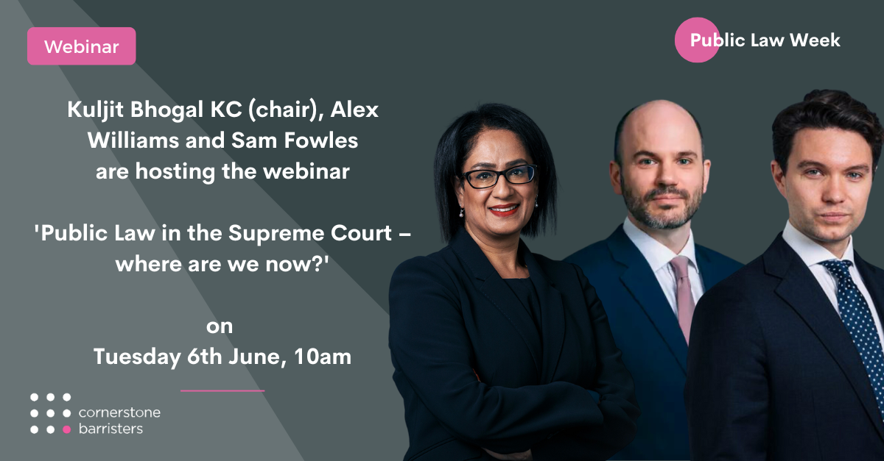

Slide 3
Overview
Several senior supreme court judges have retired in recent years: Lady Hale, Lord Carnworth, Lord Wilson and Lord Kerr.
Current president Lord Reed, replacing Lady Hale
Will look at what this means

Slide 4
A change in approach?
Diceyan realists (Hale and Bingham):
hold the executive to account
influence and relevance of international law
Diceyan traditionalists (Reed):
parliament is the ultimate arbiter, not the courts
rejects relevance of international law
courts to defer to parliament

Slide 5
The Diceyan Framework

Slide 6
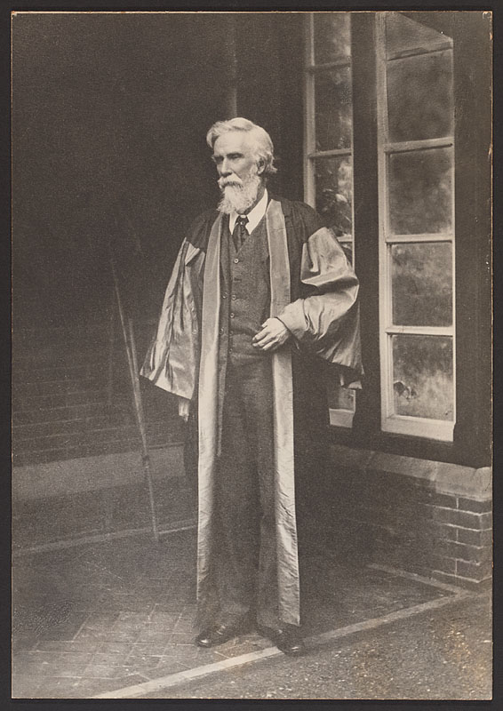
The Diceyan Framework

Slide 7
Diceyan Framework (1)
  Parliamentary sovereignty as the constitutional bedrock
  Strict separation of powers
  Textual interpretation of statutes (as distinct from more modern purposive interpretations)

Slide 8
Diceyan Framework (2)
  Rule of law – “thin” not “thick
  Equality before the law
  Dislike of administrative discretion
  Strict dualism – influence by international law only if sanctioned by Parliament

Slide 9
The HRA 1998 and the High Watermark: 3 Cases

Slide 10
(1) A v Home Secretary [2004] UKHL 56
  UK Government derogates from Art 5 ECHR (right to liberty) following 9/11 attacks
  ATCSA 2001, s.23 – detention of non-nationals suspected of terrorism who cannot be deported
  Whether Art 15 ECHR (derogation) satisfied

Slide 11
(1) A v Home Secretary [2004] UKHL 56
  SIAC says a public emergency existed, but measures were disproportionate; quashes 2001 derogation order and grants a DOI against s.23
  Court of Appeal allows SOS’s appeal
  HL – overturns CA; restores SIAC

Slide 12
(1) A v Home Secretary [2004] UKHL 56
  Lord Bingham:
    Great weight to Govt and Parliament on the question of public emergency (§29)
    Re strict necessity, the degree of deference “conditioned by the nature of the decision” (§39)
    Deference does not preclude a review of proportionality here (§42), esp. given liberty (§44)

Slide 13
(1) A v Home Secretary [2004] UKHL 56
  Baroness Hale:
    Agrees with Lord Bingham et al (§219)
    Only courts can decide when/for how long to detain (§222)
    Democracy/majoritarian rule cannot prevail if inconsistent with equal rights (§237)

Slide 14
(1) A v Home Secretary [2004] UKHL 56
  Headline points:
    Robust protection of individual liberty, even in the face of clear legislation
    Robust analysis of proportionality of Govt measures, despite national security context
    Robust application of international law, not simply the ECHR but other international treaties

Slide 15
(2) Ex p Ullah [2004] UKHL 26
  Asylum applications of non-nationals rejected
  Whether deportation to countries with risk of religious persecution breaches Art 9
  What it means to “take into account” Strasbourg cases

Slide 16
(2) Ex p Ullah [2004] UKHL 26
  Lord Bingham (§20); Baroness Hale concurs
    Only the Strasbourg Court can correctly interpret the ECHR as an international instrument
    National courts shouldn’t therefore dilute/weaken the effect of Strasbourg case-law
    Duty of national courts is to keep pace with Strasbourg: “no more, but certainly no less”

Slide 17
(2) Ex p Ullah [2004] UKHL 26
  Headline points:
    Strong appreciation of the importance of ECHR and authority of Strasbourg Court
    Subsidiary role for domestic courts on ECHR matters (“meaning should be uniform” in Europe)
    Reading-up of s.2 discretion (“take into account”) into something closely resembling a duty to follow

Slide 18
(3) YL v Birmingham CC [2007] UKHL 27
  Provision/termination of residential care services by private provider on BCC’s behalf
  Whether a “function of a public nature” under s.6(3)(b) HRA so as to engage ECHR duties
  By bare majority – HL says not

Slide 19
(3) YL v Birmingham CC [2007] UKHL 27
  Lord Bingham (dissenting):
    The answer is clear (§2).
    No “test”, but s.6 deserves a wide reading as a measure intended to give effect to ECHR (§4).
    Parliament would not have intended to leave residents of care homes unprotected (§19).

Slide 20
(3) YL v Birmingham CC [2007] UKHL 27
  Baroness Hale (dissenting):
    White Paper – Govt wanted domestic remedies if UK responsible in Strasbourg (§55).
    Various relevant factors (§§66-72) including whether state has assumed responsibility, and public funding
    Close connection between this service and the ECHR’s core values, plus risk of violation (§71)

Slide 21
(3) YL v Birmingham CC [2007] UKHL 27
  Majority position:
    Private arrangement for the payment of a commercial fee (§§27, Lord Scott).
    No contracting-out (§147, Lord Neuberger)
    Arbitrary to give enhanced protection to contracted-out residents; for Parliament to widen ECHR protection to private providers (§151 and §171, Lord Neuberger)

Slide 22
(3) YL v Birmingham CC [2007] UKHL 27
  Headline points:
    Majority – driven by technical legal position (contract) and commercial setting; keen not to disadvantage privately-funded users or trespass into political decision-making
    Bingham/Hale – approach driven by the position of the individual, and need for protection; relies more heavily on ECHR values/duties

Slide 23
The Reed Court and the Return of Traditionalism

Slide 24
The Reed Court
  Refused 80% of human rights claims (Hale court 60%)
  Public bodies twice as likely to win than lose (Hale court closer to even chance)

Slide 25
3 Key Changes
  Increased deference to the executive/public bodies.
  Courts no longer seen as the ultimate arbiter of rights.
  International standards (including human rights) less relevant.

Slide 26
3 Case Studies
  R (Begum) v Special Immigration Appeals Commision [2021] AC 765 (“Begum”)
  R (Friends of the Earth) v Secretary of State for Transport [2021] PTSR 190 (“FoTE”)
  R (SC) v Secretary of State for Work and Pensions [2022] AC 223 (“SC”)

Slide 27
Begum
  Shamima Begum – radicalised/groomed as a child and ran away/trafficked to join ISIS
  British nationality terminated – s. 40 British Nationality Act 1981
  Refused leave to enter the UK to contest the decision.
  Challenge failed before SIAC but succeeded in the Court of Appeal.

Slide 28
FoTE
  Third runway at Heathrow
  Challenge to the Airports National Policy Statement
  Section 5 of the Planning Act 2008 – SOS required to explain how she had taken “government policy” into account.
  Challenge – failed to take emissions commitments under Paris Climate Agreement 2015 into account.
  Succeeded in Court of Appeal

Slide 29
SC
  Two child limit for tax credits
  Discriminated against women – Engaged Art. 14 ECHR
  Was the discrimination permissible?
  What standard should be applied?
  Claimants had lost case at every level.

Slide 30
Deference to the Executive
  Begum - Case concerned “national security” so court must defer to executive throughout (not just on national security assessment).
  FoTE – Narrowed definition of “government policy” – essentially “legitimate expectations”.
  SC – “Manifestly without reasonable foundation” test.

Slide 31
Deference to the Executive
Lord Reed in SC
In practice, challenges to legislation on the ground of discrimination have become increasingly common in the United Kingdom. They are usually brought by campaigning organisations which lobbied unsuccessfully against the measure when it was being considered in Parliament, and then act as solicitors for persons affected by the legislation, or otherwise support legal challenges brought in their names, as a means of continuing their campaign. The favoured ground of challenge is usually article 14, because it is so easy to establish differential treatment of some category of persons, especially if the concept of indirect discrimination is given a wide scope.

Slide 32
Parliament as Guardian of Constitution/Rights
Lord Hope – Jackson v Attorney General [2005] UKHL 56
It must never be forgotten that this rule [of recognition]... depends upon the legislature maintaining the trust of the electorate. In a democracy the need of the elected members to maintain this trust is a vitally important safeguard. The principle of parliamentary sovereignty... is built upon the assumption that Parliament represents the people whom it exists to serve.

Slide 33
Parliament as Guardian of Constitution/Rights
Lady Hale – Ghaidan v Godin Mendoza [2004] 2 AC 577
Such a guarantee of equal treatment is also essential to democracy. Democracy is founded on the principle that each individual has equal value. Treating some as automatically having less value than others not only causes pain and distress to that person but also violates his or her dignity as a human being. The essence of the Convention, as has often been said, is respect for human dignity and human freedom: see Pretty v United Kingdom (2002) 35 EHRR 1 , 37, para 65. Second, such treatment is damaging to society as a whole. Wrongly to assume that some people have talent and others do not is a huge waste of human resources. It also damages social cohesion, creating not only an under-class, but an under-class with a rational grievance. Third, it is the reverse of the rational behaviour we now expect of government and the state. Power must not be exercised arbitrarily. If distinctions are to be drawn, particularly upon a group basis, it is an important discipline to look for a rational basis for those distinctions. Finally, it is a purpose of all human rights instruments to secure the protection of the essential rights of members of minority groups, even when they are unpopular with the majority. Democracy values everyone equally even if the majority does not.

Slide 34
Parliament as Guardian of Constitution/Rights
  Begum - Accepted concerned fundamental rights but applied reasonableness not proportionality standard (contrary to Pham v Home Secretary [2015] 1 WLR 1591 and UNISON v Lord Chancellor [2017] UKSC 51]
  FoTE – Adopting executive perspective.
  SC – Fundamental rights and the separation of powers itself is in the gift of Parliament.

Slide 35
Parliament as the Guardian of Constitution/Rights
Lord Reed in SC
Since the principle of proportionality confers on the courts a very broad discretionary power, such cases present a risk of undue interference by the courts in the sphere of political choices. That risk can only be avoided if the courts apply the principle in a manner which respects the boundaries between legality and the political process. As Judges Pejchal and Wojtyczek commented, at para 10:
“Judicial independence is accepted only if the judiciary refrains from interfering with political processes. If the judicial power is to be independent, the judicial and political spheres have to remain separated.”

Slide 36
Reduced relevance of international standards
  Begum – Customary international law standards not taken into account.
  FoTE – The executive’s agreement to be bound by international law is not “government policy”
  SC – Compliance with UN Convention on the Rights of the Child not even relevant to the interpretation of domestic/human rights law.

Slide 37
Significance
  Greater deference to discretion
  Less tolerance for “public interest” claims
  Fundamental rights not seen as “trumps”
  Housing/benefits cases – UNCRC etc not relevant to interpretation
  Planning cases – Climate change commitments unlikely to be relevant (for now!)

Slide 38
What does this mean for public law decision making?

Slide 39
Public interest groups
Background documents
Relevance of international law
Standard of review in areas of social and economic policy: ‘manifestly without reasonable foundation’
Does MWRF insulate the decision maker from effective review?

Slide 40
Questions?

