Slide 1
Duty of Candour and its Impact
Andy Lane and Matt Lewin

Slide 2


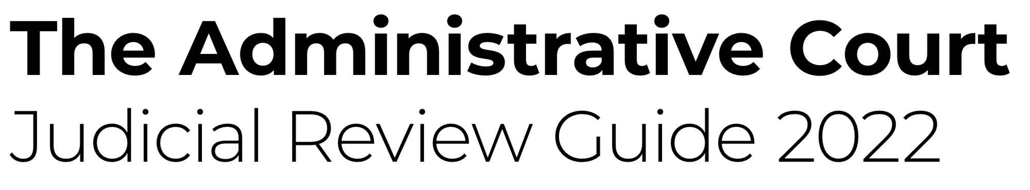
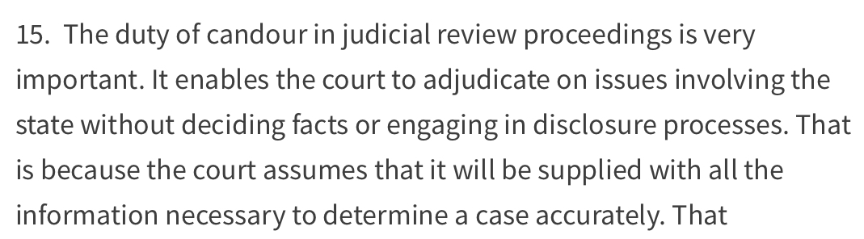
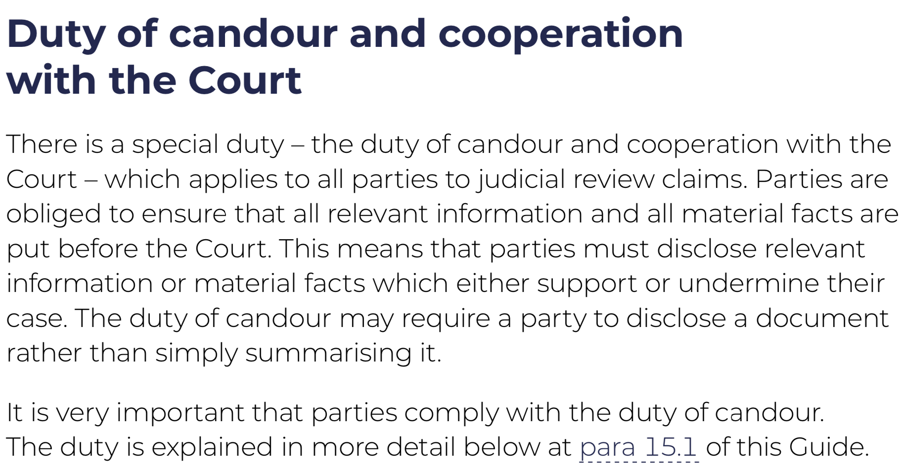
AGENDA
What is the duty of candour?
When does it apply/how is it satisfied?
Impact of breach of duty on case.
Practice points.
R (HM, MA & KH) v SSHD [2022] EWHC 2729 (Admin) – Edis LJ

Slide 3
What is the duty of candour?

Slide 4
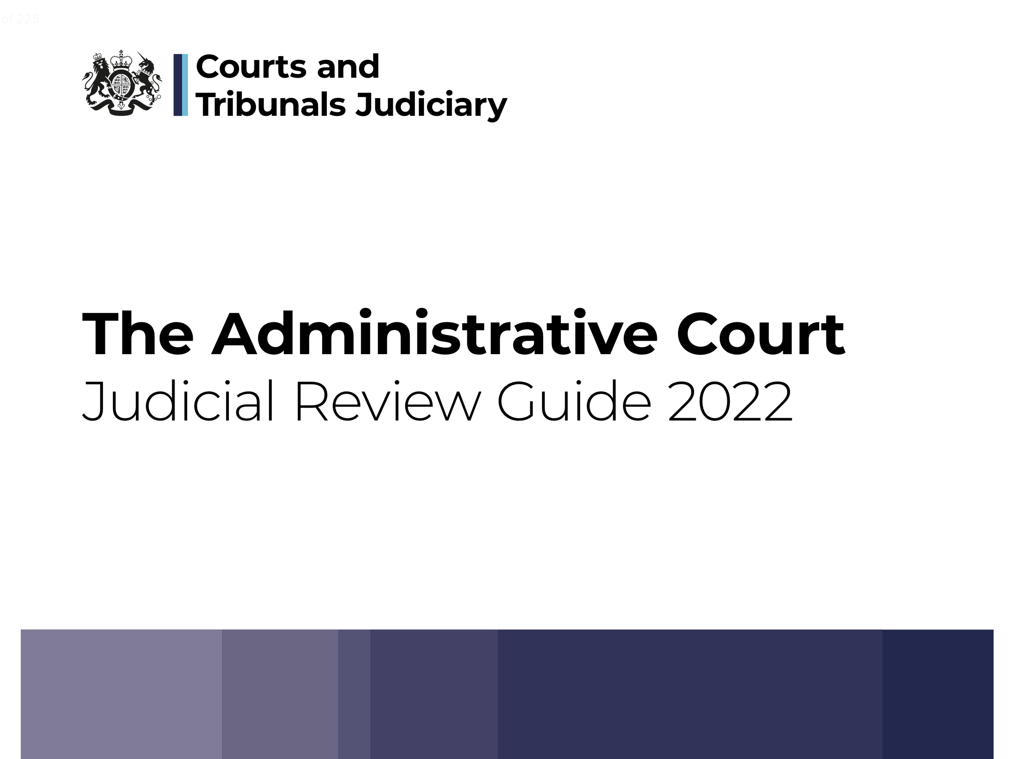
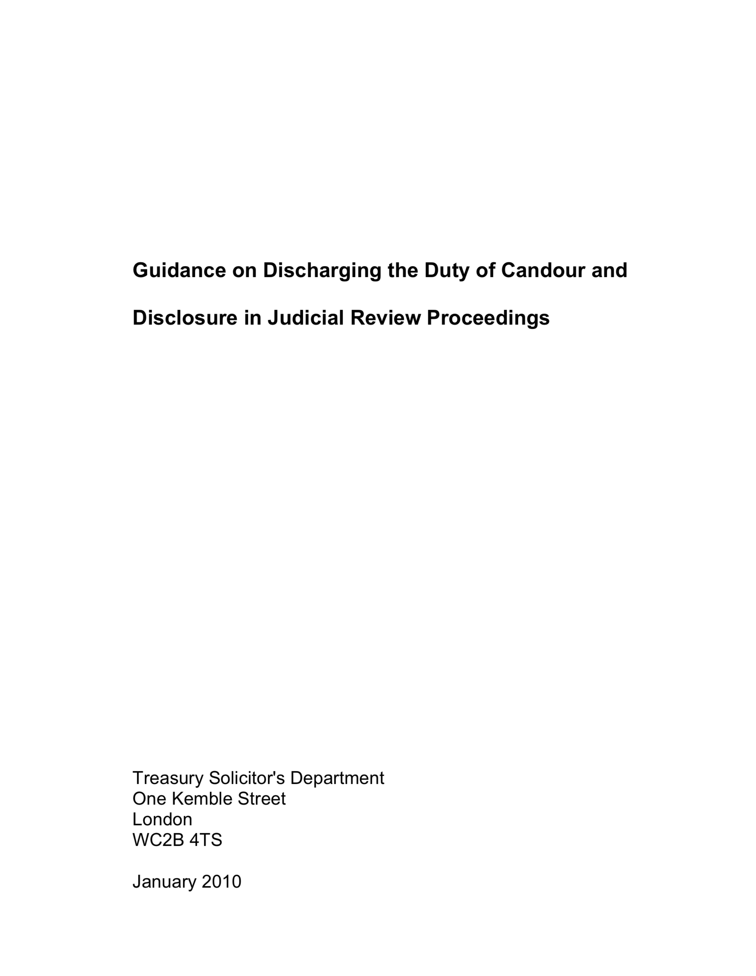
Duty of candour Judicial Review
CPR 54A PD 10.1 – disclosure not required in JR claims unless court order
Article 6 influence - R (Belhaj and another) v DPP (No 2) [2018] 1 WLR 3602 at 39
More important when less opportunity for response – e.g. urgent applications
Self policing – obligations on solicitors/barristers
All relevant material/facts to be before the court
Relevant adverse case-law, alternative remedy etc
Whether it supports or undermines the case
Continuing duty – pre litigation included
See Treasury Solicitor’s Department’s Guidance (2010)
See section 15 of JR Guide 2022

Slide 5
Civil Procedure Rules
CPR Part 54
Evidence
54.16
(1) Rule 8.6 (1) does not apply.
(2) No written evidence may be relied on unless –
(a) it has been served in accordance with any –
(i) rule under this Section; or
(ii) direction of the court; or
(b) the court gives permission.
8.6
(1) No written evidence may be relied on at the hearing of the claim unless –
(a) it has been served in accordance with rule 8.5; or
(b) the court gives permission.
PD 54A
10.1 In accordance with the duty of candour, the defendant should, in its Detailed Grounds or evidence, identify any relevant facts, and the reasoning, underlying the measure in respect of which permission to apply for judicial review has been granted.
10.2 Disclosure is not required unless the court orders otherwise.
10.3 It will rarely be necessary in judicial review proceedings for the court to hear oral evidence. Any application under rule 8.6(2) for permission to adduce oral evidence or to cross-examine any witness must be made promptly, in accordance with the requirements of Part 23, and be supported by an explanation of why the evidence is necessary for the fair determination of the claim.

Slide 6
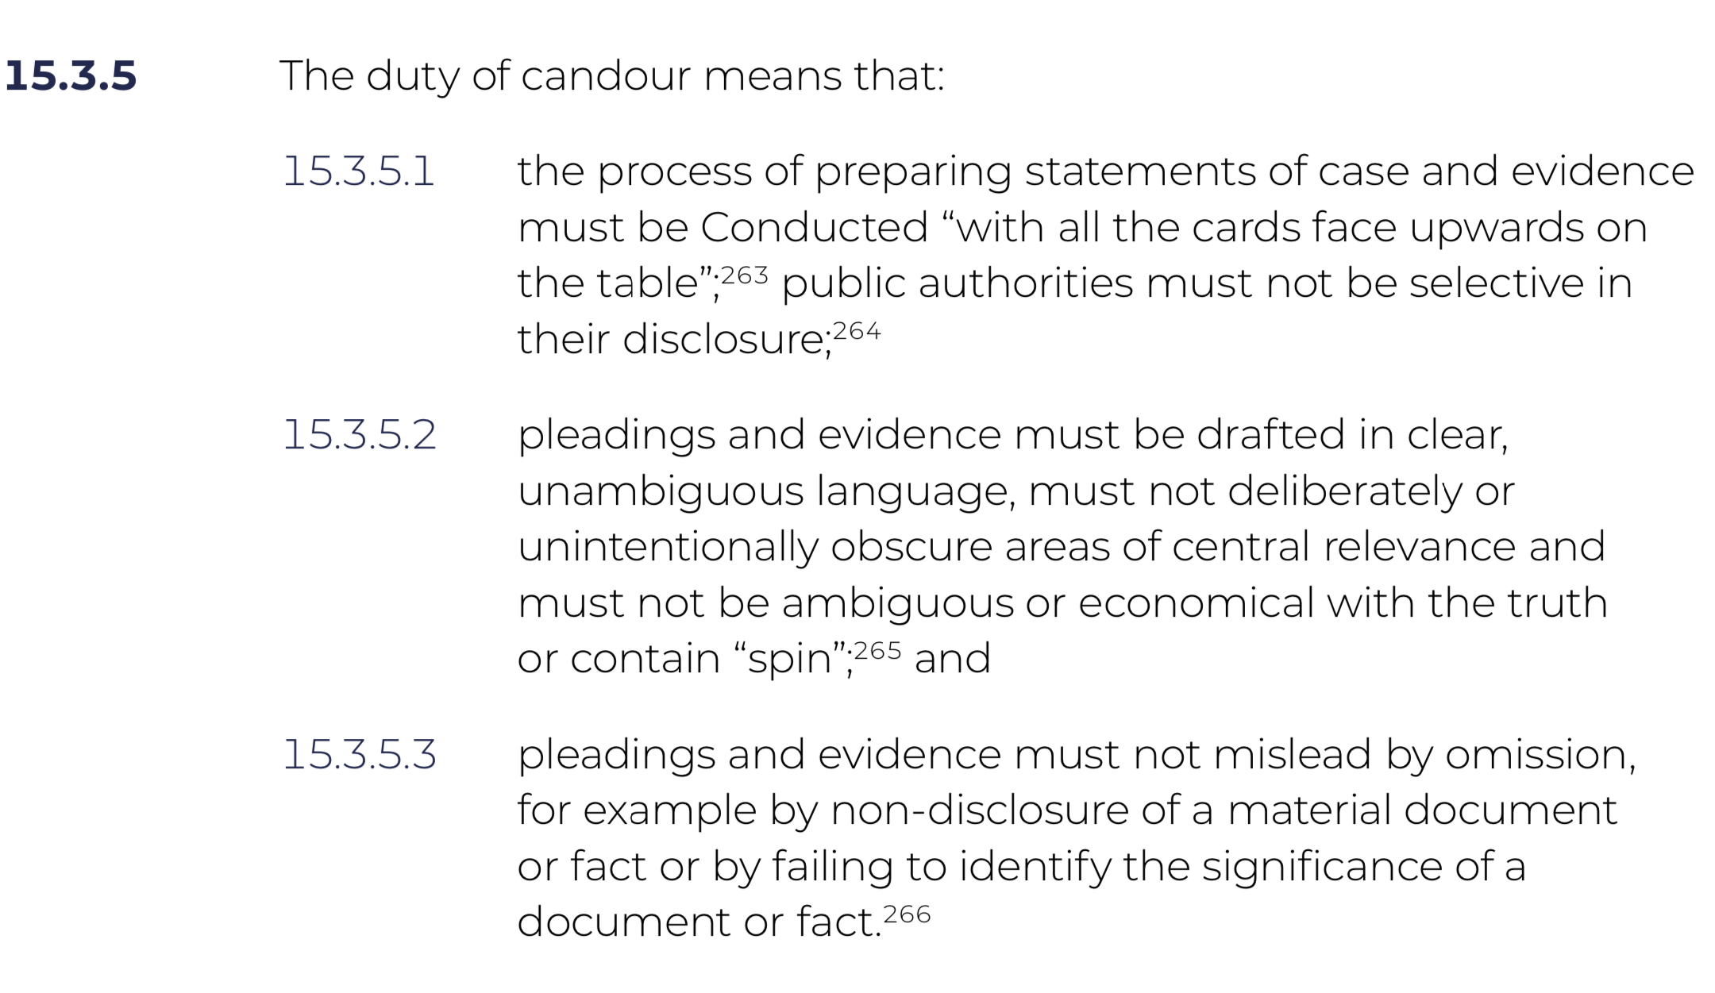
Administrative Court Judicial Review Guide 2022

Slide 7
R (Belhaj and another) v Director of Public Prosecutions (No 2) [2018] EWHC 513 (Admin); [2018] 1 W.L.R. 3602
The duty of candour is an important common law duty and, classically, includes the duty to approach the court with “its cards face up on the table”: R v Lancashire County Council, Ex p Huddleston [1986] 2 All ER 941 , 945. The duty applies not only to documents in the possession of the state but also to information known to it. In R (Quark Fishing Ltd) v Secretary of State for Foreign and Commonwealth Affairs [2002] EWCA Civ1409 the court was concerned with what appeared to it to be a reluctance on the part of the defendant to give full sight of the reasons which motivated the decision being challenged. At para 50 Laws LJ observed:
“there is no duty of general disclosure in judicial review proceedings. However there is—of course—a very high duty on public authority respondents, not least central government, to assist the court with full and accurate explanations of all the facts relevant to the issue the court must decide. The real question here is whether in the evidence put forward on his behalf the Secretary of State has given a true and comprehensive account of the way the relevant decisions in the case were arrived at. If the court has not been given a true and comprehensive account, but has had to tease the truth out of late discovery, it may be appropriate to draw inferences against the Secretary of State upon points which remain obscure: see Padfield v Minister of Agriculture, Fisheries and Food [1968] AC 997 , per Lord Upjohn at pp 1061G–1062A.”

Slide 8
Example application – Age Assessment R (BG) v LB Hackney [2022] UKUT 338 (IAC)
(1) The duty of candour which applies in judicial review proceedings obliges the parties to disclose all material facts, including those which are or appear to be adverse to his case.
(2) That duty also obliges the parties to make reasonable enquiries to identify such facts, so as to ensure that the judge dealing with the application has the full picture.
(3) In practice, the duty of candour obliges an applicant's legal representatives in Age Assessment Judicial Review proceedings to:
(i) Ascertain what social media and other methods of communication are used by the applicant;
(ii) Consider the relevant accounts with a view to ascertaining whether they contain any material which potentially undermines the applicant's case; and
(iii) Disclose any material which might be relevant to the case, including any material adverse to the applicant.
(4) The duty is a self-policing one, but the Upper Tribunal might legitimately require a 'disclosure statement' from an applicant's solicitor, confirming that the applicant has disclosed to them the details of any social media accounts that they hold and that the solicitor in question has undertaken a reasonable and proportionate search of those accounts in order to ensure that all documents relevant to the issues in the case have been disclosed.

Slide 9
Example breach – removal from the UK R (Khan) v SSHD [2008] EWHC 1367 (Admin)
“10.So, contrary to the impression given by the grounds submitted on his behalf, first, the claimant's presence here is, and has since his arrival in or before June 1999 been, in defiance of a still extant deportation order. Second, his return and his application to remain here as the spouse of a refugee came hard upon the heels of his wife's securing indefinite leave to remain in proceedings in which she had asserted that the claimant had deserted her, creating more than a whiff at least of opportunism and possibly of collusion. Third, the claimant's contention that any application for entry clearance will now founder on his wife's inability to support him since he is the breadwinner is incompatible with his assertion that he is not working since he has no permission to do so.
11.In this light, it seems to me that the picture painted by the grounds of the claimant simply arriving in the United Kingdom in mid-1999 and seeking permission to join his wife who, with their children, had shortly before been granted political asylum here involves such a suppression of the truth as to amount to a falsehood. In so finding, I am not for the present allocating blame between the claimant and his lawyers, save in order to exonerate Miss Akinbolu who has represented him today and has come late into the case. She has conducted the claimant's case with candour and skill.
12.The Home Office, by Mr Manknell, having given notice of its intention to do so, seeks to set aside the grant of permission pursuant to the liberty given by Collins J. I am not deciding, since I do not need to decide, whether Collins J would have granted permission had he known the true facts as he would have done had the Home Office filed its acknowledgment of service, though I very much doubt whether he would. What I do hold is that there has been a want of candour and of disclosure of material documents and facts sufficient by itself to vitiate the grant of permission. As put in Mr Fordham's Judicial Review Handbook, paragraph 10.3:
"Judicial review claimants have always been under an important duty to make full and frank disclosure to the court of all material facts and any procedural hurdles (eg, ouster, alternative remedy, delay) . . . Claimant candour remains a necessary virtue, both at the outset and in alerting the court as to any key development as the case proceeds."
The counterpart is of course a duty on defendants which is at least as high.”
Sedley LJ

Slide 10
Extent of Duty All parties
Defendants
“[there is] a very high duty on public authority respondents, not least central government, to assist the court with full and accurate explanations of all the facts relevant to the issue the court must decide.”
[R (Quark) v SSFCA [2002] EWCA Civ 1409 at para. 50 per Laws LJ]
Claimants
“It is essential that those who bring judicial review proceedings appreciate that there is a duty of candour. That means that they must put before the judge all relevant material, and in particular any material which may be adverse, or may appear to be adverse. They must not leave the situation that the judge does not have the full picture in order to make the relevant decision.”
[R (I) v SSHD [2007] EWHC 3103 (Admin) at para. 8 per Collins J]
Interested parties
“In this case that duty certainly rested on the first respondent, the Department of the Environment of Belize ("the DoE")…But for present purposes its most important consequence is that BECOL was also, in my opinion, under a duty to make candid disclosure to the court.”
[Belize Alliance if Conservation NGOs v DoE [2004] UKPC 6 at para. 87 per Lord Hoffman]

Slide 11
Means of compliance Disclosure generally minimum requirement
Summarise information/document
Disclosure
Explain significance
(In statement of case)
R(Lawer) v Restormel BC [2007] EWHC 2299 (Admin); [2008] HLR 20

Slide 12
R v SSHD, Ex parte Brown The Times, 6 February 1984
“It was highly desirable for counsel and solicitors instructed by an applicant for judicial review to give further careful consideration to the merits of the application once they had received notice of the respondent's evidence, even though leave to move for judicial review had already been obtained. If that were done, much time, expense and disappointment involved in the hearing of hopeless applications would be saved.”
Hodgson J

Slide 13
When does it apply and how is it satisfied?

Slide 14
Duty of candour: when does it apply?
Pre-action protocol letter
Continuing duty
“… as soon as the department is aware that someone is likely to test a decision or action affecting them”
Until conclusion of proceedings
Earlier, if controversial

Slide 15
Duty of candour: how is it satisfied?
Solicitor with conduct
Counsel
A team effort
Client department

Slide 16
Duty of candour: how is it satisfied?
Decisions to disclose/not disclose
Search locations
Keeping a record
Presentation of documents
Searches

Slide 17
Impact of breach of duty

Slide 18
Impact on case Judicial Review
Case Management – e.g. disclosure; stay; indemnity costs
Adverse inferences of fact – R (Das) v SSHD [2014] 1 WLR 3358 at 80:
Miss Anderson submitted that there is no obligation to file witness evidence in relation to whether or not there is an entitlement to compensatory or nominal damages, and that question is a matter for the court to assess. She also urged the court not to punish the Secretary of State for not filing evidence, and referred to the scarcity of resources, the heavy litigation burden on the Secretary of State, and the need to prioritise resources on those currently detained. The latter submission may reflect the position in which this part of the public service finds itself, but it was not and could not have been an invitation to the court to give the Secretary of State a privileged position in litigation. There is equally no question of the court punishing the Secretary of State or treating her less favourably than other litigants. The judge stated the correct position clearly. He observed (at [21]) that:
"Where a Secretary of State fails to put before the court witness statements to explain the decision-making process and the reasoning underlying a decision they take a substantial risk". In general litigation where a party elects not to call available witnesses to give evidence on a relevant matter, the court may draw inferences of fact against that party …. The basis for drawing adverse inferences of fact against the Secretary of State in judicial review proceedings will be particularly strong, because in such proceedings the Secretary of State is subject to the stringent and well-known obligation owed to the court by a public authority facing a challenge to its decision, [in the words of Lord Walker of Gestingthorpe in Belize Alliance of Conservation Non-Governmental Organisations v Department of the Environment [2004] UKPC 6 at [86])] 'to co-operate and to make candid disclosure by way of affidavit, of the relevant facts and (so far as they are not apparent from contemporaneous documents which have been disclosed) the reasoning behind the decision challenged in the judicial review proceedings. …“
Beatson LJ

Slide 19
Breach of duty Judicial Review
Permission refused:
“To fail to produce that sort of material will readily be regarded by the court as a failure to comply with the duty of candour. I make it clear that there is ample authority which indicates that the court is entitled to, and will in certain cases, refuse permission purely on the basis of such a breach. Whether or not there might be an arguable claim, a failure to act in accordance with the view to give candour can result in a refusal of permission.”
[R(I) v SSHD [2007] EWHC 3103 (Admin) at para. 10 per Collins J]
Permission set aside – R (Khan) v SSHD [2008] EWHC 1367 (Admin)
Discharge of injunction – R (MS, a child) v SSHD [2010] EWHC 2400 (Admin)
Referral to SRA/BSB – R (Sathivel) v SSHD [2018] 4 WLR 89
Costs including wasted costs – R v SSHD (ex p Shahina Begum) [1995] COD 176

Slide 20
Practice points

Slide 21
Duty of candour: practice points
Assumption that duty has been discharged
Disclosure statements
Practice points
Positive evidence required to rebut
Openness and unreserved apologies

Slide 22
Duty of candour Reading list
HM v Secretary of State for the Home Department [2022] EWHC 2729 (Admin)
“The duty of candour continues to apply throughout the proceedings. For example, if after the service of evidence, further relevant information comes to light, that information must be disclosed to the other parties to the proceedings and put before the Court at the earliest possible opportunity.”
R (Soilleux) v South Cambridgeshire DC [2023] EWHC 204 (Admin)
“It is also relevant that the local authority appears in these proceedings, with a duty of candour, and if there were material in the possession of the local authority to support the conclusion that it had been "materially misled" by what Castlefield said, I would expect it to be brought to the Court's attention.
R (Gardner) v Secretary of State for Health and Social Care [2021] EWHC 2422 (Admin)
“At this stage, however, it has not been demonstrated that the defendants' witness statements serve to obscure areas of central relevance, and the criticism made pre-supposes an obligation to provide disclosure of documentation akin to a contested trial on the evidence, rather than a judicial review.”

Slide 23

Questions

Slide 24
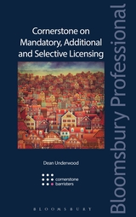
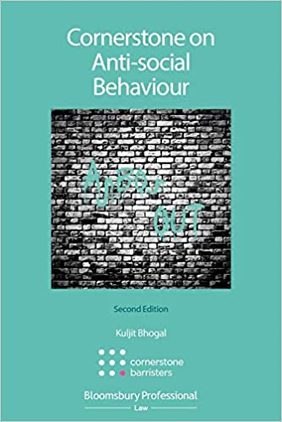
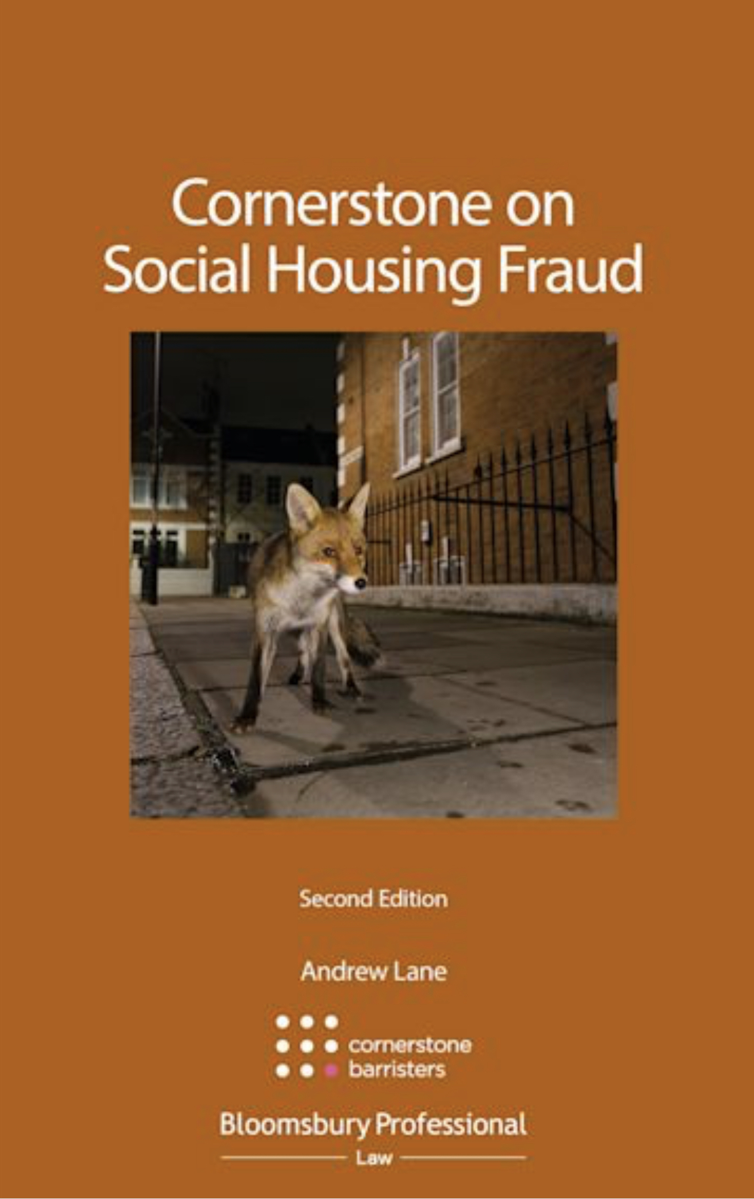
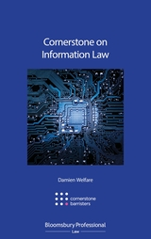


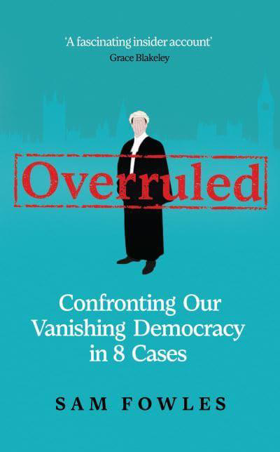
Cornerstone Books

Slide 25
Contact details: Cornerstone Barristers 2-3 Grays Inn Square London WC1R 5JH Tel: 020 7242 4986 Fax: 020 3292 1966 Email: alane@cornerstonebarristers.com mlewin@cornerstonebarristers.com You can also contact our clerking team via clerks@cornerstonebarristers.com

