Slide 1
Disrepair update 2023
Catherine Rowlands
Alexander Campbell
21 July 2023

Slide 2
New legislation
Alexander Campbell

Slide 3
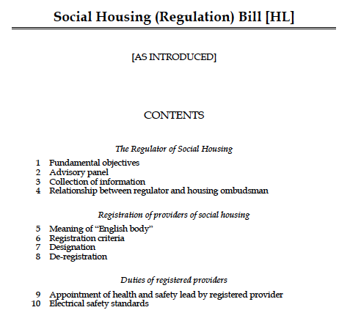

Slide 4
Regulator of Social Housing: objectives
Economic regulation objective
Consumer regulation objective
Provision of social housing that is:
Safe
Energy efficient
Transparency
Notes:
Section 1 Bill: amends s92K Housing and Regen Act 2008

Slide 5
Advisory panel (clause 2)
Information and advice
Registered providers
Secured creditors
Tenants
LHAs
GLA
HCA
Secretary of State

Slide 6
Collection of information (clause 3)
Requiring provision of documents or information
Requiring an explanation
Offence: false or misleading

Slide 7
Ombudsman and Regulator
Cooperation
Memorandum of understanding
Consultation
Why?
How they will cooperate
Must publish
Making mandatory what is already done

Slide 8
Registration criteria
Clause 7
Compliance with standards

Slide 9

Health and safety lead
Functions:
Monitor provider’s compliance with H&S requirements
Assess risks of failure to comply
Notify provider of risks or failures

Slide 10
Health and safety lead
‘Health and safety requirement’:
A statutory requirement relating to H&S of social housing tenants
Includes statutory implied covenant e.g. s9A L&TA 1985
Includes a requirement imposed by a notice given under legislation or enforcement action (e.g. HA 2004)

Slide 11

Health and safety lead
Who?
Registered provider or LHA?
Type of LHA
Size
Substitute in case of illness

Slide 12

Health and safety lead
Duties of registered provider
H&S lead has sufficient authority…
can devote sufficient time…
has resources needed…

Slide 13
Health and safety lead
Duties of registered provider
Publish name and contact details and inform Regulator

Slide 14

Health and safety lead
Where the buck stops!
Registered provider still liable

Slide 15
Standards
Competence & conduct
Information & transparency
Consumer matters
Directions from SoS
Intervention powers
Performance monitoring

Slide 16

Surveys
Property condition surveys
Minimum notice period: 48 hours
Obtaining warrants

Slide 17

Inspection plans
Make
Implement
Publish
Review

Slide 18

PIP
Performance improvement plan
PIP notice…
…then PIP…
…then enforcement action…
Appeal to High Court against notice

Slide 19

Emergency remedial action
Conditions
Entering without warrant
Pre-entry notice
Warrant from a JP
Offences
Appeals to the High Court

Slide 20
Case law update
Catherine Rowlands

Slide 21
Court of Appeal - quantum
ZOHRA KHAN
Claimant/Appellant
- and –
TARIQ MEHMOOD
Defendant/Respondent
-and-
THE HOUSING LAW PRACTITIONERS' ASSOCIATION
Intervenor
[2022] EWCA Civ 791 https://www.bailii.org/ew/cases/EWCA/Civ/2022/791.html

Slide 22
Court of Appeal - quantum
Khan
Mehmood
The landlord
The tenant – or one of them!

Slide 23
Allegations of disrepair
Unstable floors
Gas cooker unsafe
Damp
Filthy carpets
Repairs inadequate
Roof leak
deteriorated

Slide 24
Effect on the tenant
Ill
Unable to work
Got into arrears

Slide 25
Litigation ensued…
12/7/13 possession claim
9/8/13 defence and counterclaim
2/9/13 judgment (T did not attend) – set aside
19/2/14 Reply and Defence to counterclaim
14/8/14 listed for final hearing – L did not attend!

Slide 26
District Judge’s judgment
Possession claim dismissed
Judgment on counterclaim:
50% reduction in rent (bumped up to take account of special damages as to which there was no evidence) and increased by 10% on the basis of Simmons v Castle
Deposit + penalty
interest

Slide 27
What happened next?
L applied to set aside the judgment – dismissed in 2015
Also appealed the judgment – not heard until 2019!
In the meantime took separate possession proceedings and evicted T

Slide 28
Grounds of appeal to CJ
(1) The district judge awarded damages for an excessive period. The obligation to repair which s.11 of the Landlord and Tenant Act 1985 implies into every applicable lease is owed only to the tenant, not to a licensee and, as a result, the defendant had no claim for damages for the period between 2007 and 2011 when he was in occupation but not a tenant.
(2) The district judge failed to set off rent arrears, which the defendant admitted he owed, against the damages awarded.
(3) The order for the return of the deposit, plus a penalty, was erroneous because the deposit had already been repaid.
(4) There was no proper basis for the order to carry out works.
In addition, the claimant asserted as a "subsidiary point" that it was wrong as a matter of law to increase the damages by 10% under the principle in Simmons v Castle.

Slide 29
Appeal to HHJ Saunders
All grounds dismissed
"38. Although it does not strictly fall within the grounds of appeal, the appellant has raised an issue with regard to the district judge's decision to increase the general damages that he has awarded in his final order by 10% invoking Simmons v Castle. The appellant says this is a wrong approach and that a rent rebate approach should be adopted. I disagree. …this is the case involving physical inconvenience and discomfort to the defendant and it was a civil claim. The district judge was correct in applying the Simmons v Castle uplift to the facts of this case…."

Slide 30
Two grounds of appeal to the Court of Appeal
The period of claim
Simmons v Castle

Slide 31
Simmons v Castle [2013] 1 WLR 1239
"with effect from 1 April 2013, the proper level of general damages in all civil claims for (i) pain and suffering, (ii) loss of amenity, (iii) physical inconvenience and discomfort, (iv) social discredit, or (v) mental distress, will be 10% higher than previously, unless the claimant falls within section 44(6) of LASPO

Slide 32
Simmons v Castle
The introduction of Conditional Fee Agreements in 2013
Recommendation in Jackson report that damages increase by 10% to compensate for the fact that the success fee was not recoverable
the increase "may appear to be a windfall for claimants who are not on CFAs", but [Jackson] pointed out that "the level of general damages in England and Wales is not high at the moment", so "[t]he abolition of 'recoverability' would be an opportune moment for raising the level of such damages generally."

Slide 33
Simmons v Castle in disrepair?
The Landlord argued that the uplift should not apply. The Jackson Report did not intend to uplift damages for disrepair which are contractual
General damages for breach of repairing covenant are based on the compensatory principle, application of which, by itself, corrects for inflation and other matters which might lead personal injuries awards to fall behind.
(On the specific facts of this case, the general damages awarded to the defendant included an element of compensation for special damage. Even if the uplift is held to apply to general damages for breach of the implied covenant, it cannot extend to that element.)

Slide 34
Simmons v Castle in disrepair?
HLPA intervened to argue that the uplift should apply to disrepair claims
The judgment was said to apply to all civil cases
The fact that the assessment of damages for loss of amenity starts with a calculation based on rent does not put these cases into the type of case where the cause of action or nature of the damages is such that it is outside the Court of Appeal's reasoning. The reference to a percentage of rent in the award of damages is a broad-brush approach, not a precise calculation.
The fact that the level of rent is usually taken as the starting point does not necessarily mean that the effect of inflation is already taken into account.
In addition to breach of repairing covenant, claims for damages arising out of disrepair may brought by tenants against landlords in nuisance or for personal injury under the Defective Premises Act 1972, both of which would plainly attract the 10% uplift.

Slide 35
Simmons v Castle in disrepair?
HLPA intervened to argue that the uplift should apply to disrepair claims
Many claims are CFA-funded so the rationale for SvC applies
Another consequence of LASPO was to reduce the scope of legal aid for housing disrepair cases. The number of legal aid practitioners specialising in this area is falling. Representation by CFA is therefore increasingly common and necessary for potential claimants. The success fee is a vital part of the sustainability of representation for tenants, particularly for those in social housing or at the lower end of the private housing market who are unable to afford legal fees out of their own resources. Removing the Simmons v Castle uplift, and thereby reducing the level of general damages, would have an adverse impact on success fees and the availability of legal representation for such claimants.

Slide 36
Simmons v Castle in disrepair?
The tenant agreed:
there is no merit in the argument that the 10% uplift should be confined to cases where damages are assessed by reference to a "tariff". There is nothing in the approach to general damages for breach of a repairing covenant as propounded in the case law (see in particular Wallace v Manchester City Council (1998) 30 HLR 1111 and the line of subsequent authorities) to support excluding such damages from the scope of the uplift

Slide 37
Simmons v Castle in disrepair
The Court of Appeal agreed that the uplift should apply.
They were convinced by HLPA’s arguments that CFAs are important
Claim for damages for disrepair manifestly fell within the scope of the SvC judgment
Even where the rental value is used as the basis for calculation, the particular circumstances of the tenant may lead to either an increase or a reduction in the quantification. For that reason, the fact that taking a notional reduction in rent as the starting point may sometimes (though not invariably) incorporate an adjustment for inflation is no justification for excluding such damages from the scope of the uplift.

Slide 38
They reviewed the authorities on calculating the quantum of damages
McCoy & Co v Clark (1982) 13 HLR 87 (CA)
Calabar Properties Ltd v Stitcher [1984] 1 WLR 287
Wallace v Manchester City Council (1998) 30 HLR 1111
…diminution in the value of the property in relation to the amount of rent paid is not a separate head of damage
Shine v English Churches Housing Group [2004] EWCA 434
Damages assessed by reference to a proportion of the rent
Global award – what is fair
if an award of damages for stress and inconvenience arising from breach of the implied covenant to repair is to exceed the level of the rental payable, clear reasons need to be given
Notes:
"The object of awarding damages against a landlord for breach of his covenant to repair is not to punish the landlord but, so far as money can, to restore the tenant to the position he would have been in had there been no breach. This object will not be achieved by applying one set of rules to all cases regardless of the particular circumstances of the case. The facts of each case must be looked at carefully to see what damage the tenant has suffered and how he may be fairly compensated by a monetary award."

Slide 39
But how does this work in practice?
Global assessment
10% higher than would otherwise have awarded
But the rent payable will still be the cap unless there are special reasons
The percentage of rent should still be the same
- ie if there is a 50% loss of amenity, that should still lead to a 50% reduction in rent
But then add 10%
So award 55% of rent not 60%
Again, cap at 100% unless special reasons
There are two options:
Global assessment
Percentage of rent

Slide 40
The other ground of appeal
The tenant had claimed damages for a period when he was not the tenant.
The pleadings had established that he became tenant in 2011 and not 2007.
The Judge had ignored the pleaded case as the claim and Defence to Counterclaim had been struck out, but the facts were clear as between the parties.
the defendant only became the tenant of the property in March 2011. It was only at that point that he became entitled to the benefit of the term implied into the tenancy agreement by s.11 of the 1985 Act. He was therefore only entitled to damages for breach of the implied term from that date. The damages to which he is therefore entitled are equal to 50% of the rent paid under the tenancy from 23 March 2011. The award of damages calculated by reference to a reduction in rent dating back to 2007 was therefore excessive.
Appeal allowed on this ground
Subsequently the Court clarified that T was only entitled to damages from May 2011 as L was entitled to a “grace” period of 2 months to carry out repairs.
L was awarded a proportion of her costs.

Slide 41
Anchor Hanover Group v Cox
Martin Rodger KC, Deputy Chamber President
Does section 11 of the Landlord and Tenant Act 1985 prevent a landlord from recovering service charge contributions towards the cost of repairing the lift in a block of flats from its assured tenants of the flats in the building?
FTT held that lift was a common facility so landlord was obliged to repair it
Rodger held that the FTT had approached s11 the wrong way. You should start with s 11(1): The lift is clearly not part of the structure or exterior of Mr Cox’s flat and so does not fall within subsection (1)(a); nor is it an installation in the flat for the supply of water, gas, electricity or sanitation, or for space heating or heating water, and so does not fall within subsection (1)(b) or (c). It is neither in the flat, nor the sort of installation which is covered by the obligation.
Then look at s11(1A) (which is subject to ss1B): this does not cover everything in the building, but is limited to the same things as in s11(1).
The FTT had effectively extended the repairing obligation to cover all the common parts of the building – they had treated s11(1B) as a separate obligation when in fact it limits s11(1A)
There could be times however when L was obliged to carry out such repairs
[2023] UKUT 14 (LC)
https://www.bailii.org/cgi-bin/format.cgi?doc=/uk/cases/UKUT/LC/2023/14.html&query=(anchor)+AND+(hanover)+AND+(cox)

Slide 42
Housing Ombudsman decisions
Good practice
Bad practice
Newham – good investigation into damp – works had been done and £250 offered
https://www.housing-ombudsman.org.uk/decisions/newham-council-202123428/
LiveWest had responded quickly to a ceiling collapse – works took longer than 28 days but was a reasonable period of time
https://www.housing-ombudsman.org.uk/decisions/livewest-homes-limited-202203429/
L&Q – delay in dealing with damp and other repairs but credit given for the lockdown period
15% of rent awarded for 105 weeks
https://www.housing-ombudsman.org.uk/decisions/london-quadrant-housing-trust-202104537/
Livv Housing Group maladministration led to damp and leaks going unremedied for 4 years – repair logs insufficiently detailed – landlord ordered to review other tenants in block who might have been affected – compensation £3,000 ordered
https://www.housing-ombudsman.org.uk/2023/07/18/livv-housing-group-ordered-to-pay-nearly-3000-after-severe-record-failings-left-resident-in-damp-home-for-four-years/

Slide 43
Tips and tactics
Alexander Campbell

Slide 44
Express terms
s.11
LTA 1985
Disrepair claims
s.9A
LTA 1985
s.4
DPA 1972

Slide 45
It’s all about the records!
What was reported? When? How?
Who attended the property?
What specifically did they find?
What did they do? When?
What was the condition after the works?
What proof that the job was done properly?
Photos?
Tenant sign-off?

Slide 46
Common issues
Causation
Recurrent problems

Slide 47








Records
Who?
How?

Slide 48
Delays?
Scale of works
Further investigations
Parts/
equipment
Access

Slide 49

Legal advice
The best time?
Internal or external
Costs

Slide 50

Pre-action stage
Pre-Action Protocol for Housing Disrepair Cases (England)
A nuisance…
…or a strategic tool

Slide 51
A (proper) pre-action letter
Tenant’s name, address & phone number
Details of when access is available
Details of defects (schedule if appropriate)
History of defects, inc. attempts to rectify
Details of notice given/reasons why LL has notice
Effect of defects on tenant
Identities of all persons making PI claims
Brief details of all PI injuries
Details of special damages (see Annex D form)
Proposed expert and draft letter of instruction
Any relevant documents from the tenant

Slide 52
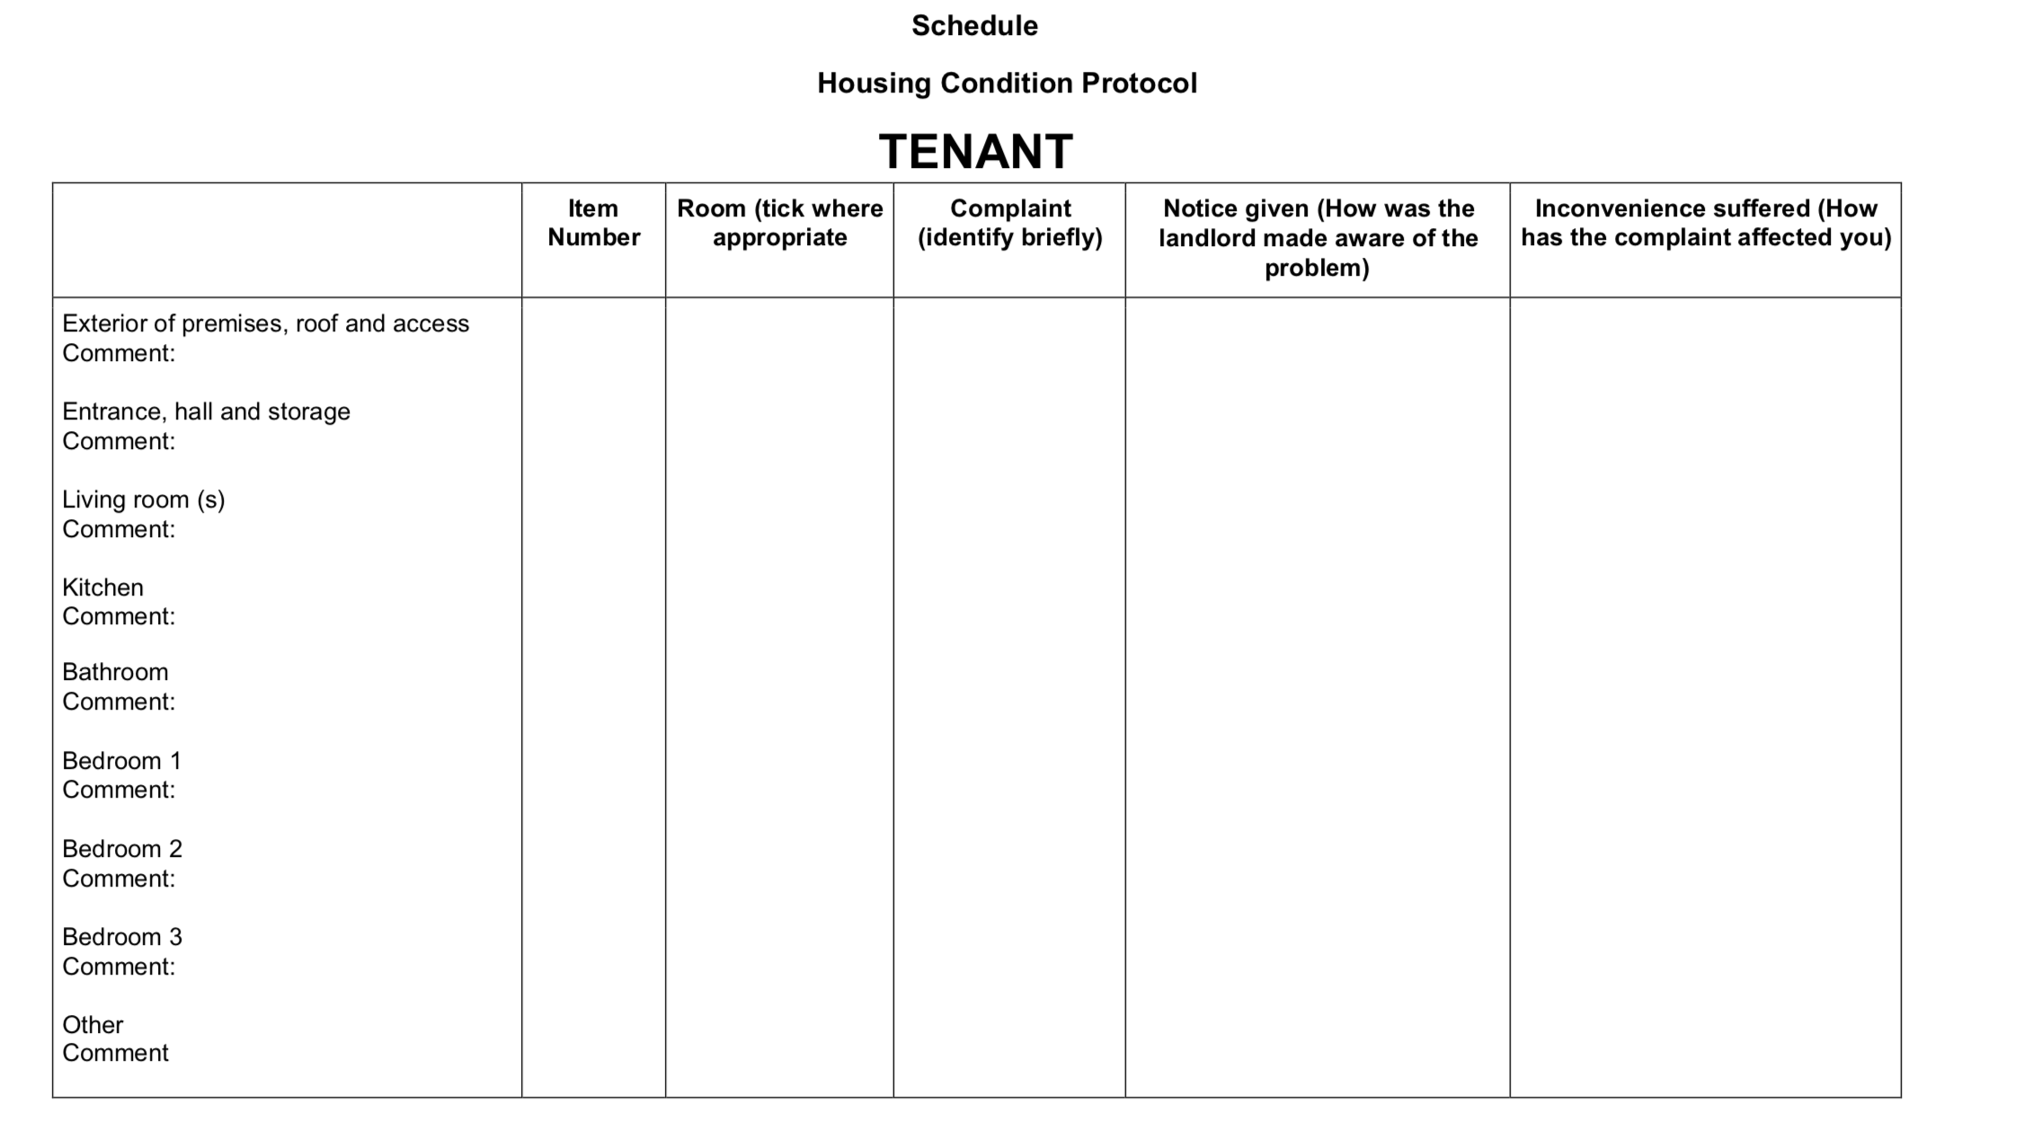

Slide 53
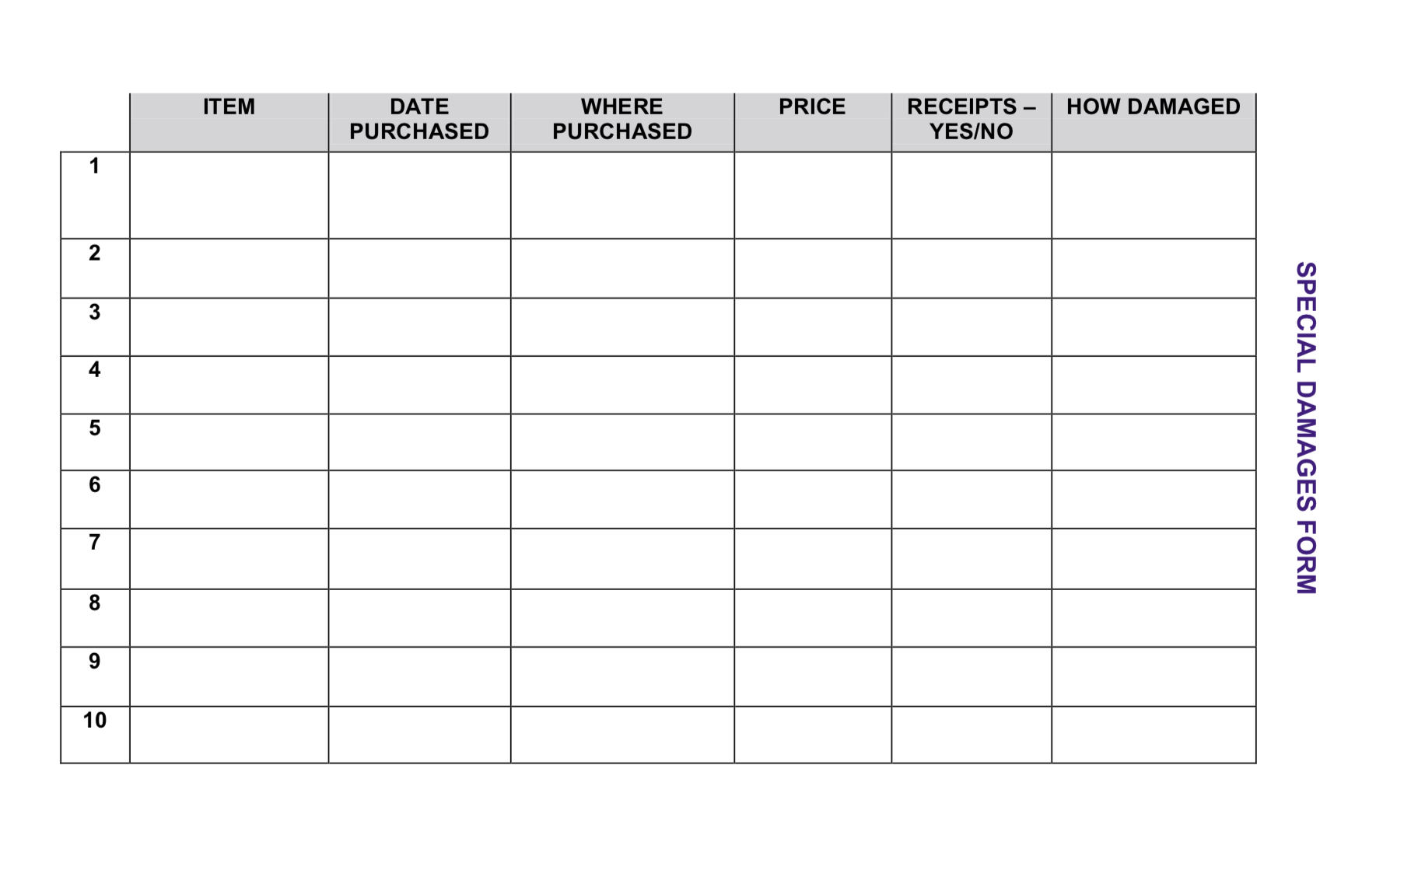

Slide 54
Landlord’s reply
Replying
What to include
Deemed receipt
Deadline for reply
Documents/records requested
Tenant’s proposed expert
Need time to investigate?

Slide 55
Liability admitted?
If not, why not?
Lack of notice?
Lack of access?
Schedule of works (with end date)
Compensation
Costs

Slide 56

Experts
Get control!
Single joint expert…
…by default if no objection!
Deadlines in pre-action protocol

Slide 57

The right mindset
Not just a formality
Good or bad claim?
Non-compliance
Varied deadlines

Slide 58
The right mindset
Respond on time
Know the detail – comply and insist on compliance!
Concessions

Slide 59
The magic numbers
More than £1,000 worth of works claimed under specific performance and more than £1,000 of other damages.
More than £10,000 by way of general damages.
If tenant not claiming above either level, any claim will be a small claim and costs will generally not be awarded to either party.

Slide 60


Pick your battles!
OR

Slide 61
Pick your battles!
Sensible offers
Early offers
Do works quickly

Slide 62
Pick your battles!
Will the tenant show up?
Willingness?
Information the tenant might not want raised in court

Slide 63
Common issues
The Homes (Fitness for Human Habitation) Act 2018
Mitigation of loss by the tenant
Is there a personal injury element to the claim? Can you argue that there is?
Who is the surveyor instructed by the tenant?
Quality of the report
Conflict of interest

Slide 64
Q&A
Catherine Rowlands and Alexander Campbell
Your questions already submitted

Slide 65
Repairs in temporary accommodation
In temporary homeless accommodation where there is a managing agent on behalf of a private landlord but the local authority grant non secure tenancies pursuant to s.188, to what extent are the local authority liable to the occupier under ss.9A- 11 L&T Act 1985?
Helen Dent, LB Tower Hamlets

Slide 66
Someone else’s leak
Please outline the liability where a council flat is subject to leaks, inc unexpected flood, from flat above, in scenarios where the upstairs flat is / is not a council freehold property, and where no notice has been given. Is control a valid response.
Zainul Pirmohamed, Stoke Council

Slide 67
The right expert
What are the tactical advantages for the local authority of using an external building surveyor in disrepair litigation compared to inhouse inspector or qualified surveyor?
Jatin Ghedia, Milton Keynes Council

Slide 68
Wrong from the start
Challenging from the start: Some claims come through that are neither correct or accurate (such as tenant is not (or was not) the occupier of the property they are claiming against at the time they claim to have reported it. Can L simply refuse the claim?
Paul Boreham, North Yorks Council

Slide 69
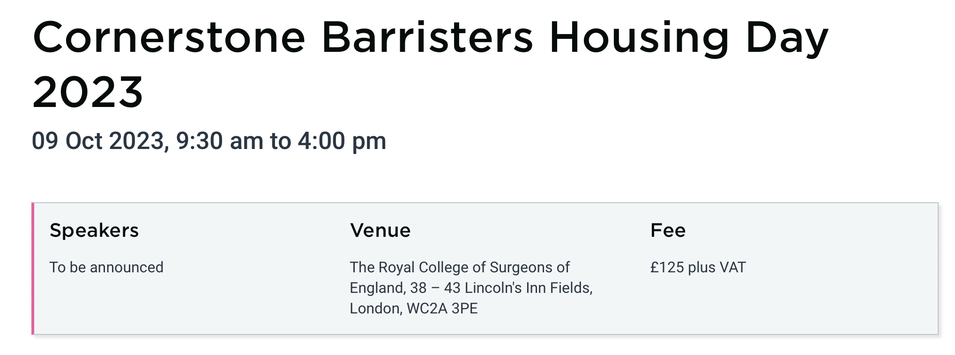
Thank you
crowlands@cornerstonebarristers.com
acampbell@cornerstonebarristers.com

