Slide 1
Housing Needs Assessment:
How to avoid challenge
Andy Lane, Sarah Salmon & Tara O’Leary

Slide 2

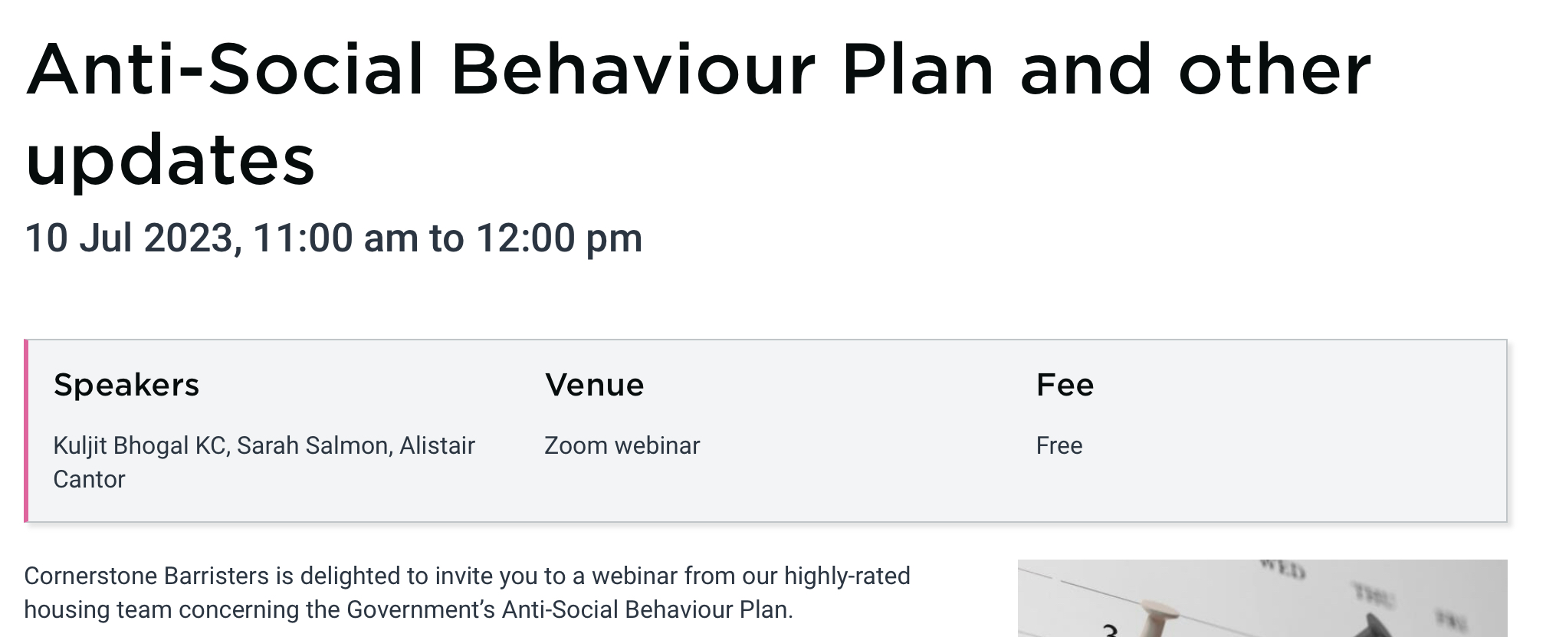
AGENDA
What are we covering?
What is a Housing Needs Assessment?
Common problem areas.
Practice points.
Questions.
Coming up

Slide 3

What is a housing needs assessment?

Slide 4
Housing Needs Assessment
3 April 2018
S.189A introduced by the Homelessness Reduction Act 2017, s.3
Same time as prevention & relief duties
Linked especially with Personalised Housing Plans
Pre-2018 requirement for an HNA for the intentionally homeless
Assessment must be notified to the applicant in writing: s.189A(3)
Overlap with suitability challenges

Slide 5
Housing Act 1996
Section 189A
(2)The authority's assessment of the applicant's case must include an assessment of—
(a) the circumstances that caused the applicant to become homeless or threatened with homelessness,
(b) the housing needs of the applicant including, in particular, what accommodation would be suitable for the applicant and any persons with whom the applicant resides or might reasonably be expected to reside (“other relevant persons”), and
(c) what support would be necessary for the applicant and any other relevant persons to be able to have and retain suitable accommodation.

Slide 6
Homelessness Code of Guidance for Local Authorities
Section 11
11.10 When assessing the housing needs of an applicant housing authorities will need to consider the individual members of the household, and all relevant needs. This should include an assessment of the size and type of accommodation required, any requirements to meet the needs of a person who is disabled or has specific medical needs, and the location of housing that is required. The applicant’s wishes and preferences should also be considered and recorded within the assessment; whether or not the housing authority believes there is a reasonable prospect of accommodation being available that will meet those wishes and preferences.
11.11 An assessment of the applicant’s and household member’s support needs should be holistic and comprehensive, and not limited to those needs which are most apparent or have been notified to the housing authority by a referral agency. Housing authorities will wish to adopt assessment tools that enable staff to tease out particular aspects of need, without appearing to take a ‘checklist’ approach using a list of possible needs. Some applicants may be reluctant to disclose their needs and will need sensitive encouragement to do so, with an assurance that the purpose of the assessment is to identify how the housing authority can best assist them to prevent or relieve homelessness.
Notes:
Some “red flags” to consider when assessing housing needs:
Bedsize. What size of accommodation is necessary to accommodate the family?
Needs and best interests, of any children in the household – e.g. locations of schools etc. S.11 Children Act 2004.
Medical issues and disability: any particular features of accommodation or adaptations required? Location in terms of access to treating medical professionals or support for MH. PSED relevant here – a “function” for the purposes of s.149 Equality Act 2010
Any history of domestic abuse. May give rise to issues about location, security (CCTV)

Slide 7
Housing Act 1996
Section 189A
HNAs are challenged by way of judicial review, not s.202 review. BUT:
In deciding what reasonable steps it will take to prevent (s.195(3)) and relieve (s.189B(3)) homelessness, LHA “must have regard to their assessment of the applicant’s case under s.189A”
Statutory review is available of the LHA’s decision as to the steps it will take to prevent and relieve homelessness: ss.202(1)(ba)(i) and (bc)(i)
Code Guidance para. 11.36:
Applicants have a right under section 202 to request a review of the reasonable steps the housing authority is to take under sections 189B(2) and 195(2) which includes having regard to their personalised housing plan within the prevention and relief stages. Housing authorities should encourage applicants to raise any concerns they have about their plan and work to resolve disagreements to minimise the occasions on which the applicant will feel the need to request a review.

Slide 8

Common Problem areas

Slide 9
Common Problems
Overview
Insufficient.
No assessment (just recording of applicant’s wishes): see R(ZK) v Havering LBC [2022] H.L.R. 47 at 42.
Not supplied to applicant.
Obvious omissions.
Not updated/reviewed.
The Code recommends that at least one face-to-face interview should be carried out before the housing needs assessment process is completed: paragraphs 11.14 - 11.15: R(UO) v Redbridge LBC [2023] EWHC 1355 (Admin) at 59, 95

Slide 10
Court review
Administrative Court
R(YR) v Lambeth LBC [2023] H.L.R. 16 – out of borough placement; needs of children and impact of school move not referred to in HNA/PHP; unlawful. S11 CA2004 overlap.
R(XY) v Haringey LBC [2019] EWHC 2276 (Admin) at 52 – advise applicant of the assessment in writing
Pre-Homelessness Reduction Act 2017
R(S(Albania) v Waltham Forest LBC [2016] H.L.R. 41 – need to undertake HNA before deciding not to exercise section 192 discretion not to accommodate
R(Savage) v Hillingdon LBC [2010] P.T.S.R. 1859 – requirement of HNA in IH case post s184 and pre-s190(2)(b) advice & assistance

Slide 11
Judicial oversight
Legal challenges to HNAs
Whilst the assessment does not have to deal with and set out every need that an applicant might possibly have, it should nevertheless set out the key needs that would provide the "nuts and bolts" for any offer of accommodation: R (S) v Waltham Forest LBC [2016] EWHC 1240 (Admin) [92] per Upper Tribunal Judge Grubb.
Mr Justice Lane in R (UO) v LB Redbridge [2023] EWHC 1355 Admin at 60.
This duty is important because it determines any decision on the suitability of accommodation. While it does not need to include an exhaustive list of housing needs, it does need to include the key needs: those that would provide the "nuts and bolts" for any offer of suitable accommodation: c.f. R(S) v Waltham Forest LBC [2016] EWHC 1240 (Admin) [2016] H.L.R. 41 at [92].
Judge Allegra in R (ZK) LB Havering [2022] H.L.R. 47 at 17.

Slide 12
R(XY) v Haringey LBC [2019] EWHC 2276 (Admin)
DHCJ Clive Sheldon KC
“62 I acknowledge that this Court should not treat the documents in the housing file as if they were a piece of exquisite draftsmanship, and a commonsense approach should be taken. The Court should ask itself how a reasonable and sensible housing officer would understand what had been written.”
“63…The failure to identify this as a need for XY had the practical consequence that she was offered accommodation where she would have had to use stairs which was obviously unsuitable for her. In the circumstances, the inadequacy of the assessment was not merely a technical matter, but had real-life consequences for XY.”
“66…An assessment does not need to be a counsel of perfection. Although the local housing authority should ask the right questions when carrying out an assessment, or on a review of an assessment, and in some circumstances may be required to seek the advice and input of other agencies (e.g. local health and children's services) to ensure that the applicant's needs were property understood, it can ordinarily be expected to rely on the fact that the applicant for housing will let it know what her fundamental needs are. The applicant is frequently the person who best knows her needs and those of any of her children. If the applicant fails to inform the local housing authority of any particular needs, this will rarely lead to a finding of unlawfulness if the local housing authority fails to identify one or other of the applicant's particular needs.”

Slide 13
Overlap with Public Law Duties
Further Enquiries
“…the duty of assessment in s. 189A and the duty to make inquiries under s 184 and s. 188(1), read in the light of s. 11(2) of the Children Act 2004 and Tameside, required the Defendant to conduct further inquiries: see above, paragraph 52.i). No reasonable authority with the information available to the Defendant would have failed to undertake inquiries as to the disruption to the children’s education if they were required to move school before concluding accommodation far from their schools was ‘suitable’ for the purposes of s. 206 and that it was not 'reasonably practicable' to accommodate them in or near Lambeth.”
R(YR) v Lambeth LBC [2023] H.L.R. 16 at 86
“The reasonable inquiries that an authority is required to take as part of its assessment should be evident from the s. 189A assessment or housing plan, or at least should be evidenced on the housing file. They are not.”
YR v Lambeth LBC at 88(iv)
“The Defendant must be able to demonstrate that it has applied its Placements Policy properly: above, paragraph 56. In my judgment, that duty to demonstrate compliance with a published policy by way of a contemporaneous, reasoned decision, applies even when there is no statutory duty to give reasons.”
YR v Lambeth LBC at 88(iii)

Slide 14

Practice Points

Slide 15
Remember
...needs
Approach the HNA from the right starting point.
Applicant's needs vs. Applicant's wishes i.e. identify what is “needed” as distinct from what would be “nice to have”.
“The assessment does not, in my judgment, have to deal with and set out every need that an applicant might possibly have. It should, however, set out the key needs: those that would provide the "nuts and bolts" for any offer of accommodation: c.f. R (S) v. Waltham Forest LBC [2016] EWHC 1240 (Admin) at [92].”
R(XY) v Haringey LBC [2019] EWHC 2276 (Admin) at [51], DHCJ Clive Sheldon KC
Think about and ask material questions.
Make any enquiries that may be relevant to needs.
Don't just state the obvious.

Slide 16
Remember
...assessments
Assessment does not need to be in one document: XY v Haringey at [54]
Assessment may be included with PHP – a flawed assessment may = a flawed plan: R(YR) v Lambeth LBC [2023] H.L.R. 16 at 89.
Notify the applicant of the assessment – section 189A(3).
The assessment requirement continues until any Part 7 duty ends – section 189A(9)(10).
Be clear:
  The key is whether the assessment is “sufficiently clear as for it to be obvious to the "reasonable and sensible housing officer" what exactly is needed for the Claimant and his family”
  R(ZK) v Havering LBC [2022] H.L.R. 47 at 45 (and see 46 and XY v Haringey at 62).
Be careful if using a template.
Keep under review and update.

Slide 17
Remember … reasons
R(YR) v Lambeth LBC [2023] H.L.R. 16 at [88]
“Third, the s.189A housing assessment and plan were inadequately evidenced and reasoned to demonstrate that the Defendant had regard to the statutory relevant factors and other matters set out at paragraph 65, above, even applying a 'benevolent' rather than 'an overly technical' or 'nit-picking' approach to the construction of those documents. I do not consider it appropriate for me to infer that the Defendant had regard to those matters, for the reasons given by Baroness Hale in Nzolameso, [31-35]: above, paragraph 52.ii). I accept the Defendant’s argument that Baroness Hale’s observations as to reasons in Nzolameso [31-35] were made in the context of a statutory duty to give reasons in s.203(4). I also accept that there is neither a statutory nor a common law duty to give reasons as to the suitability of accommodation provided under s.188(1), applying Akhtar and Alibkhiet: above, paragraph 58. However, the latter cases are to be distinguished, and Nzolameso is relevant and persuasive…”

Slide 18

Questions
This Photo by Unknown author is licensed under CC BY.

Slide 19
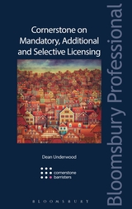
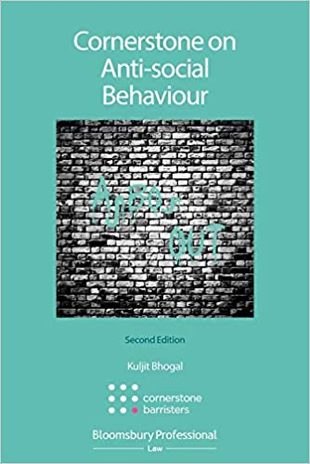
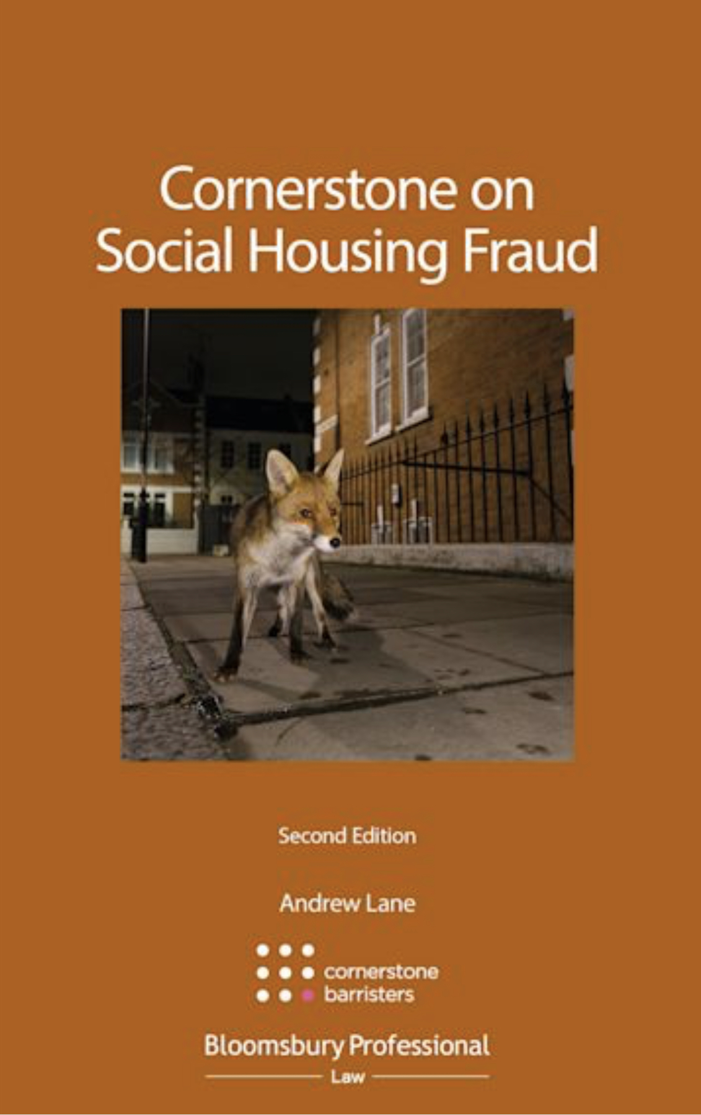
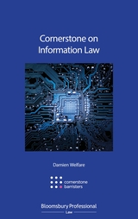



Cornerstone Books

Slide 20
Contact details:
Cornerstone Barristers
2-3 Grays Inn Square
London
WC1R 5JH
Tel: 020 7242 4986
Fax: 020 3292 1966
Email: alane@cornerstonebarristers.com ssalmon@cornerstonebarristers.com toleary@cornerstonebarristers.com
You can also contact our clerking team via clerks@cornerstonebarristers.com

