Slide 1
Judicial Review: Pitfalls and the new Procedural Rigour
Jack Parker, Ruchi Parekh and Verity Bell
June 2023

Slide 2
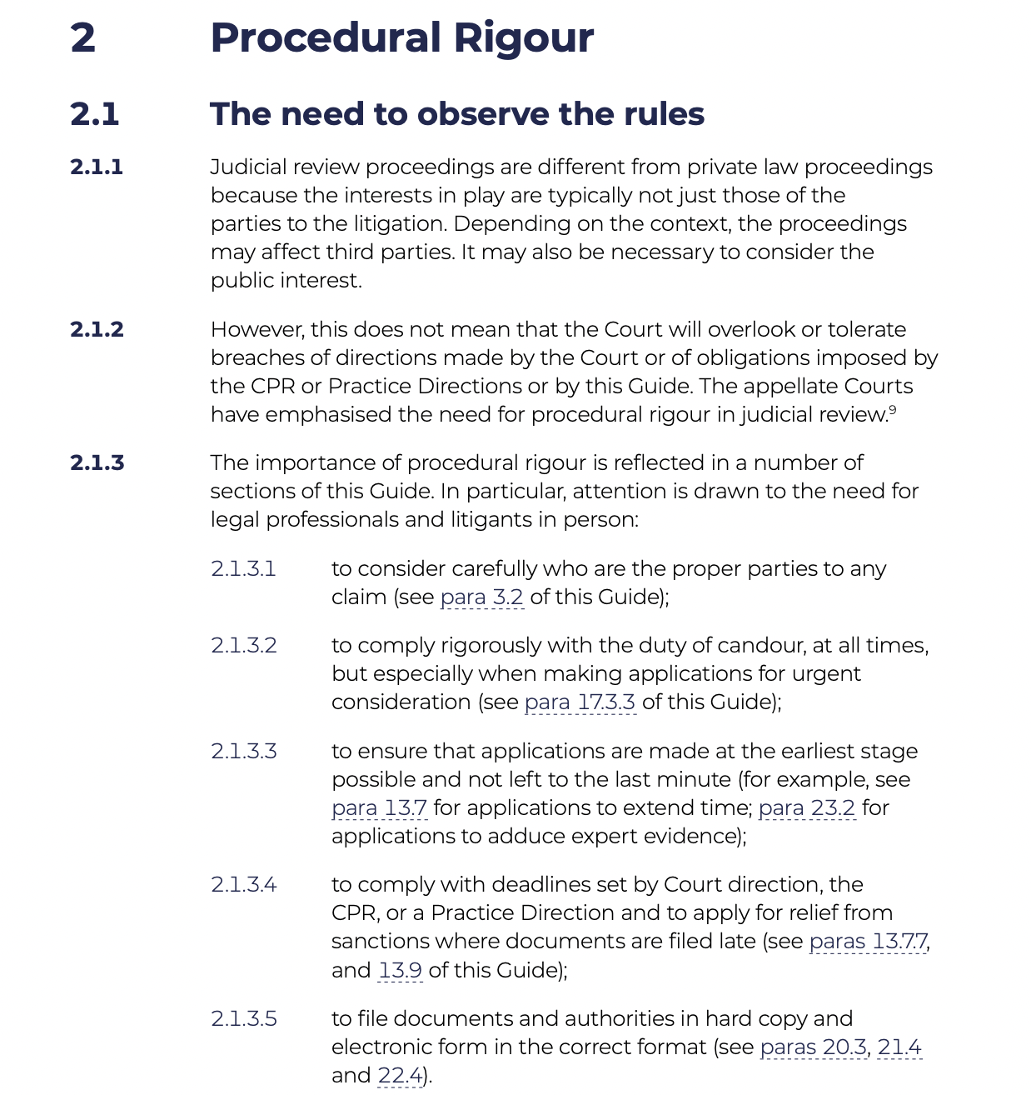
New Procedural Rigour?

Slide 3
Overview
Standing
Time Limits
Rolling JRs
Costs

Slide 4
Standing

Slide 5

Don’t you know I’m still standing better than I ever did?
Looking like a true survivor, feeling like a little kid…
And I’m still standing after all this time

Slide 6
Standing: principles
Sufficient Interest
“the court shall not grant leave to make such an application unless it considers that the applicant has a sufficient interest in the matter to which the application relates”
(s.31(3) SCA 1981)

Slide 7
Standing: principles
The end of “outdated technical rules”
Question goes to Court’s jurisdiction
Wide range of factors may be relevant
Issue of standing and merits may be intertwined
Permission stage = “mere busybody”
Relevant to the question of remedy

Slide 8
Standing: group challenges
Associational Standing
Surrogate Standing
Public Interest Standing

Slide 9
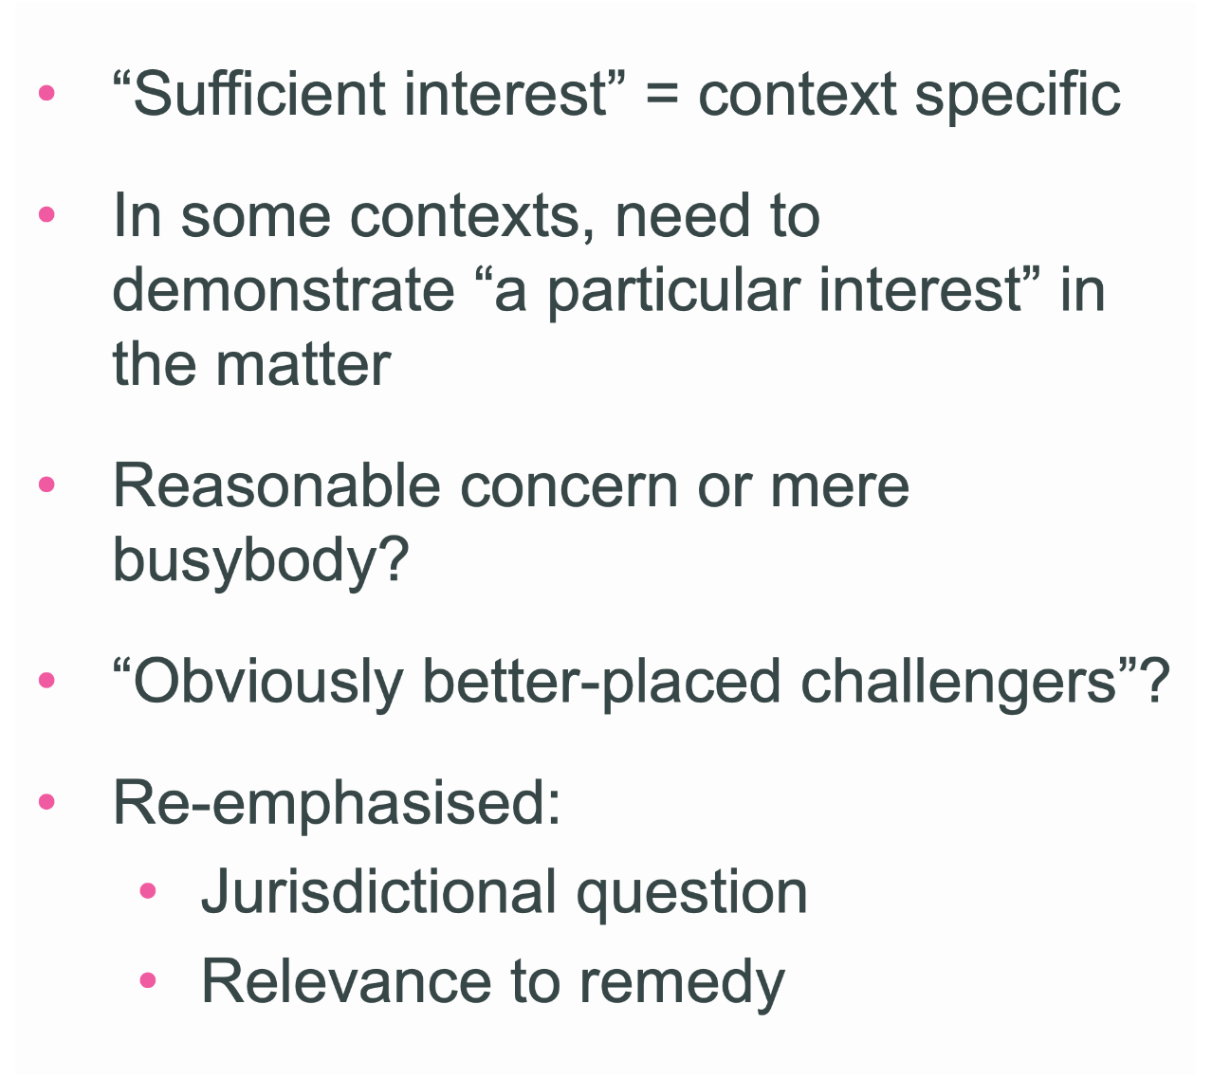
Standing: return of “technical rules”?
Good Law Project & Runnymede Trust

Slide 10
Standing: return of “technical rules”?
Net Zero Strategy challenge
GLP v SoS Health & Social Care
Jet Zero Strategy challenge

Slide 11
Standing: practical considerations
Claimants:
Constitution? Articles of Association?
Did you respond to relevant consultations?
Alternative claimant(s)?
Interest in relief vs Interest in ground of challenge
Defendants:
Raise the issue at earliest possible stage
Consider effect on actual claimant

Slide 12
Issue and Service

Slide 13
Issue and service in Judicial Review
Claim is issued on the date entered by Court: CPR 7.2
Court must seal claim with date on which claim is sealed: Walton v Pickering [2023] EWCA 602
JR Claim Form must be served within 7 days of issue (different time limits apply to other types of claim)
Claim Form may be served in a variety of ways: See CPR 6.3
Practice Direction 6A, para 4,1 provides rules on service of documents by email

Slide 14
Good Law Project
R (Good Law Project) v Secretary of State for Health and Social Care [2022] EWCA Civ 355
Sealed Claim Form sent directly to solicitor with conduct of claim but not to Defendant’s specified email address (although unsealed claim form previously sent to that address)
Sealed Claim Form subsequently sent to specified email address one day out of time
Claimant applied for an order authorising service by an alternative method under CPR 6.15 (i.e. on solicitor with conduct) and to extend time under CPR 3.1(2)(a) .

Slide 15
Good Law Project
Court of Appeal found 2 vs 1 against Claimant
Appeal to be heard by Supreme Court on 12th October 2023
General observations:
Need for promptness and speed in JR
Importance of service

Slide 16
Good Law Project
CPR 6.15 application:
Court of Appeal refused to interfere with High Court’s evaluative judgment to refuse application for discretionary order
Designated email address ensures certainty
If application granted, D would suffer prejudice because it would be deprived of an accrued limitation defence
No duty on a defendant to warn a claimant that valid service of a claim form has not been effected

Slide 17
Good Law Project
CPR 3.1(2)(a) application to extend time:
Although CPR 7.6(3) does not apply to JR, principles should apply by analogy
Need to show C has taken all reasonable steps to effect service but has been unable to do so and acted promptly in making the application
C could not show that all reasonable steps had been taken

Slide 18
LJ Phillips (dissenting)
“In the circumstances of this case, [the failure to effect valid service of the claim form] was highly technical and did not have (and was never likely to have) any practical consequences whatsoever. If service is not to be validated retrospectively in such circumstances, form really has triumphed over substance and litigation has become a game of forfeits: the overriding objective, to deal with cases justly, has itself been overridden.”

Slide 19
Application
R (Karanja) v University of West Scotland [2022] EWHC 1520 (Admin)
Halton BC v Secretary of State for Levelling Up, Housing and Communities [2023] EWHC 293 (Admin) to planning cases

Slide 20
Rolling Judicial Review

Slide 21

'Rolling’ or ‘evolving’ judicial review?
Contrast: conventional challenge
Single, specific decision
Fixed point in time (‘the decision date’)
‘Rolling’ judicial review
Moving picture/target
Public body under a continuing breach of a public law duty
Scope of challenge evolves as circumstances change
Court may scrutinise post-decision evidence
This Photo by Unknown Author is licensed under CC BY-SA

Slide 22
When will ‘rolling’ JR be appropriate?
“In short, there is no hard and fast rule. It will usually be better for all parties if judicial review proceedings are not treated as “rolling” or “evolving”, and it is generally simpler and more cost-effective for the reviewing court to avoid scrutinising post-decision material. But there will also be a need to maintain a certain procedural flexibility so as to do justice between the parties”
SSHD v R(Spahiu) [2018] EWCA Civ 2604 at [63]
“Dangers lie in 'rolling judicial review' where unfocused claims (or appeals) involve moving targets, especially where the Court is asked – for no principled reason, or without discipline, or without practical utility – to evaluate legality across a fluctuating factual matrix or an extended timeline.”
R(Rowley) v Minister for the Cabinet Office [2021] EWHC 2108 (Admin) at [2]

Slide 23
Examples
Suitable: Continuing refusals by a local authority to grant series of requests for interim nigh-time care provision under s19(3) Care Act 2014 pending a full assessment of the Claimants’ care needs
R(Raja) v Redbridge LBC [2020] EWHC 1456 (Admin)
Unsuitable: “then and now” claim – Failure to make reasonable adjustments contrary to s29(2) Equality Act 2010 by not providing BSL interpretation during Coronavirus data briefings
R(Rowley) v Minister for the Cabinet Office [2021] EWHC 2108 (Admin)

Slide 24
Key questions
Is the Defendant under an ongoing public law duty?
What is the temporal focus of the relief sought by the Claimant?
Mandatory relief: always about the present “now”
Declaratory relief: can be either about the present circumstances, or a past decision, or both
Not a challenge to a failure to revoke a decision

Slide 25
Costs

Slide 26
Aarhus costs caps
Aarhus Convention claims
“a claim brought by one or more members of the public by judicial review or review under statute which challenges the legality of any decision, act or omission of a body exercising public functions, and which is within the scope of Article 9(1), 9(2) or 9(3) of the [Aarhus Convention]”
(CPR r.45.41)

Slide 27
Aarhus costs caps: the basics
“Members of the public” includes parish councils
“Relating to the environment”
Where costs cap triggered by one ground (brought “in good faith”), it applies to whole claim
R (Lewis) v Welsh Ministers [2022] EWHC 450 (Admin)
Default caps (CPR r.45.43)
C (individual): £5,000
C (all other cases): £10,000
D: £35,000
Can be varied on application (CPR r.45.44)

Slide 28
Aarhus costs caps: claimants
Address in pre-action correspondence
Seek protection in claim form + SFGs
Must include financial resources schedule
Consider a full witness statement to address why proceedings would be “prohibitively expensive”
See CPR r.45.44(2)-(4)
Court may properly have regard to C’s own costs – R (RSPB) v SSJ [2018] Env LR 13
Timeliness is key
R (Ibrar) v SSLUHC [2022] EWHC 3425 (Admin)
Change in circumstances?

Slide 29
Aarhus costs caps: defendants
Clarify position on principle at pre-action stage
Wish to dispute application of Aarhus Convention?
Address in AoS
Wish to vary default cap?
Application must be made in AoS
Must address why it would not be “prohibitively expensive” for C
Significant change in C’s circumstances?
Entitled to make a variation application

Slide 30
Protective Costs Orders in JR
Sections 88 and 89 of the Criminal Justice and Courts Act 2015
Court may only make order if:
proceedings are ‘public interest proceedings’;
Applicant for JR would otherwise be withdraw application or cease to participate and it would be reasonable for applicant to do so if order is not made

Slide 31
Protective Costs Orders in JR
Public interest proceedings’ only if:
Raise issue of general public importance,
Public interest requires issue to be resolved, and
proceedings likely to provide an appropriate means of resolving it"
Further factors to consider in determining whether ‘public interest proceedings’ set out in s.88(8)

Slide 32
Protective Costs Orders in JR
Factors which Court must take into account:
Financial resources of the parties to the proceedings, including the financial resources of any person who provides, or may provide, financial support
Extent to which applicant/anyone providing financial support may benefit if relief is granted to applicant for JR
Whether legal representatives are acting free of charge
whether applicant is an appropriate person to represent the interests of other persons or the public interest generally.

Slide 33
Protective Costs Orders in JR
R(We Love Hackney) v Hackney LB [2019] EWHC 1007 (Admin)
Restrictive approach to whether issues are of “general public importance”
Willingness to look behind the identity of applicant to determine available financial resources

Slide 34
Any questions?
Jack Parker (jparker@cornerstonebarristers.com)
Ruchi Parekh (rparekh@cornerstonebarristers.com)
Verity Bell (vbell@cornerstonebarristers.com)

