Slide 1
The slides and recording will be available on our website shortly after the webinar

Slide 2
Remote licensing hearings: essentials and best practice
Joe Cannon and Matt Lewin
3 May 2023

Slide 3
Overview
Walk Safe Security Ltd v LB Lewisham
Practical implications

Slide 4
Walk Safe Security Ltd v LB Lewisham

Slide 5
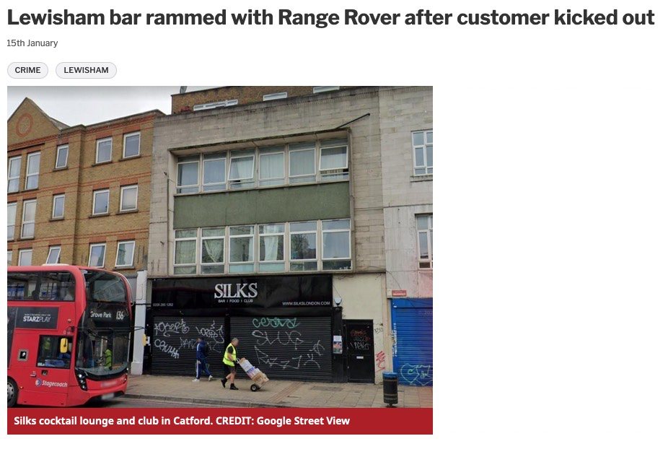
Factual background

Slide 6
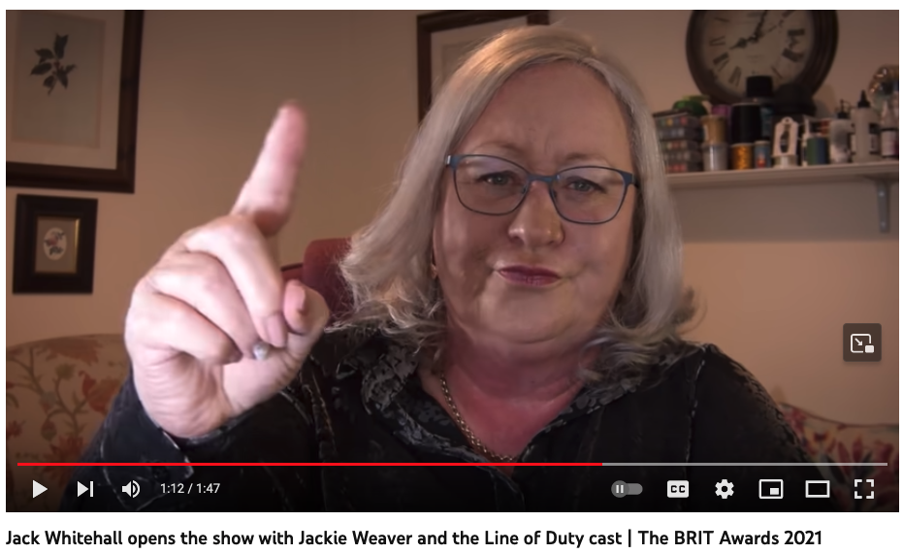
Legal background

Slide 7
Legal background
“Meetings” under the LGA 1972
“Hearings” under the LA03 and Hearings Regs

Slide 8
The arguments
Remote hearings are not lawful
“Place” means a single, physical location
Welsh legislation expressly permits remote hearings
In-person meetings promote greater certainty
Remote hearings are lawful
No statutory definition of “hearing”
“Place” not defined or qualified
Licensing committee power to regulate own procedure (s.9(3) LA03)
Welsh legislation resolved ambiguity as to whether remote hearings permitted

Slide 9
The judgment
Remote hearings are a procedural matter
“… the use of the word ‘subject’ [to the Hearings Regulations] implies that unless the Regulations specifically permit or prohibit remote hearings, then the authority may determine the matter for themselves.”
Hertfordshire not relevant
“We can readily accept that ‘meeting’ can, in some contexts, encompass virtual or remote meetings: since March 2020 it has been common to refer to a ‘Zoom meeting’.”

Slide 10
The judgment
Welsh legislation clarified ambiguity
“It is equally arguable that the Welsh [Assembly] has simply sought to make clear and particular provision for remote hearings. It does not necessarily follow that the legislation applying in England prohibits remote hearings.”
“Place” can be online
“A ‘place’ may be a physical location, but I see no reason why it cannot be a virtual platform. Nor can I see any reason why ‘attend’ cannot include electronic attendance. There is nothing within the language of the provisions which limits the scope of the word ‘place’ (as there is in the LGA 72).”

Slide 11
Practical implications

Slide 12
Overview
Protocol for Remote Hearings
“Hearings” v “Meetings”
Do’s and Don’ts

Slide 13
Herts CC v SSHoCoLoGo [2021] EWHC 1092
‘Meetings’ not ‘Hearings’
“…within or without their area…”
LGA 1972 only
Need for certainty about e.g. attendance
The Hertfordshire decision

Slide 14
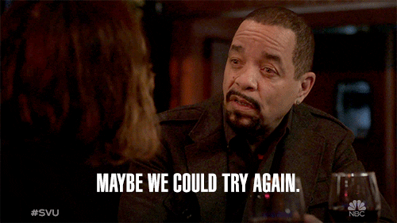
How to head off further challenges
Key is certainty
Regulation 9 (3) – power to regulate own procedure
Make clear what the choices/arrangements are
Contingency plans

Slide 15
Protocol for remote hearings
Advice, deliberation and decision
Attendance by members
Protocol for remote hearings
Attendance by the parties
Removal; managing the hearing
Access to the public

Slide 16

Horror stories…

Slide 17
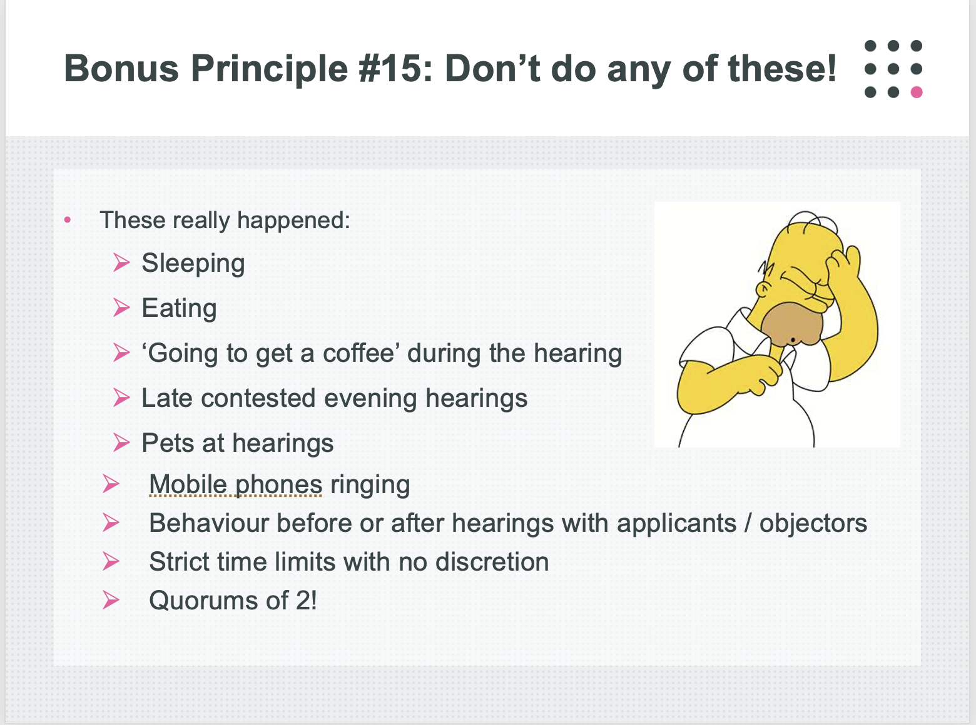
…have been around for years!
(From licensing committee training slides, 2017)

Slide 18
Any questions?

Slide 19
Ask us more questions: events@cornerstonebarristers.com
For instructions and enquiries:
clerks@cornerstonebarristers.com

