Slide 1
Planning Policies:
Interpretation v. Application?
Tom Cosgrove KC and Ruchi Parekh

Slide 2
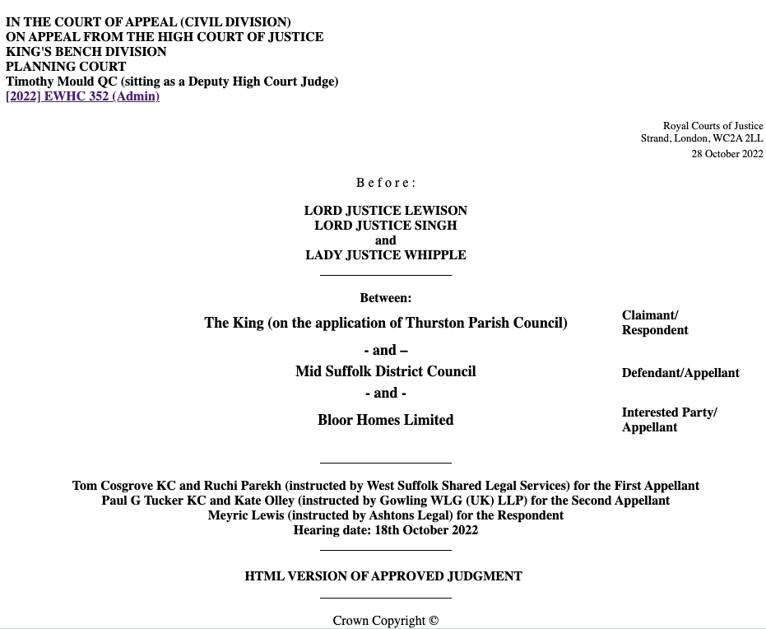

Welcome
HILLSIDE PARKS LTD
-v-
Snowdonia National Park Authority

Slide 3
Overview
Application v. Interpretation: context
R (Thurston PC) v Mid Suffolk DC & Bloor Homes
Practical Implications
Questions?

Slide 4

Application v. Interpretation: context
Application
Interpretation

Slide 5
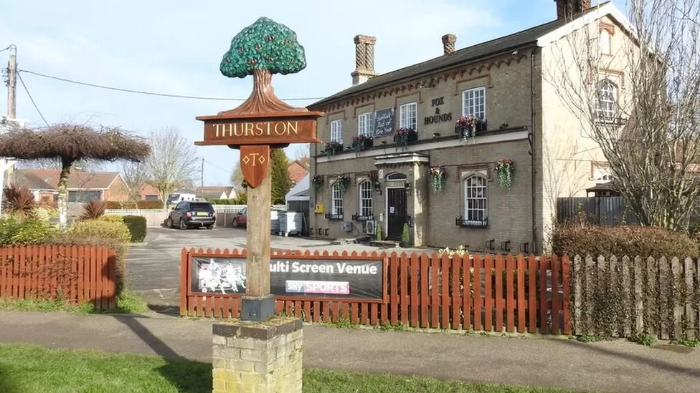
R (Thurston PC) v Mid Suffolk DC
Adrian S Pye/Geograph (bbc.co.uk)

Slide 6

R (Thurston PC) v Mid Suffolk DC
High Court Challenge
Members wrongly advised on NDP Policy 1
Members wrongly advised on ‘tilted balance’ under NPPF para.11 & para.14
Prejudice to the ongoing Local Plan process
Court of Appeal
Focus on NDP Policy 1 only

Slide 7
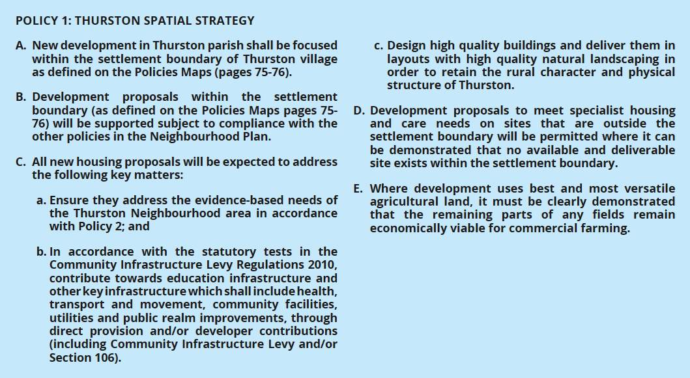
R (Thurston PC) v Mid Suffolk DC

Slide 8
R (Thurston PC) v Mid Suffolk DC
New development in Thurston parish shall be focused within the settlement boundary of Thurston village as defined on the Policies Maps
“tension”
“conflict”

Slide 9
Practical Implications
Where are we now?
Benevolent approach to decision making
Move away from legalistic arguments
Focus on the application of policies

Slide 10
Practical Implications
Examples
What is a question of law: e.g. “settlement boundary”
What is a question of planning judgment: e.g. “focus”
When is a Committee misled: context, context, context

Slide 11

Questions?
medium.com

Slide 12
Thank you
Tom Cosgrove KC (tcosgrove@cornerstonebarristers.com)
Ruchi Parekh (rparekh@cornerstonebarristers.com)

